Slide 1
Objects Layout in Memory
Virtual Machine presentations cycle
Carolina Hernández Phillips
PhD student in RMod Team

Slide 2
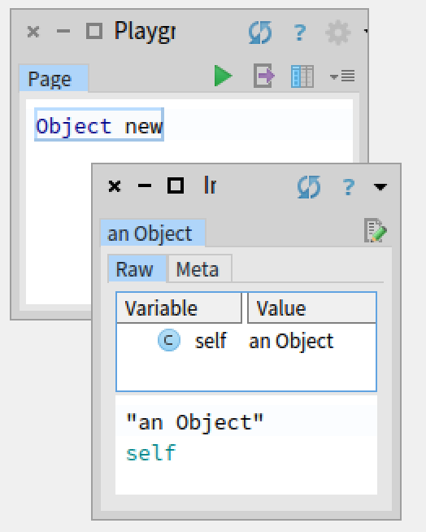
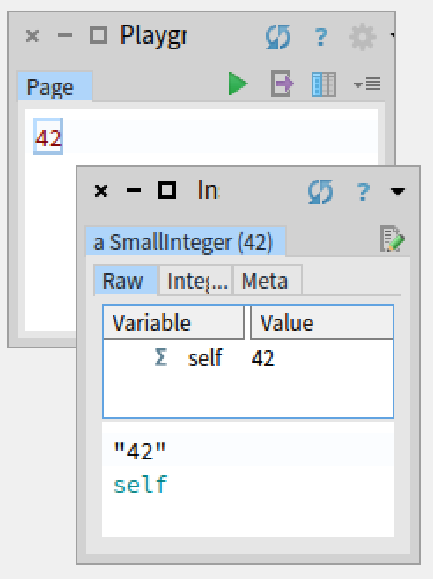
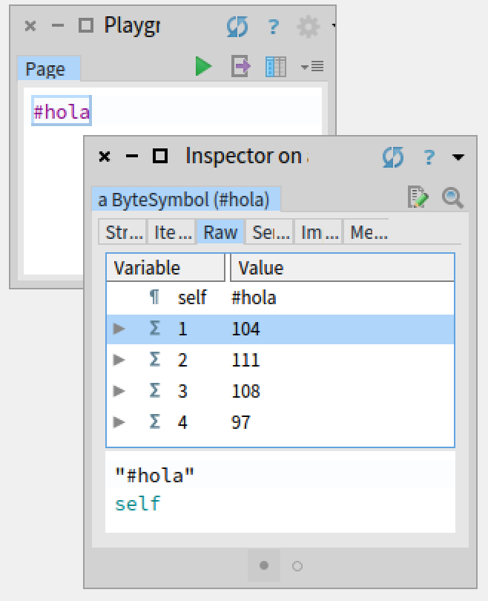
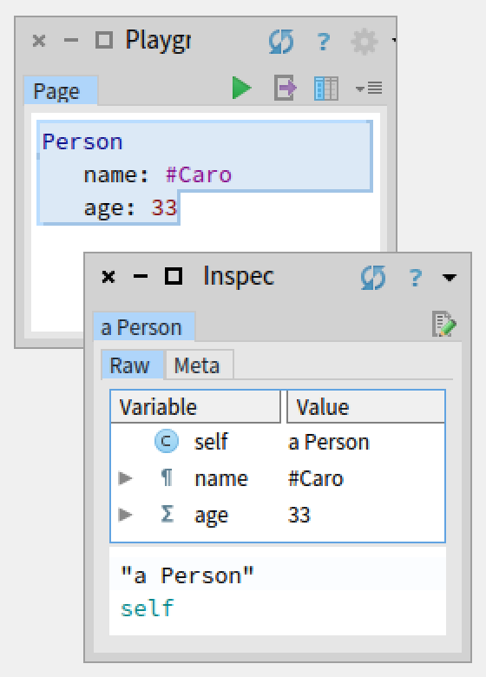
Layout -> The way an Object is stored in memory

Slide 3
Objects Layouts
  Fixed, Indexable Pointer, Indexable Byte ….
Object’s Header
  Format, number of slots, identity hash…

Slide 4
This presentation is about
how objects are stored in memory
Motivations?
Understand implementation design decisions
  Modify the implementation
    Garbage Collection algorithms
    Custom images bootstrapping
    Memory optimizations
Develop custom debugging tools
Implement ad-hoc inspectors

Slide 5
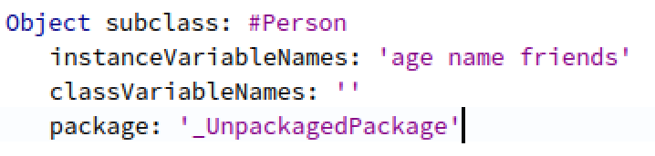
Example: Let’s create a Person object
Notes:
Agregar array amigos como atributo de la persona.
Usarlo para hacer crecer el array
Diagrama de la persona
Usar el mismo monito con todos los layouts
Agre: nil

Slide 6
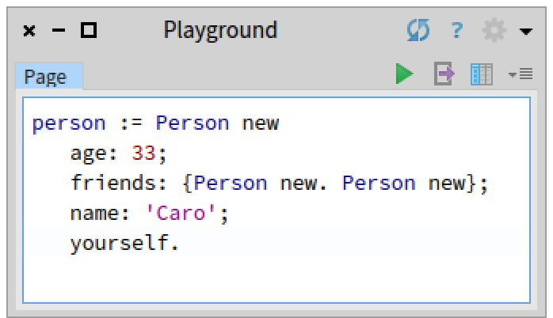
Example: Let’s create a Person object

Slide 7
The memory:
In 64 bits *
1 word = 8 bytes = 64 bits
* In 32 bits
1 word = 4 bytes = 32 bits

Slide 8
The memory:
address
(aligned to 8 bytes)

Slide 9
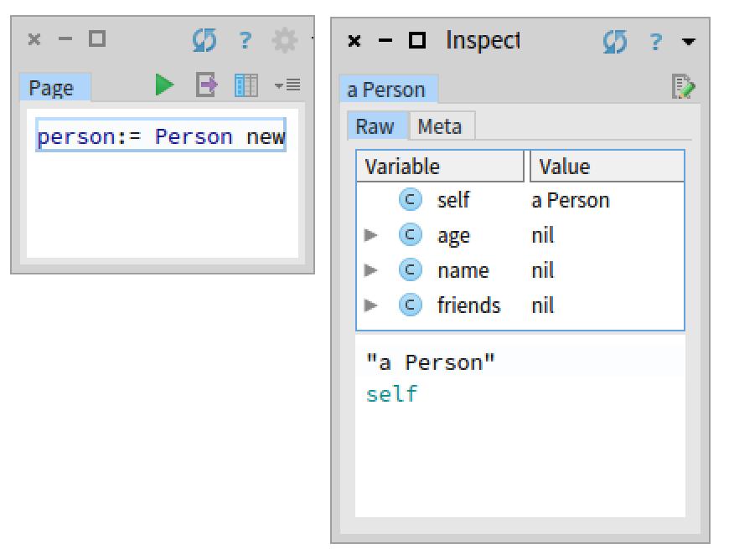
a Person object in memory

Slide 10
a Person object in memory
person
header*
slots
* In 32 bits
header size is 64 bits = 2 words

Slide 11
a Person object in memory
age
name
friends

Slide 12
a Person object in memory: Fixed Layout
age
name
friends
What is a Layout?
It is the structure of an object in memory

Slide 13
a Person object in memory: Fixed Layout
address = 24 = 2r11000
nil
age
name
friends

Slide 14
a Person object in memory: Fixed Layout
address = 24 = 2r11000
nil
age
name
friends

Slide 15
a Person object in memory: Fixed Layout
address = 24 = 2r11000
nil
nil
age
name
friends
Notes:
Agregar array amigos como atributo de la persona.
Usarlo para hacer crecer el array
Diagrama de la persona
Usar el mismo monito con todos los layouts
Agre: nil

Slide 16
a Person object in memory: Fixed Layout
Each slot is an instance variable
Objects created sending the message new
Number of slots is constant and defined by the class
Each slot is initialized with a valid value: in this case with ‘nil’
Slots contain Oop (ordinary object pointer)
  references (address of another object)
  values (immediates)
nil
nil
nil
age
name
friends
Notes:
Agregar array amigos como atributo de la persona.
Usarlo para hacer crecer el array
Diagrama de la persona
Usar el mismo monito con todos los layouts
Agre: nil

Slide 17
A convention:
nil
nil
nil
nil
Slots referencing nil:
age
name
friends
Notes:
Agregar array amigos como atributo de la persona.
Usarlo para hacer crecer el array
Diagrama de la persona
Usar el mismo monito con todos los layouts
Agre: nil

Slide 18
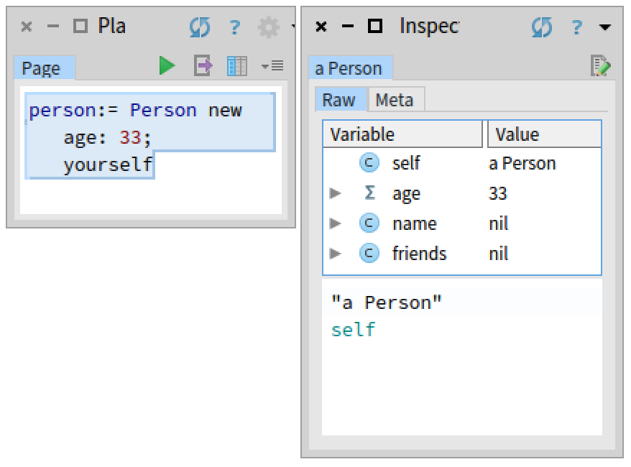
Setting the age
Notes:
Esto es una optimizacion, numeros son infinitos

Slide 19
Setting the age
nil
nil
nil
age
name
friends
Notes:
Esto es una optimizacion, numeros son infinitos

Slide 20
Setting the age
nil
nil
age
name
friends
Notes:
Esto es una optimizacion, numeros son infinitos.

Slide 21
Setting the age: Immediate layout
1 word = 8 bytes = 64 bits
nil
nil
1 bit
Tag saved in the 3 least significant bits:
  001 -> SmallInteger
  010 -> Character
  100 -> SmallFloat64 (only in 64 bits)
Immediates are a memory optimization!
Notes:
SpurMemoryManager >> smallIntegerTag
SpurMemoryManager >> characterTag
SpurMemoryManager >> smallFloatTag

Slide 22
More about Immediate layout
SmallIntegers
Characters
  Raw integer interpreted using the Unicode of the character
SmallFloat64
    61 bits precision
* Float diagram author: Clement Bera https://clementbera.wordpress.com/2014/01/16/spurs-new-object-format/

Slide 23
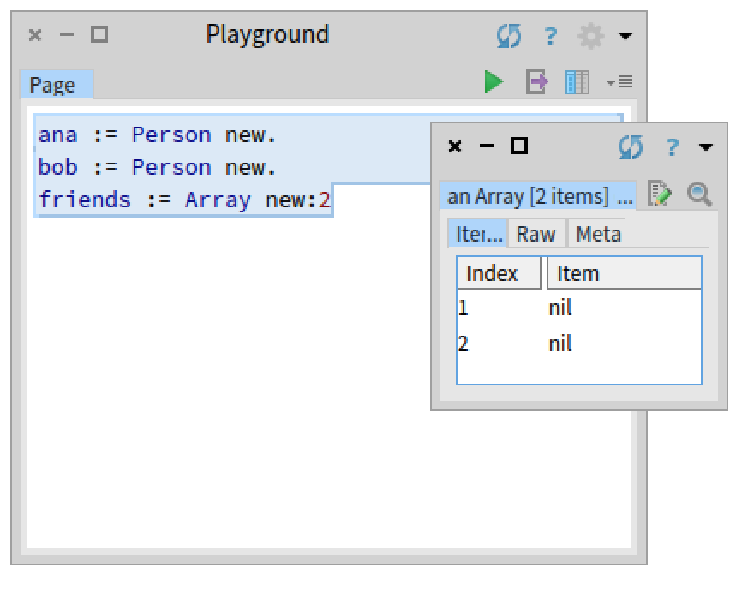
Setting the friends
Notes:
Explicar usando new: y new la diferencia entre fixed e indexable

Slide 24
Setting the friends
nil
nil
nil
nil
nil
ana
Notes:
Explicar usando new: y new la diferencia entre fixed e indexable

Slide 25
Setting the friends
nil
nil
nil
nil
nil
nil
ana
bob
Notes:
Explicar usando new: y new la diferencia entre fixed e indexable

Slide 26
Setting the friends: Indexable Pointer layout
Variable number of slots
  Defined dynamically at the moment of allocation
Object created by sending the message new:
Objects can’t grow or shrink!
Size of slots is 1 word
Slots contain Oop
nil
nil
nil
nil
nil
nil
nil
nil
ana
bob
friends
Notes:
Explicar usando new: y new la diferencia entre fixed e indexable

Slide 27
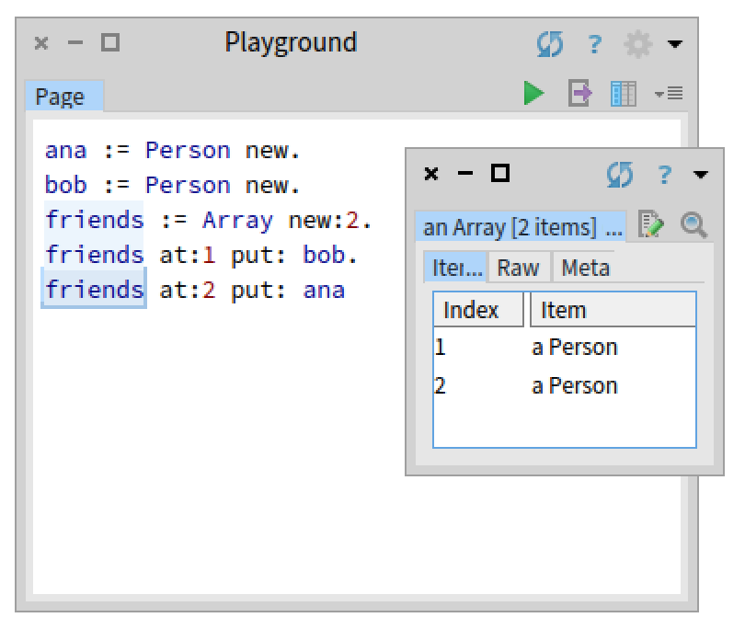
Setting the friends: Indexable Pointer layout
Variable number of slots
  Defined dynamically at the moment of allocation
Object created by sending the message new:
Objects can’t grow or shrink!
Size of slots is 1 word
Slots contain Oop
nil
nil
nil
nil
nil
nil
ana
bob
friends

Slide 28
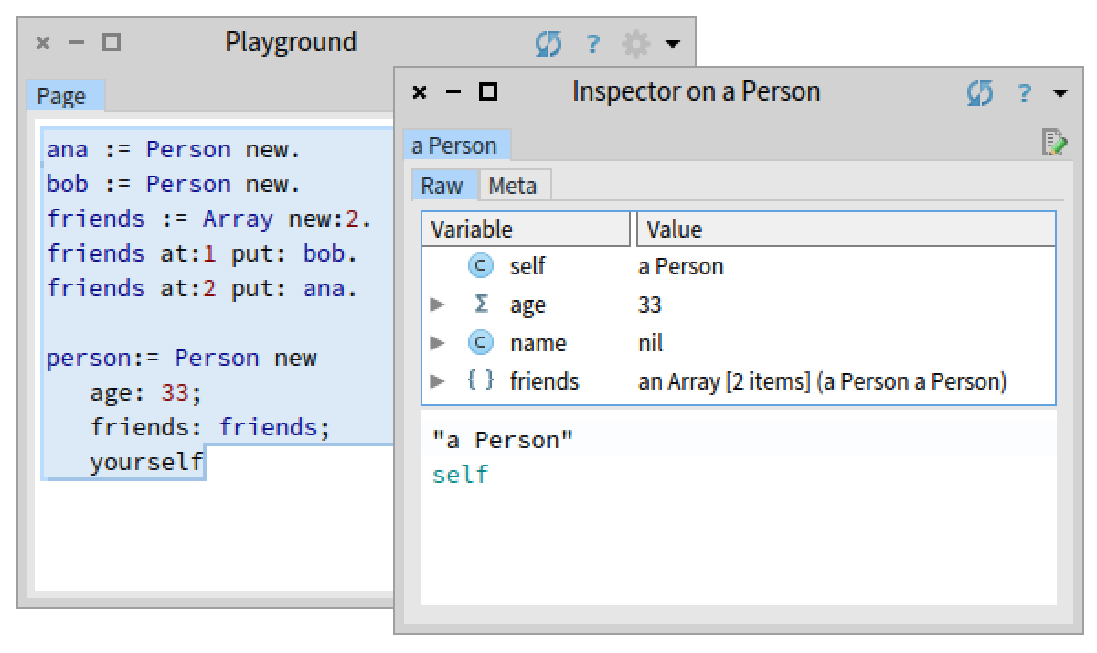
Setting the friends: Indexable Pointer layout
Variable number of slots
  Defined dynamically at the moment of allocation
Object created by sending the message new:
Objects can’t grow or shrink!
Size of slots is 1 word
Slots contain Oop
nil
nil
nil
nil
nil
nil
nil
ana
bob
friends
person

Slide 29
Setting the name
nil
person

Slide 30
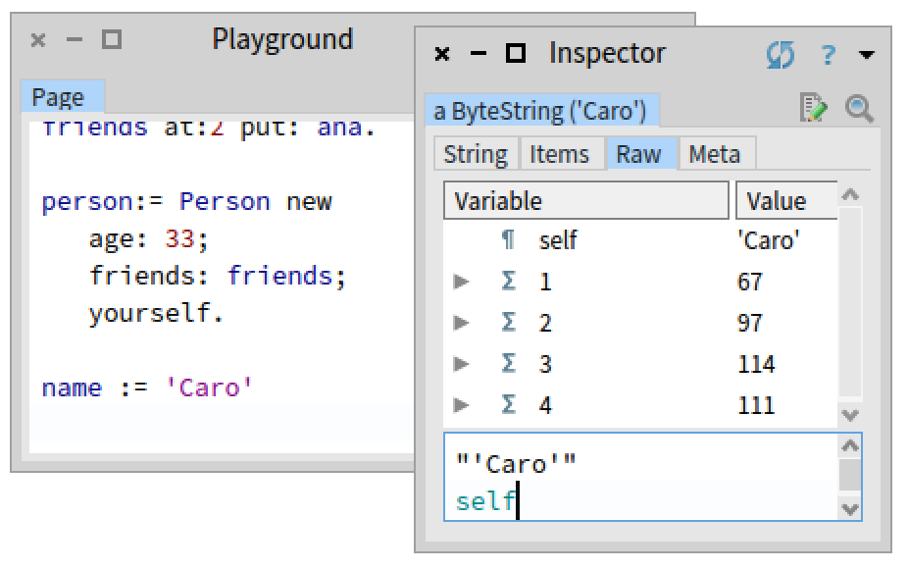
Setting the name
nil
person
name

Slide 31
Setting the name: Indexable Byte layout
ByteString (8-bit)
1 slot = 8-bits
1 word = 8 bytes = 64 bits
8 bits
nil
person
name
padding

Slide 32
Setting the name: Indexable Byte layout
ByteString (8-bit)
1 slot = 8-bits
Variable number of slots
  Slots do not contain Oop, they contain raw bytes
  Defined dynamically at the moment of allocation
  Created by sending the message new:
  Objects can’t grow or shrink!
  Size of slots depends on the object’s layout
    8-bit (eg: ByteArray)
    16 bit
    32-bit (eg: FloatArray, IntegerArray)
    64-bit
1 word = 8 bytes = 64 bits
8 bits
padding

Slide 33
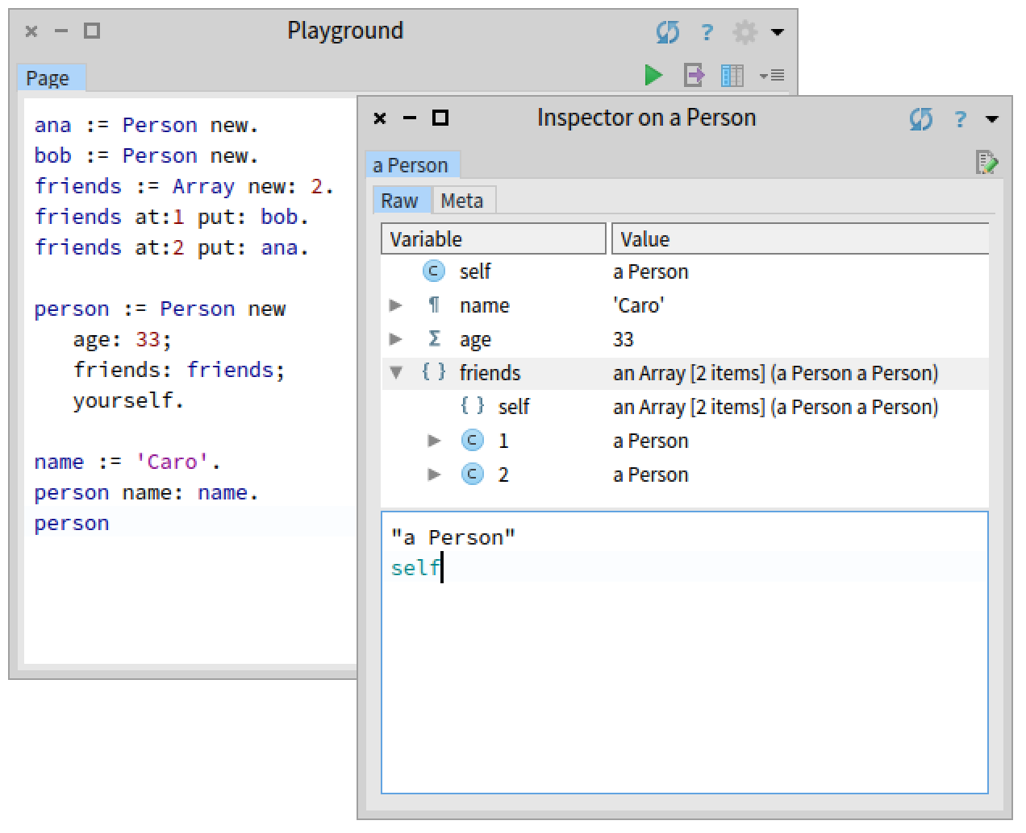
Finally!
A Person in memory
nil
nil
nil
nil
nil
nil
ana
bob
friends
person
name

Slide 34
Special layout: Indexable with Instance Variables layout
Examples:
Context
CompiledMethod
MethodDictionary
Notes:
Reference to the bluebook
Compiled method no lo voy a explicar pero es especial tb
Agregar slide al final

Slide 35
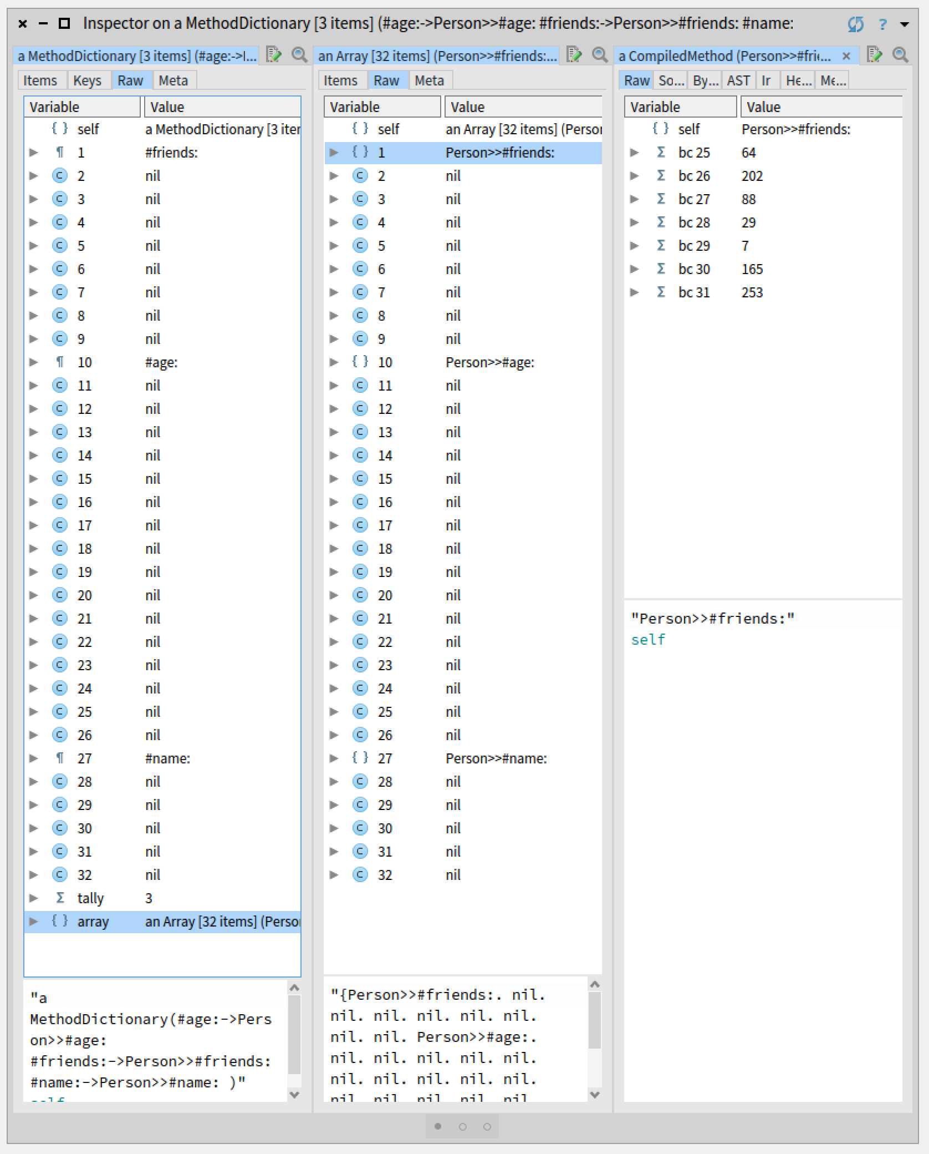
Indexable with Instance Variables layout
Example: MethodDictionary

Slide 36
Indexable with Instance Variables layout
Example: MethodDictionary
tally
selectors
array

Slide 37
Indexable with Instance Variables layout
Example: MethodDictionary
tally
selectors
array
Hybrid between Fixed and Indexable layout
  A fixed number of slots containing instance variables
    In the example: tally and array
  Plus a variable number of slots
    In the example: selectors
Notes:
Tally explain what it is

Slide 38
The Header
1 bit
( 8 bits ) number of slots
(22 bits) identity hash
( 5 bits ) format
(22 bits) class index
(1 bit) immutable
(1 bit) marked
(1 bit) pinned
(1 bit) grey
(1 bit) remembered
unused
Least significant bit

Slide 39
The Header: number of Slots (number of words)
( 8 bits ) number of slots
Least significant bit
-> 1 word
nil
nil
-> 3 words
0 <= number of slots < 255
When number of slots is 255, the object is a Big Object

Slide 40
The Header: identity hash
(22 bits) identity hash
Least significant bit
Unique identifier of the object
Check ProtoObject >> basicIdentityHash

Slide 41
The Header: format
( 5 bits ) format
Least significant bit
Stores the layout of the object
  0 = 0 sized objects (UndefinedObject True False et al)
  1 = non-indexable objects with inst vars (Point et al)
  2 = indexable objects with no inst vars (Array et al)
  3 = indexable objects with inst vars (MethodContext AdditionalMethodState et al)
  4 = weak indexable objects with inst vars (WeakArray et al)
  5 = weak non-indexable objects with inst vars (ephemerons) (Ephemeron)
  6 = unused
  7 = immediates (SmallInteger, Character)
  8 = unused
  9 = 64-bit indexable
  10-11 = 32-bit indexable (Bitmap)
  12-15 = 16-bit indexable
  16-23 = 8-bit indexable
  24-31 = compiled methods (CompiledMethod)

Slide 42
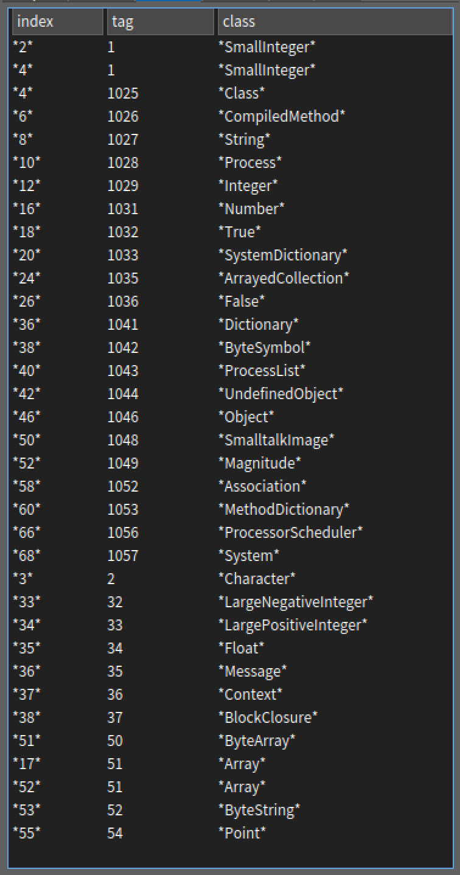
Class table
Organized in pages

Slide 43
The Header: class index
(22 bits) class index
Least significant bit
Stores the index of the class in the class table (hidden from the image side)
  This is an optimization -> we don’t save class references in objects
<12 bits> <10 bits>
  12 bits for storing the page index
  10 bits for storing the index of the class in the page (1024 entries per page)
  Approx 4 millions of classes maximum
The identity hash of a Class object is its class index
Notes:
Explicar cada uno de los campos.
Los amarillos explicar pineado y immutable pero el resto solo mencionar que se usan en GC

Slide 44
The Header: GC flags
(1 bit) immutable
(1 bit) marked
(1 bit) pinned
(1 bit) grey
(1 bit) remembered
Least significant bit
Reserved for Garbage Collection algorithms
Notes:
Explicar cada uno de los campos.
Los amarillos explicar pineado y immutable pero el resto solo mencionar que se usan en GC

Slide 45
Immediate Layout
Value directly saved in a memory
Objects addresses aligned in 8 bytes
  => Addresses in binary finish in 000 (mention this after)

Slide 46
In all the rest of layouts
Object structure:
  Header
  Slots
    References
    Immediates
Kind and size of slots depend on the layout
Examples:
  Object
  Point
  ByteArray …

Slide 47
Big objects
Objects with more than 254 slots
Example: Object with 260 instance variables
2 Headers
  H: Normal header’s number of slots set as 255 (8 bits set as 1)
  260: Extra header starting with 8 bits as 1, and saving the Object’s number of slots
Notes:
Que pasa cuando el numero de slots es superior a los 255 q se pueden guaradar en el header?

Slide 48
Objects size
Every object must have at least one slot
  Minimum size is 16 bytes
  It is hidden from the image side (smalltalk code)
  In case it becomes into a Forwarder
  Even nil, true and false have one slot!
Notes:
Agregar el test para cada feature que mencione

Slide 49
Objects Layout in Memory
VM presentations
Layouts:
  Fixed
  Immediate
  Indexable Pointer
  Indexable Byte
  Indexable with Instance Variables
Object
  Header
  Class Table
  Big Objects
Carolina Hernández Phillips
RMod Team

Slide 50
More about the padding in: Indexable Byte layout
Example: ByteString => 8 bit indexable opaque layout
8 bits
16-23 Object format 8 bits indexable opaque layout
16 -> padding 0-bits
17 -> padding 8-bits
18 -> padding 16-bits
19 -> padding 24-bits
20 -> padding 32-bits
21 -> padding 40-bits
22 -> padding 48-bits
23 -> padding 56-bits
padding
Notes:
Tests:
VMObjectLayoutTests >> testObjectHeaderEncodesObjecFormatForIndexableOpaqueLayout8Bit
VMObjectLayoutTests >> testObjectHeaderEncodesObjecFormatForIndexableOpaqueLayout16Bit
VMObjectLayoutTests >> testObjectHeaderEncodesObjecFormatForIndexableOpaqueLayout32Bit

Slide 51
More about the padding in: Indexable Byte layout
Example: ByteString => 8 bit indexable opaque layout
8 bits
16-23 Object format 8 bits indexable opaque layout
16 -> padding 0-bits
17 -> padding 8-bits
18 -> padding 16-bits
19 -> padding 24-bits
20 -> padding 32-bits
21 -> padding 40-bits
22 -> padding 48-bits
23 -> padding 56-bits
Format = 16 (padding = 0 bits)
Format = 20 (padding = 32 bits)
padding
Notes:
Tests:
VMObjectLayoutTests >> testObjectHeaderEncodesObjecFormatForIndexableOpaqueLayout8Bit
VMObjectLayoutTests >> testObjectHeaderEncodesObjecFormatForIndexableOpaqueLayout16Bit
VMObjectLayoutTests >> testObjectHeaderEncodesObjecFormatForIndexableOpaqueLayout32Bit

Slide 52
More about the padding in: Indexable Byte layout
Object formats
9 => 64 bits layout
9 -> padding 0-bits
10-11 => 32 bits layout
10 -> padding 0-bits
11 -> padding 32-bits
12-15 => 16 bits layout
12 -> padding 0-bits
13 -> padding 16-bits
14 -> padding 32-bits
15 -> padding 48-bits
16-23 => 8 bits layout
16 -> padding 0-bits
17 -> padding 8-bits
18 -> padding 16-bits
19 -> padding 24-bits
20 -> padding 32-bits
21 -> padding 40-bits
22 -> padding 48-bits
23 -> padding 56-bits
Notes:
Tests:
VMObjectLayoutTests >> testObjectHeaderEncodesObjecFormatForIndexableOpaqueLayout8Bit
VMObjectLayoutTests >> testObjectHeaderEncodesObjecFormatForIndexableOpaqueLayout16Bit
VMObjectLayoutTests >> testObjectHeaderEncodesObjecFormatForIndexableOpaqueLayout32Bit
24-27 => 16 bits
9 = 64-bit indexable
10-11 = 32-bit indexable (Bitmap)
12-15 = 16-bit indexable
16-23 = 8-bit indexable

