Slide 1
Learning by contributing to Open-Source Software
stephane.ducasse@inria.fr
https://github.com/pharo-project/pharo

Slide 2
z. zidane

Slide 3
Practiced football?
z. zidane

Slide 4
Practiced football? Yes
z. zidane

Slide 5
r. federer

Slide 6
Practiced tennis?
r. federer

Slide 7
Practiced tennis? Yes
r. federer

Slide 8
k. buniatishvili

Slide 9
Practiced Piano?
k. buniatishvili

Slide 10
Practiced Piano? Yes
k. buniatishvili

Slide 11
Did you see the pattern?

Slide 12
How to practice software skills?

Slide 13
How to practice software skills?
Program (but how to get feedback) code reviews are precious but difficult to get
Code katas (always fun)
Participate to sprints - Pair program
Participate to open-source

Slide 14
But I’m a noob

Slide 15
And the world is complex

Slide 16
Wait wait wait…

Slide 17
We are all noobs!

Slide 18
The solution is just some clicks away…

Slide 19
Take any opportunity to read code

Slide 20
Take any opportunity to contribute

Slide 21
Contributing is easy & simple

Slide 22
Possible contributions
Read/answer newbie questions
Participate to the wiki
Review bug entry description
Review bug fixes
Write tests for bug entries
Improve test coverage
Improve comments

Slide 23
Newbie Questions
I learned a lot answering them :)
When I did not know I looked for the answers
Try and learn

Slide 24
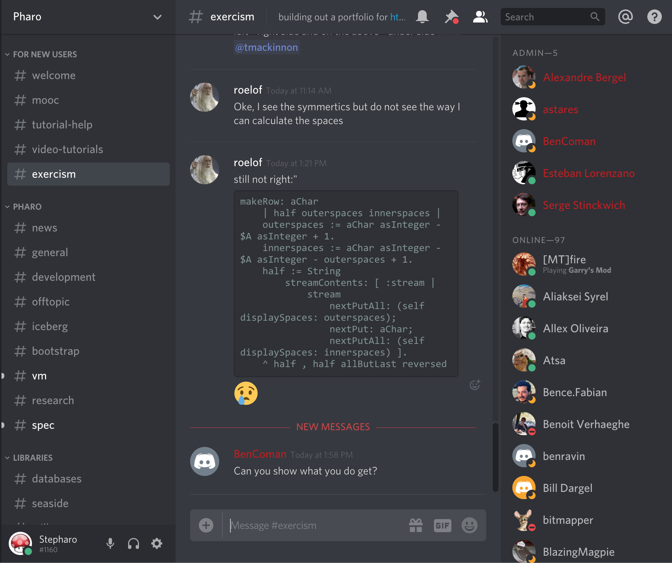
Read discord

Slide 25
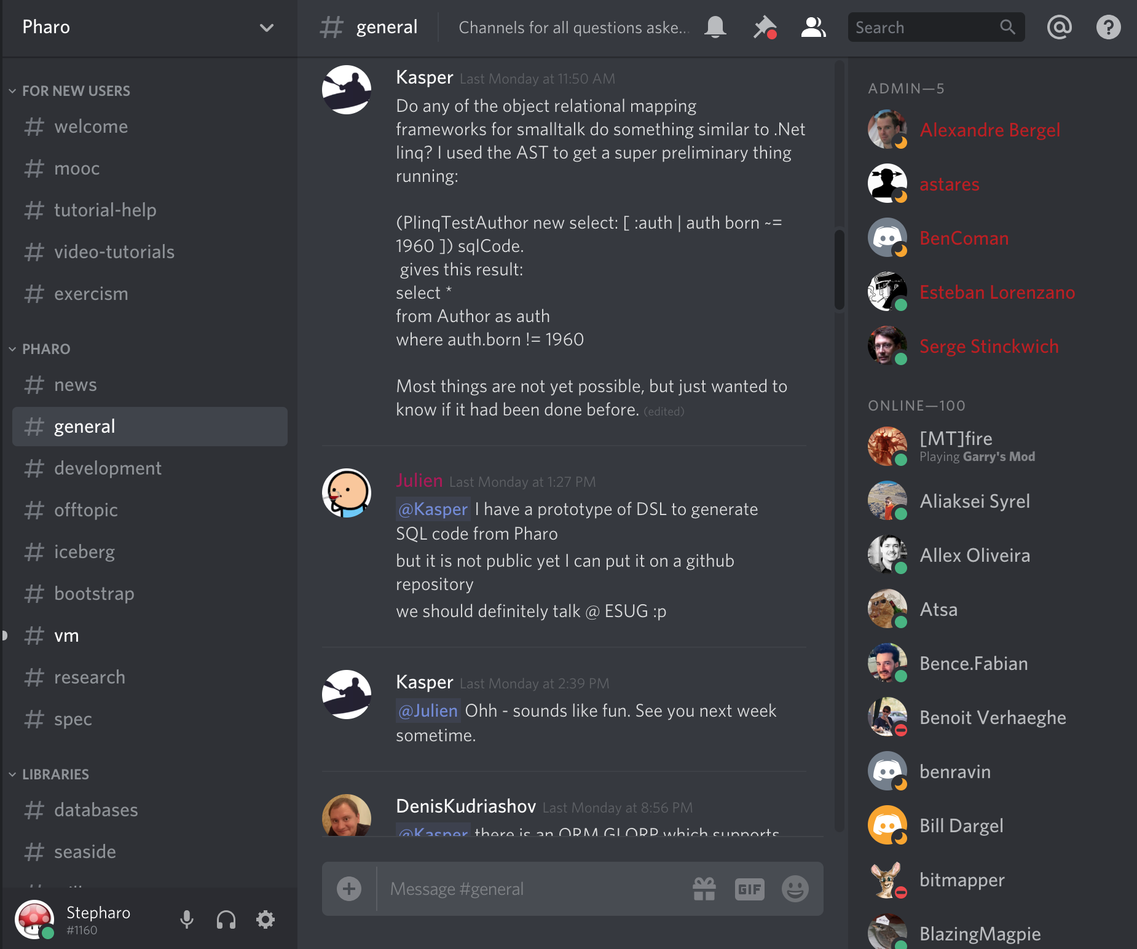
Answer questions
On discord
Mailing-list

Slide 26
Take any opportunity to contribute

Slide 27
[ how did we meet with Marcus D.? ]

Slide 28
[ we reviewed squeak bug issues ]

Slide 29
Bug issue contribution
Can you understand it?
else ask for precision
Can you repeat the problem mentioned?
report it. This is a valuable information

Slide 30
Bug issue contribution
Write a test to show the problem?
If the contributor provides a test, is it sounds?

Slide 31
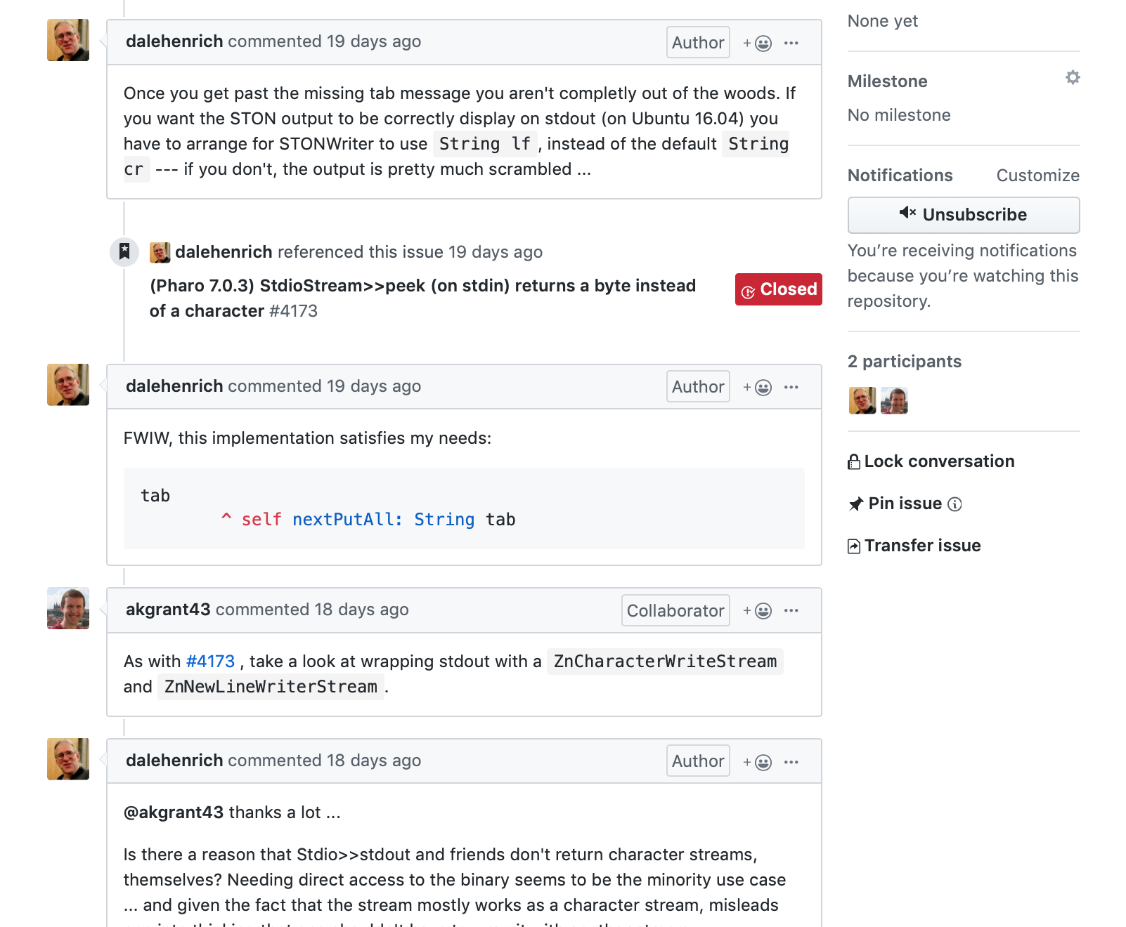
Join/read bug issue discussion

Slide 32
What if you do not know?
What if you do not understand?

Slide 33
Easy! Drop it and pick the next one

Slide 34
Read tests to learn
Tests are cool to learn
Tests can be improved, so you can improve them

Slide 35
Improve test coverage
It is often easier to write tests than the code :)
Grab an object and inspect it
Turn this in a test

Slide 36
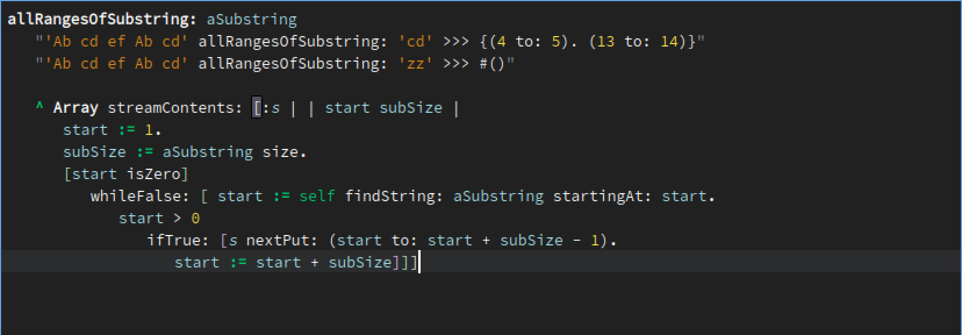
Add executable comments

Slide 37
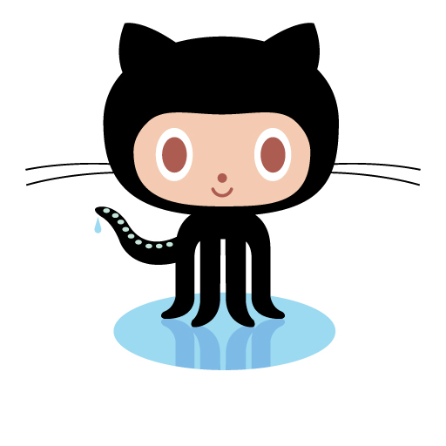
[ Free side effect ]
When you contribute to open-source you improve your visibility

Slide 38
[ Remember ]
Every thing you do today has an impact on your tomorrow!

Slide 39
[Personal note]
My objective is to read (and understand) all Pharo source code :)
So I take any opportunity to read code
I even read closed issues

Slide 40
Do not miss a great opportunity to grow your knowledge
Join and invent the future

