Slide 1

Modularity from the trenches
Stéphane Ducasse and Guillermo Polito
Modularity 2017
Brussels

Slide 3
A context: Large Systems
Several thousands of classes
Multiple Millions of LOC
Long living systems ~ 15 to 25 years
Successful systems

Slide 4
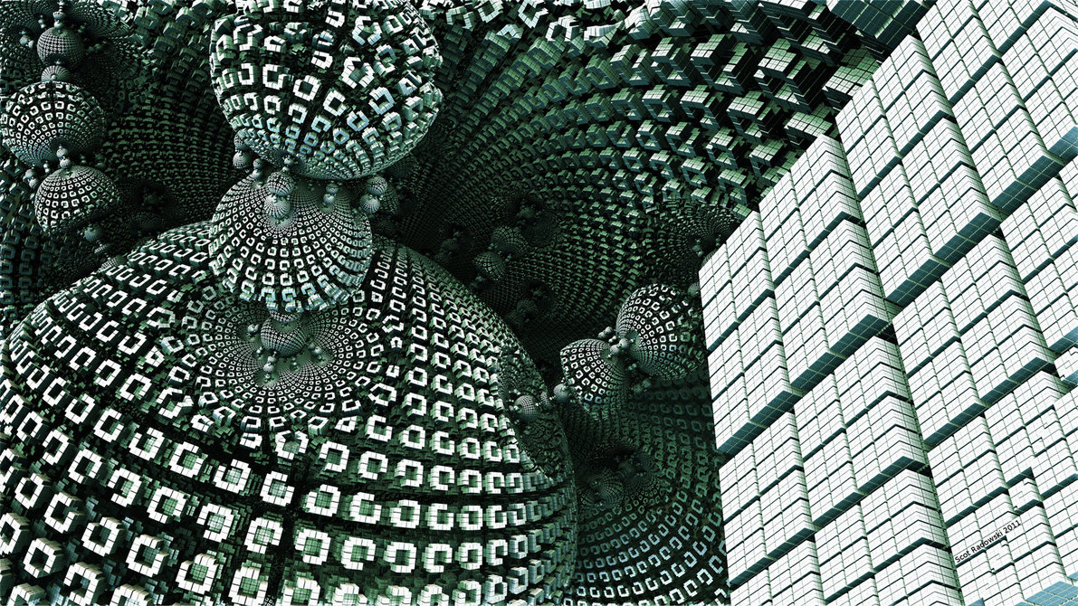
Software Entropy
You have success
Your software grows
Complexity too

Slide 5

Code for future use
Duplicated
Obsolete code
DO-NOT-TOUCH

Slide 6
Roadmap
Analyses to help modularizing software
  PhD of H. Abdeen: using simulating annealing to repackage
  PhD of J. Laval: characterising cycles and layers
The story of the Pharo Kernel mission
Removing vs. Bootstrap
  PhD of G. Polito
- Towards go Module system

Slide 7
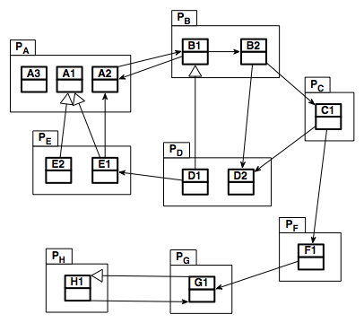

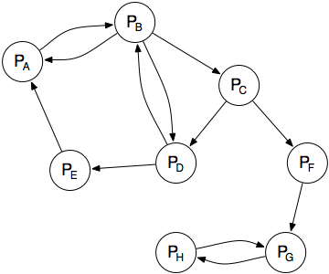


Identifying cyclic dependencies?
i. Graph abstraction
ii. Strongly Connected Components
(SCC) detection [Tarjan, 1972]
Notes:
---> les graphes pour comprendre les packages ne sont pas adaptés

Slide 8
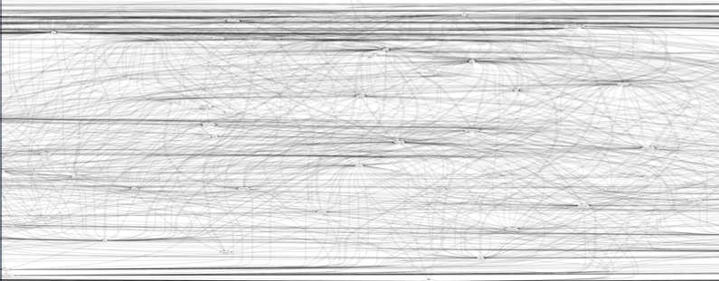
A large software application
Pharo Core 1.1, 115 packages
  One big SCC ☺
Notes:
scalable = utilisable

Slide 9
Packages in SCC
What are the differences between these dependencies ?
Pharo Core 1.1, 78 packages in cycle
  Cycles are not visible
  No information about dependencies

Slide 10

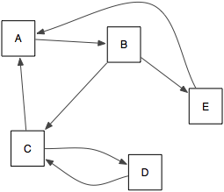
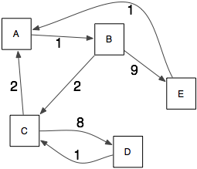

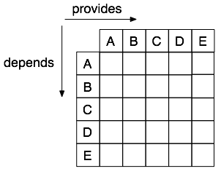
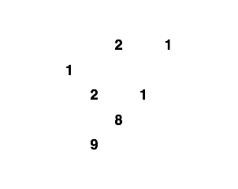

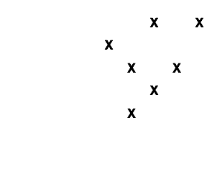
Building a DSM
weight = Inheritance + invocation + reference + extension

Slide 11
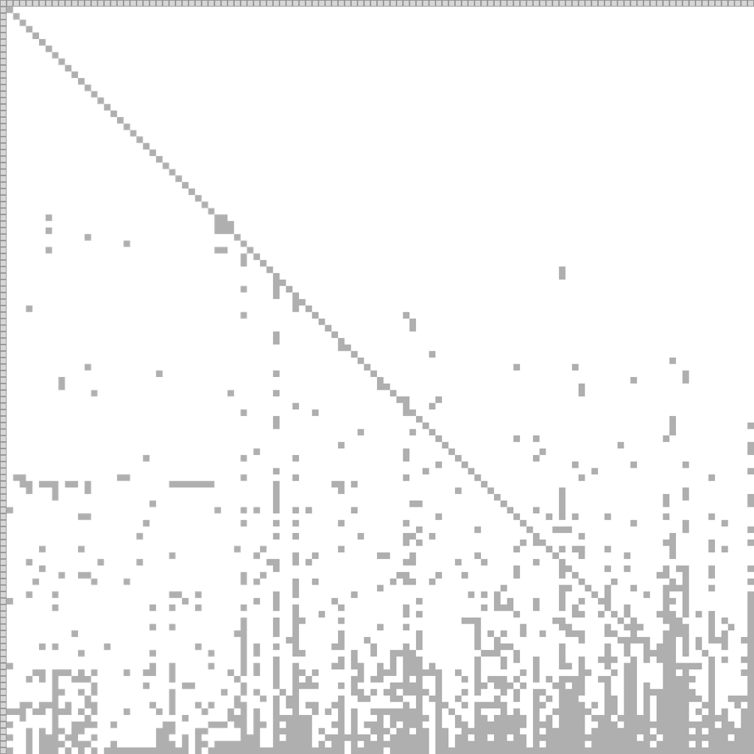
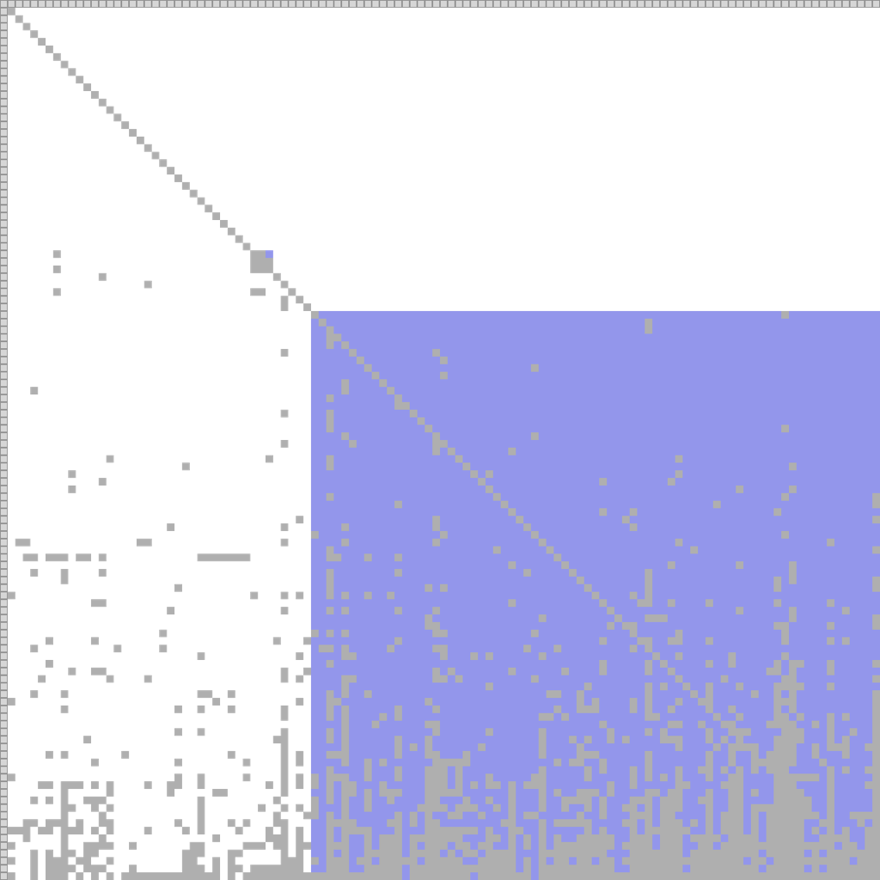


DSM for software architecture
      [ Sangal 2005 ]
PharoCore 1.1, 115 packages - 78 in cycle

Slide 12
There is a need to understand package dependencies

Slide 13
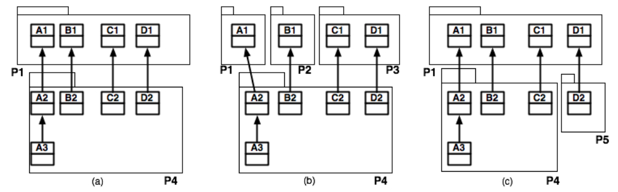
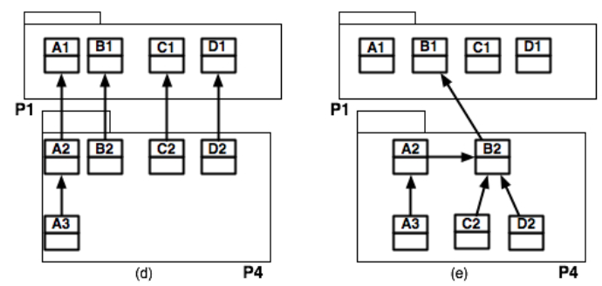

Slide 14
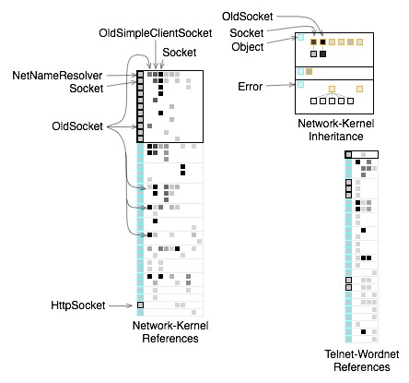
Some tools
Package Blueprints (ICSM2007)
Extended DSM

Slide 15
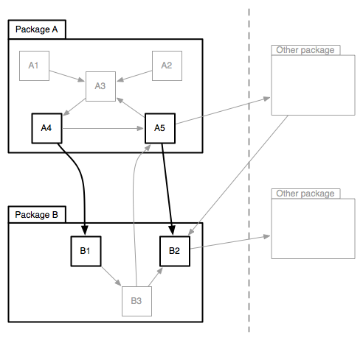
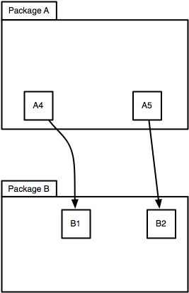
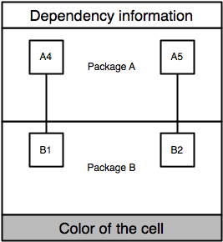
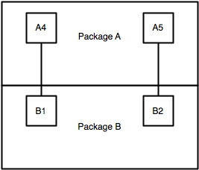
A cell expresses a dependency
From Package A to Package B
Number of dependencies:
inheritance, invocation, reference, extension
Grey, Pink/Red, Yellow

Slide 16
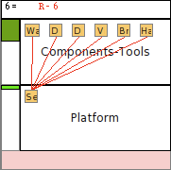

eCell example
From Components-Tools to Platform
6 dependencies:
6 references (6 classes to 1 class)
rate of impacted classes
In a direct cycle

Slide 17
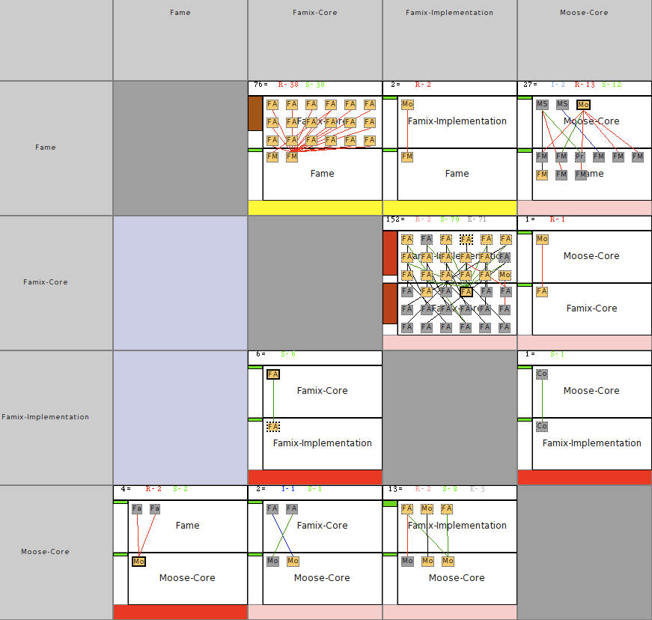

eDSM with eCell: Zoom on a SCC
A direct cycle:
The red dependency seems better to remove
2 other candidate dependencies
Notes:
expliquer les 4 packages

Slide 18
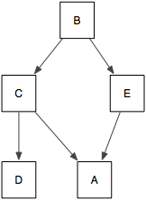
Existing approaches to layer identification
  Lattix move each SCC in a layer
      [Lattix 2005]
      Does not work with undesired cycles
  Minimum Feedback Arc Set (MFAS) break the minimum of edges.
      [Melton 2007]
      Does not take into account the semantics
  Regression and Integration testing technics
      [Le Traon 2000, Da Veiga Cabral 2010]
      => Minimization of vertices vs minimization of arcs

Slide 19
oZone strategy to identify layers
  Selecting edges that can break direct cycles.
  Selecting edges that are shared dependencies.
  User interaction to improve the results
Results are:
  A list of dependencies that are interesting to remove.
  A layered structure of the application to understand it.

Slide 20



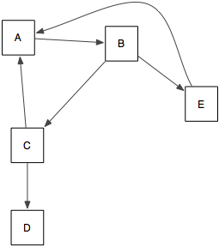
oZone: example
remove other cycles
by ignoring shared dependencies
remove direct cycles
by ignoring a dependency

Slide 21
Roadmap
Analyses to help modularizing software
  PhD of H. Abdeen: using simulating annealing
  PhD of J. Laval: characterising cycles and layers
The story of the Pharo Kernel mission
Removing vs. Bootstrap
  PhD of G. Polito
- Towards go Module system

Slide 22

Pharo as a real experimental setup
Pharo this is
  465 packages
  more than 3000 thousands external projects
  98 committers
  30 universities teaching with Pharo
  16 worldwide research groups

Slide 23

Pharo is growing
New libraries
New tools
New tests
More documentation

Slide 24
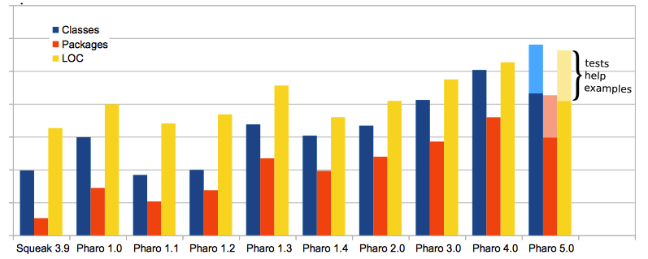
Pharo evolution
Notes:
- we are adding code
- cleaning
- growing continuously since 1.4
-

Slide 25
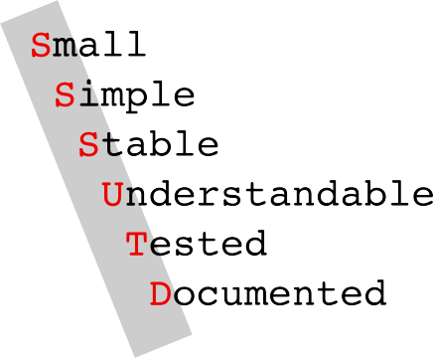
Pharo Kernel Mission

Slide 26

From top
- cleaning
- shrinking
- reloading
From bottom
- bootstrapping
- reloading

Slide 27
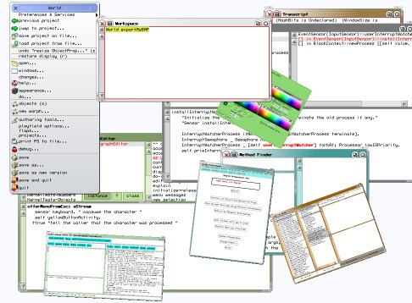
From top shrinking and modularization
started before Pharo
removing of code is easy
clean removing is not easy
reloading is even harder
Morphic reloaded
by Pavel Krivanel [22.07.2006]

Slide 28

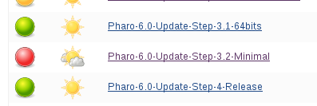
Kernel image evolution in shortcut
BROKEN!
works again
BROKEN!
works again
BROKEN!
works again
BROKEN!
works again
BROKEN!
works again
BROKEN!
works again
BROKEN!
works again
Broken again... [18.8.2016]

Slide 29

Why so hard and long?
Everyone must take of care of modularity
Should be integrated in development process
(tests, rules, CI jobs)

Slide 30
CI jobs for Pharo modularization
since Pharo 2.0
shrink image
increase granularity of reloaded modules
tests
coverage testing
https://ci.inria.fr/pharo/view/6.0-SysConf/

Slide 31
Roadmap
Analyses to help modularizing software
  PhD of H. Abdeen: using simulating annealing
  PhD of J. Laval: characterising cycles and layers
The story of the Pharo Kernel mission
Removing vs. Bootstrap
  PhD of G. Polito
- Towards go Module system

Slide 32
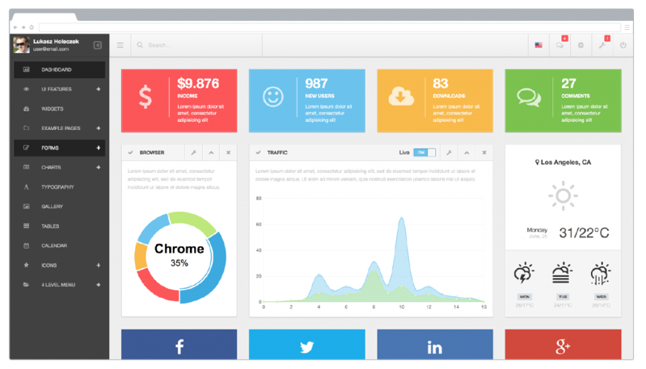
Let's talk about
BOOTSTRAP

Slide 33

Bootstrap
« The process that builds the
minimal infrastructure of a langage
reusable to define the language itself »

Slide 34
Why do we need a bootstrap ?
Have a known initial state
Be able to reproduce the state of a system
Ensure we can reinitialize the system at any time
Ease kernel evolution
Identify a small subset of the language allowing the definition of the language itself

Slide 35
Why bootstraping is difficult?

Slide 36
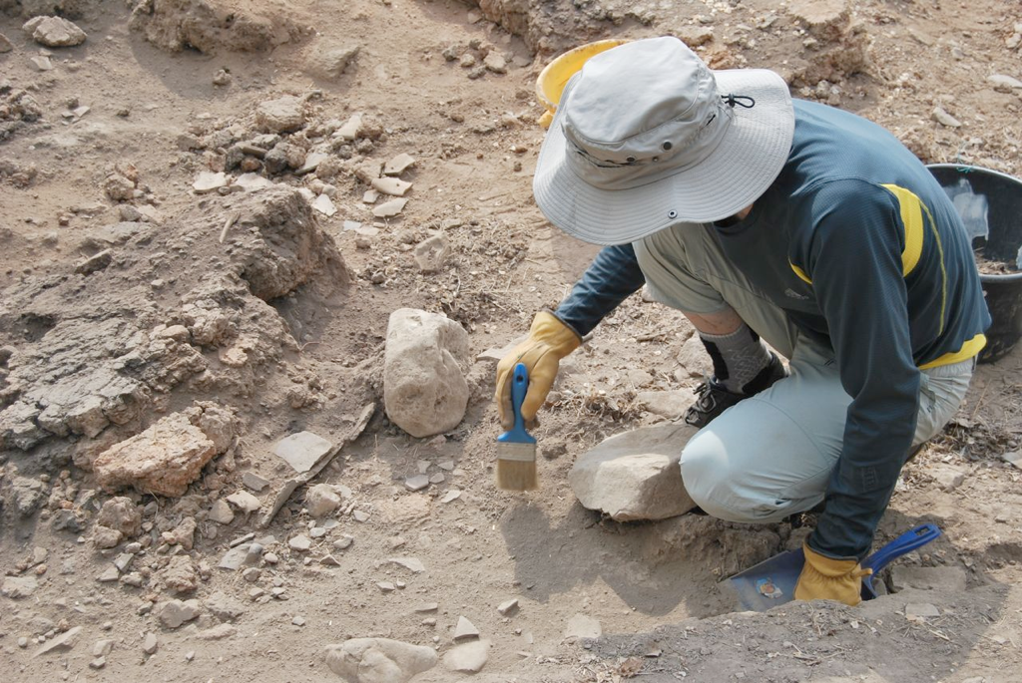
Archaelogy

Slide 37
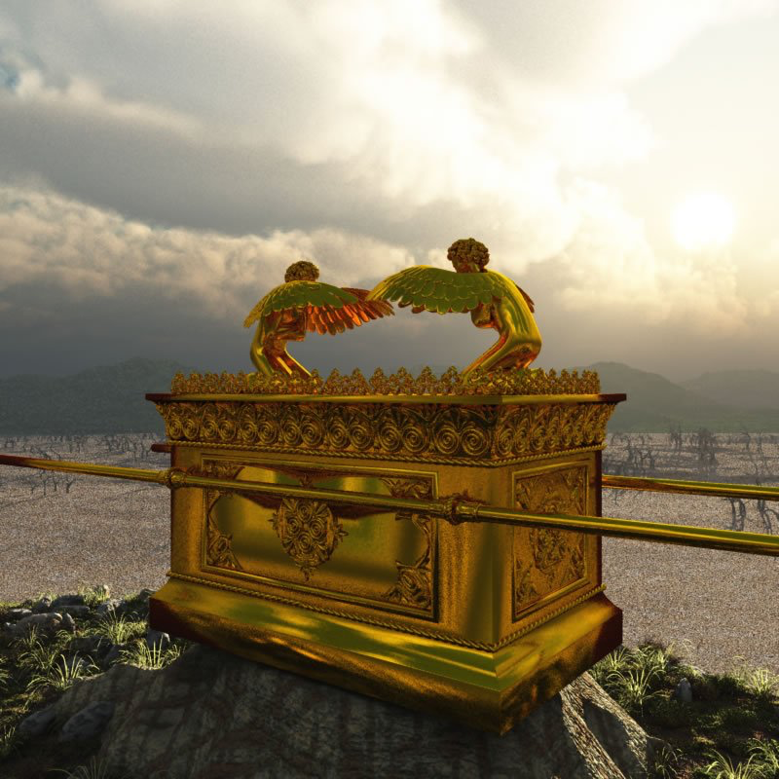



Slide 38
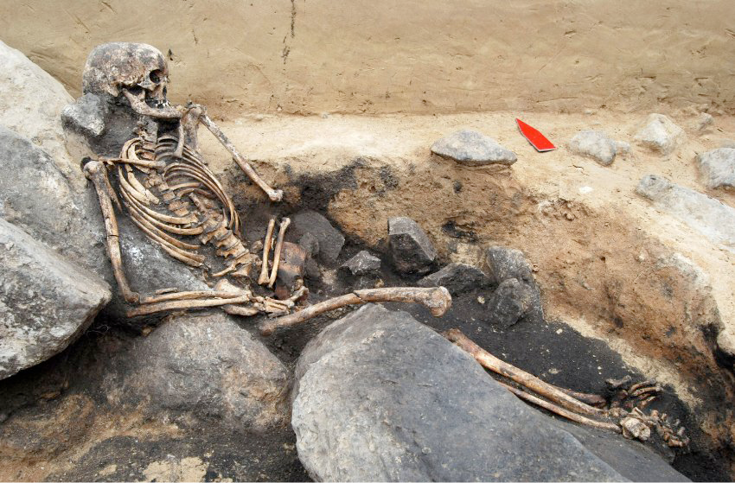
Deadcode

Slide 39
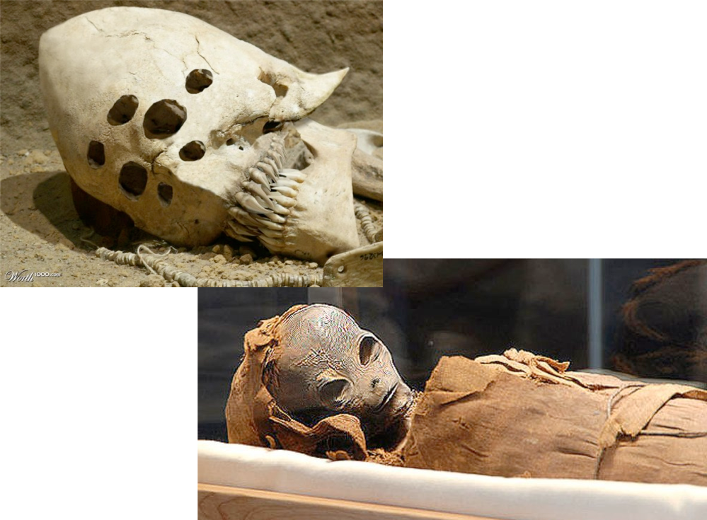
Strange logic

Slide 40

The missing initialization

Slide 41
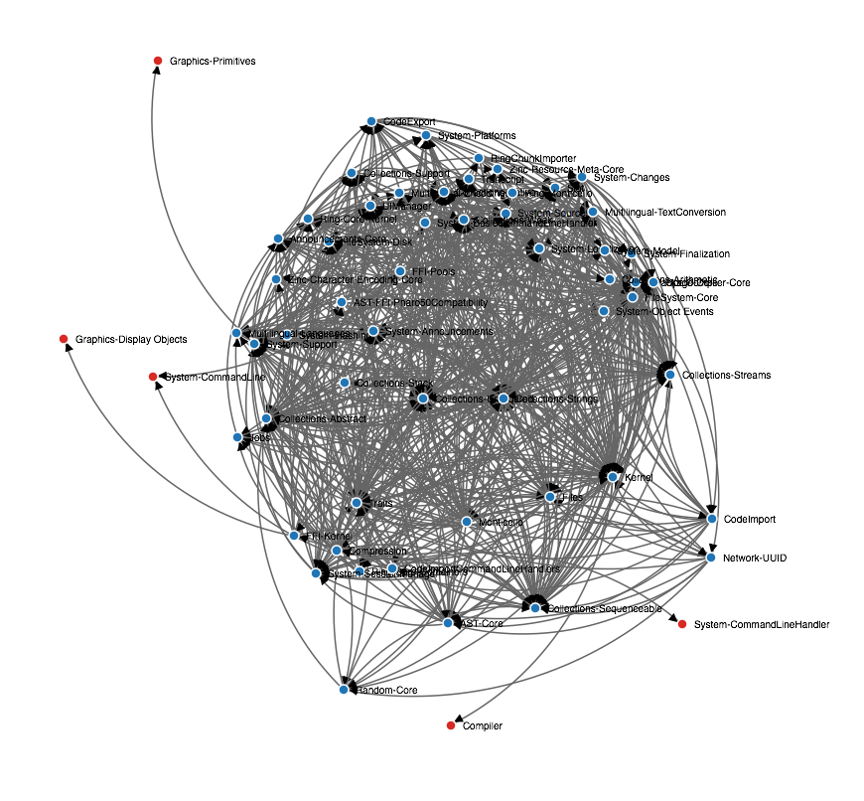
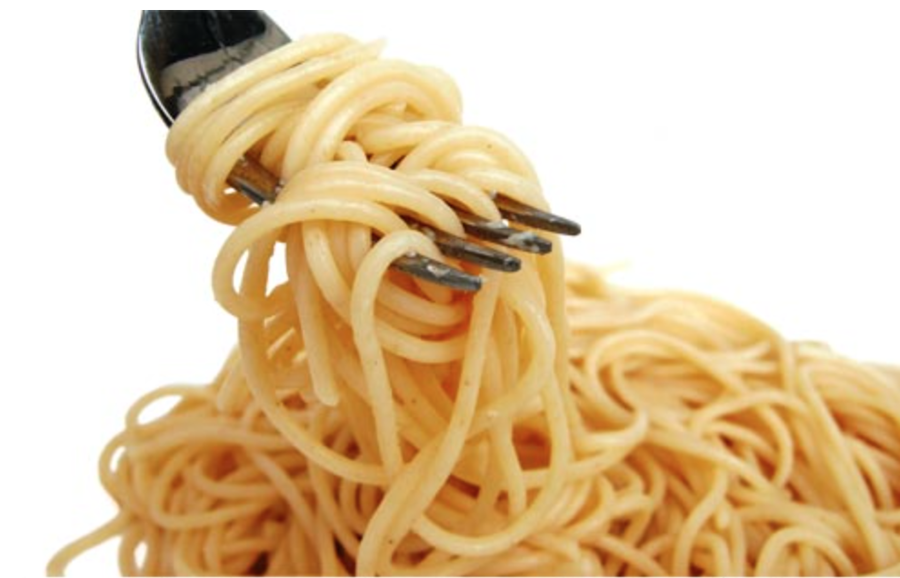
The dependency hell

Slide 42
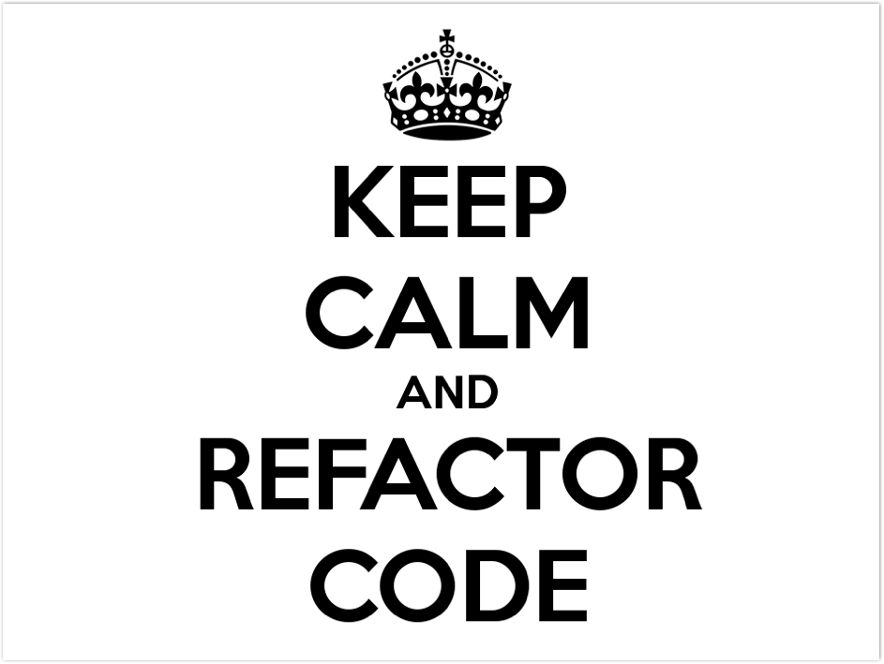

Slide 43
How to fix bad dependencies?
Create a new package to isolate functionnalities
Move methods as extensions to another package
Kill facades (there are global thinking)
Components made to be customized
  Settings
Registration mechanism
Re-design completely a functionality
  e.g. startup list
...

Slide 44
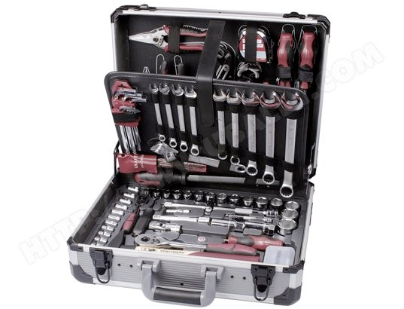
Tools support

Slide 45
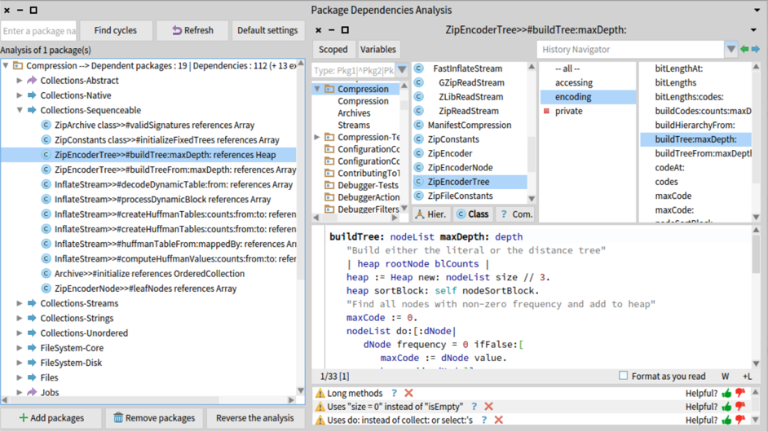
Dependencies analyser

Slide 46
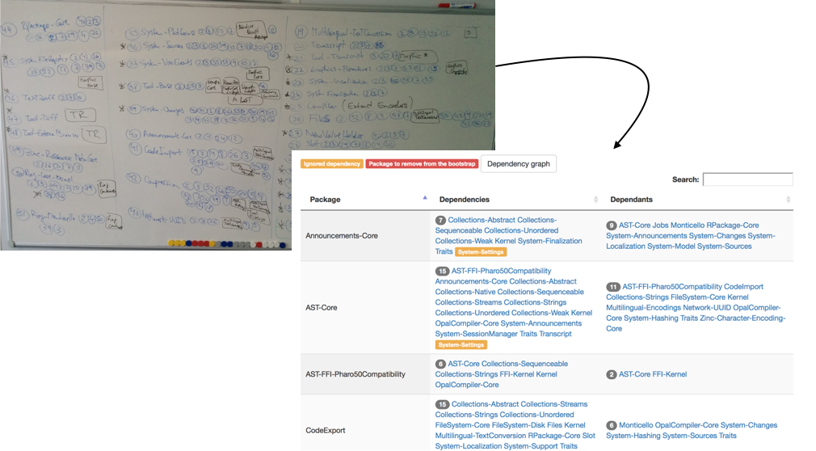
Dependency Dashboard

Slide 47
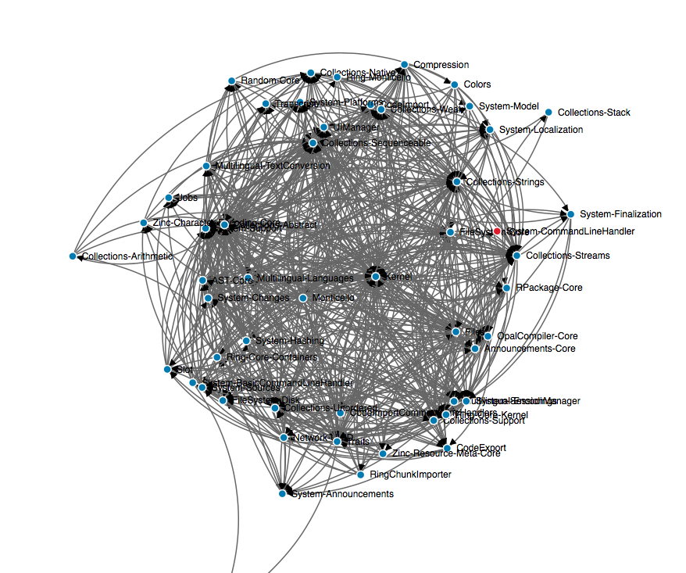
Dependency visualization
https://ci.inria.fr/pharo/job/Pharo-6.0-DependencyAnalysis/ws/bootstrap-dependency-report-graph.html

Slide 48

The bootstrap process

Slide 49
Bootstrap process insight
creation of stub objects : nil, false, true
definition of classes and metaclasses
compilation of methods
creation of the initial process
system serialization

Slide 50


Slide 51

1
Day

Slide 52
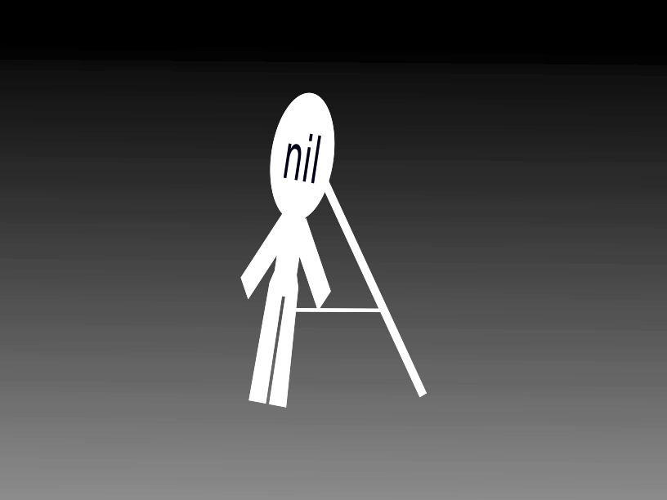

Slide 53
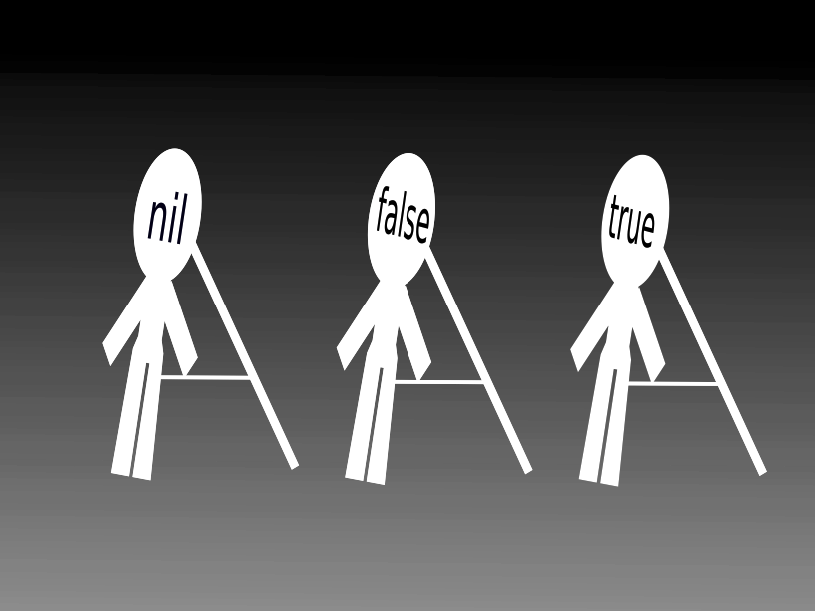
Day
2

Slide 54
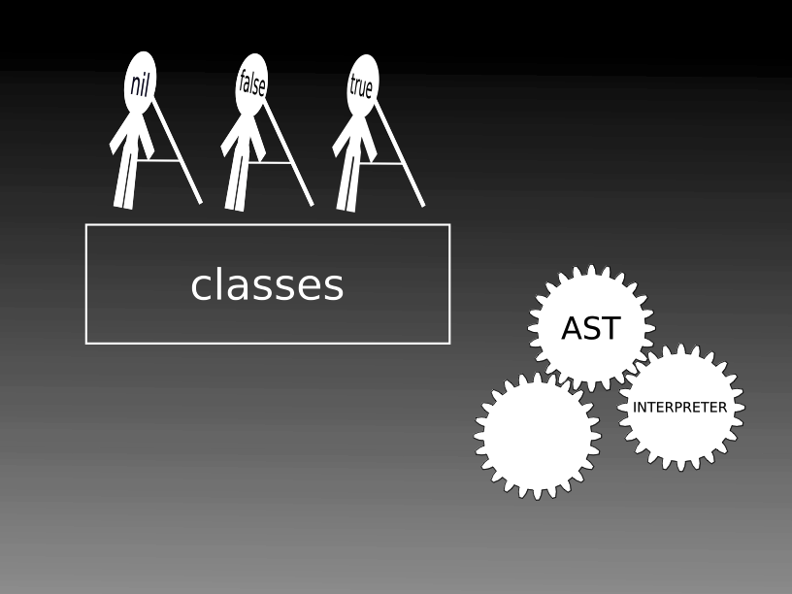
Day
3

Slide 55
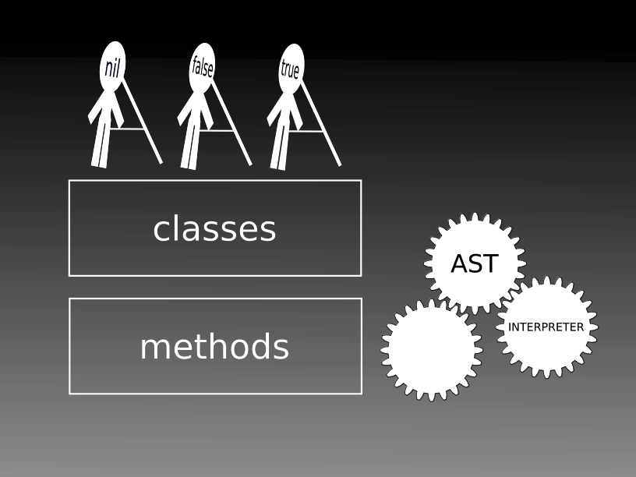
Day
4

Slide 56
Day
5
process

Slide 57
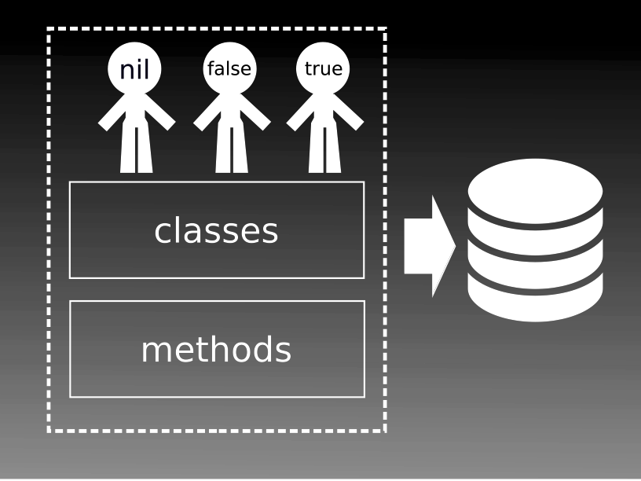
Day
6

Slide 58
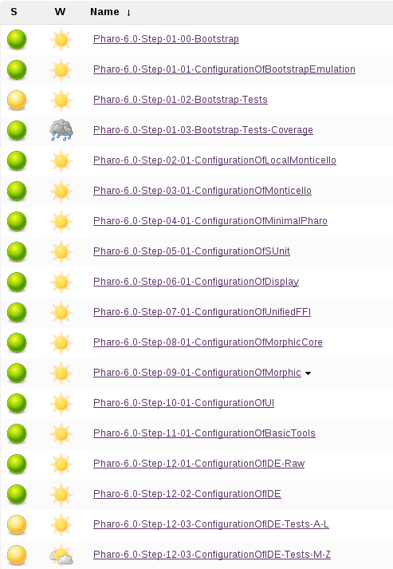
CI jobs for Pharo modularization
Kernel (shrinked / bootstrapped)
Monticello
Network support
Remote repositories support
Metacello
= minimal Pharo
SUnit, Display support, UFFI
Morphic core, Morphic
UI, Basic tools, IDE
= Pharo

Slide 59
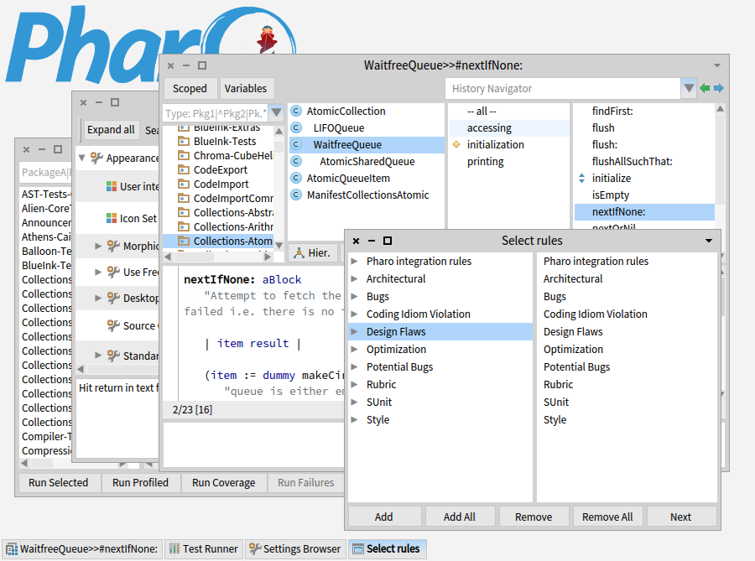
Bootstrapped & reloaded from GIT

Slide 60

7
Day

Slide 61

More details
Cf PhD Guillermo Polito:
https://hal.inria.fr/tel-01251173
Notes:
- VM side: lower-level language, less constraints but evolution more difficult => modify and recompile the VM
- it's like driving a car under construction (maybe no brakes, no wheels)

Slide 62
Story #2

Slide 63

Road to a working bootstrap
Dependencies analyser

Slide 64

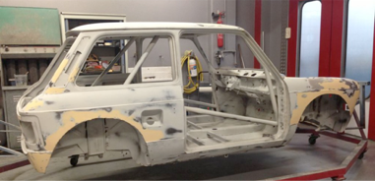
Bootstrap challenge
> language side bootstrap
Language initialization generally done VM side
We want to do it language side:
Need to run code on top of a language under construction
Notes:
- VM side: lower-level language, less constraints but evolution more difficult => modify and recompile the VM
- it's like driving a car under construction (maybe no brakes, no wheels)

Slide 65
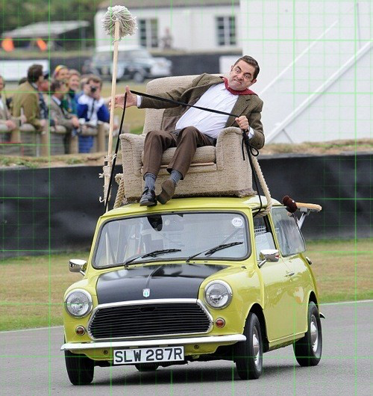
Bootstrap challenge
> language side bootstrap

Slide 66

Road to a working bootstrap
First bootstrapped image!

Slide 67

Road to a working bootstrap

Slide 68
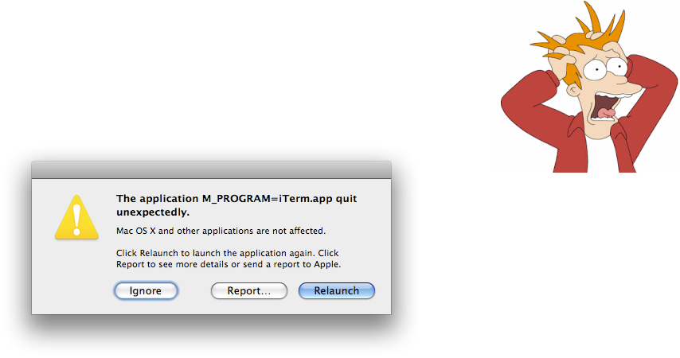
Road to a working bootstrap
Execute the system ….
the VM crashes

Slide 69
Road to a working bootstrap
> some debugging examples
Missing class in the boostrap
e.g. Float
superclass not set
superclass set to a wrong value

Slide 70
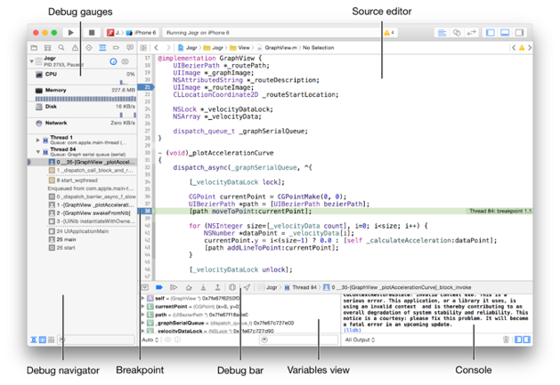
Road to a working bootstrap
Compile VM in debug mode
Run bootstrapped
system through
Xcode / LLDB

Slide 71


Road to a working bootstrap
> verifying the bootstrap
Rely on Pharo tests (>8 000 tests)
Load SUnit
Load test packages
Run tests

Slide 72
Wants to know more?
Bootstrap process hosted on Pharo CI server
https://ci.inria.fr/pharo/view/Pharo%20bootstrap/
GitHub repository
https://github.com/guillep/PharoBootstrap

Slide 73
Bootstrapped Pharo
Soon in production (Pharo 7.0)
All packages reloaded!
Architectural rules
Tools to the rescue

Slide 74
Metalo
Designing a module system
For live programming: programmer feel and feedback
Should be usable by normal programmers
Should be applicable and bootstrappable on plain Pharo

Slide 75
Objective 1 - Namespace
Smalltalk globals
...
Kernel
Network
Compiler

Slide 76
Objective 2
Better Dependency Management
Kernel
uses
uses
Network
Compiler

Slide 77
Objective 3
Module testing
Old Compiler
Opal Compiler
uses
uses
Workspace
Workspace'

Slide 78
Current Design
No nesting
No name lookup
Explicit import
To be introduced incrementally (module and monolithic side by side for a while)
Tools should support it

Slide 79
Current Design
A module has its own namespace
Shared bindings between modules as current

Slide 80
Shared Bindings

Slide 81
Tools
All the tools should be module-aware
Live programming
  Workspace
  Debugger
  Inspector
  Class browser
  Refactorings

Slide 82
Conclusion
Working with real system is rewarding
Modularisation is a battle
Tools are good weapon against entropy
We are getting there!

