Slide 1
I have a dream...
S. Ducasse stephane.ducasse@free.fr
& STICAmsud ( )

Slide 2
yo tengo un sueño ... :)

Slide 3
S.Ducasse
LISP ....1996: discover Smalltalk
1998: discover Squeak
~2000: harvester for 3.xx, 3.6, 3.7, started to clean Squeak
Responsible for Squeak3.9
2008: Pharo :)
Book author: Squeak (fr), Squeak by example (eng, fr), Pharo by example (eng)
Translated Etoy book and video in french
e

Slide 4
I dreamed about ...

Slide 5
A vehicule to reinvent the future

Slide 6
Let’s stop to think that we are that cool!

Slide 7
Python, Ruby, Groovy, Lua...
Erlang...

Slide 8
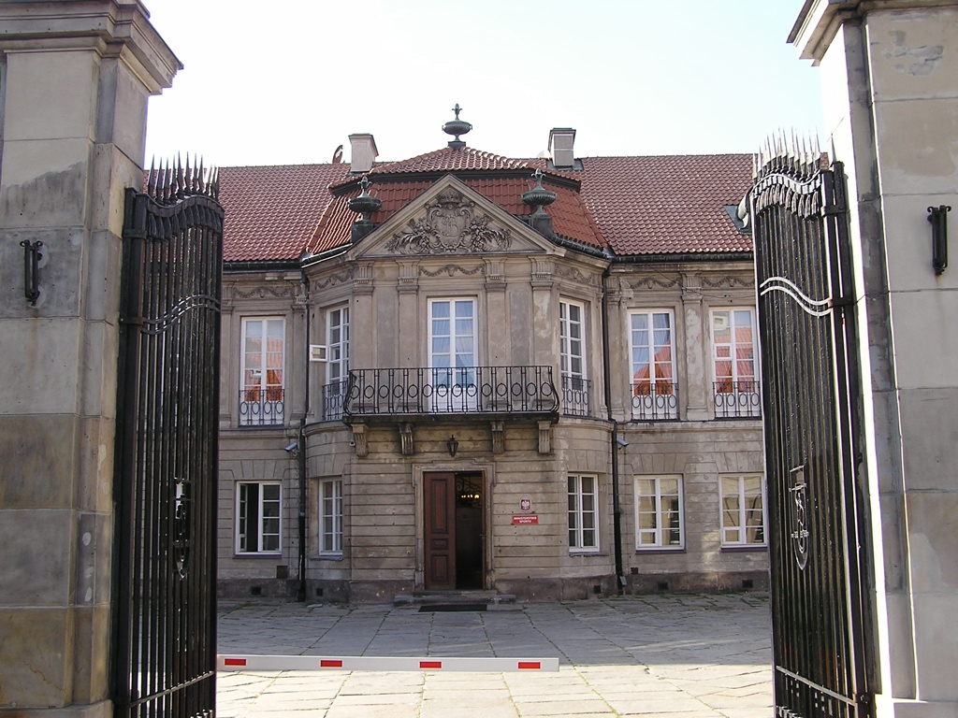
Let’s stop to live in a museum!

Slide 9
When do we really build on top of giant shoulders?
Thanks Dan and Alan. Now...
I want more!

Slide 10
We should be able to invent our future

Slide 11
Where is Smalltalk innovation?

Slide 12
Smalltalk as the language to define other languages
Advanced and stronger Mops
We deserve more than doesNotUnderstand:
New ways of defining languages
Domain specific language support
New generation of meta compilers

Slide 13
Software Engineering
Tests: which ones should I fix first?
Continuous test running
Smoother refactorings and code manipulation
Continuous integration / Extreme integration
Better Lint Rules / Domain specific lint rules
Bug tracking
Merging?

Slide 14
UI
Multitouch support
New UI
When will we be able to reinvent UI
Cairo and others?
New IDEs

Slide 15
Other
Security?
Micro modularity
Advanced runtime
Scripting syntax!

Slide 16
VM/Languages
Multiple cores?
Open VMs?
New generation JITs?
Immutable

Slide 17
They show us the way
ObjectPeople (Dave Thomas and others)
Resilient (128K) Smalltalk on hdware
S#: Dave Simmons 90ms boot fully embeddable in C Smalltalk
Dave Thomas Sapphire’s vision (ESUG@douai)
TTY + Image as a cache

Slide 18
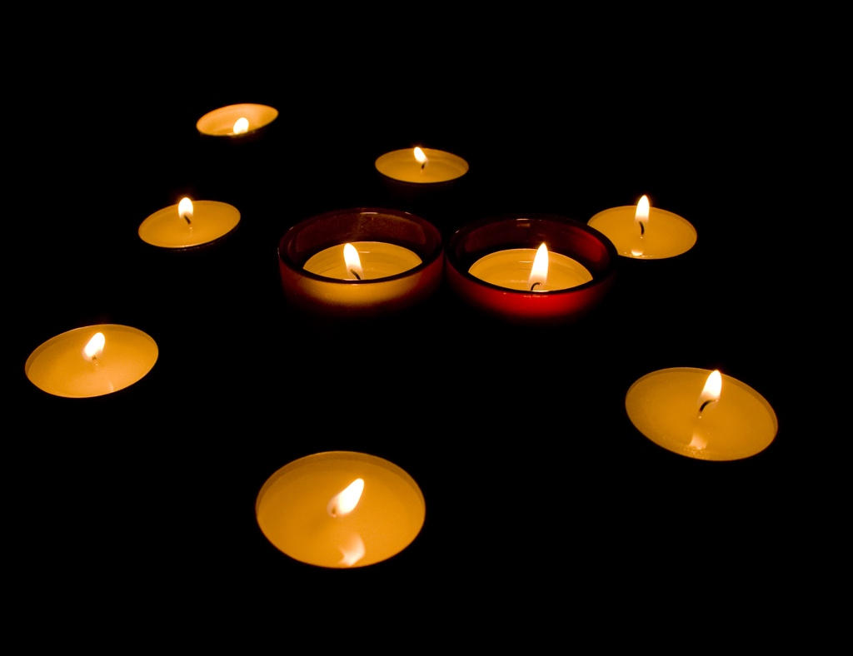
There is some hope...
Seaside
Reflectivity, NewCompiler, AOSTA?
Monticello, O’Meta, PetitParser, Helvetia, Glamour, Mondrian, Traits...
Newspeak, Pepsi/Coke....

Slide 19
When do we make sure that we could invent Smalltalk 3000?
first class instance variables, modules?, immutability bits?, visibility?, image as cache?

Slide 20
We need a new state of mind

Slide 21
We are trying...

Slide 22
http://www.pharo-project.org
A clean, innovative, open-source Smalltalk

Slide 23
In a nutshell
Pharo = language + IDE + update mechanism
Pure object-oriented programming language
Dynamically typed and trait-based
Open and flexible environment
Platform for Seaside and Aida/Web web frameworks

Slide 24
Pharo?
A progressive, open-source Smalltalk platform for professional use.
Stable
Bugs fixed fast
But innovative

Slide 25
Pharo?
A flexible environment to support the innovation in/of Smalltalk.
Stable
Bugs fixed fast
But innovative

Slide 27
Pier

Slide 28
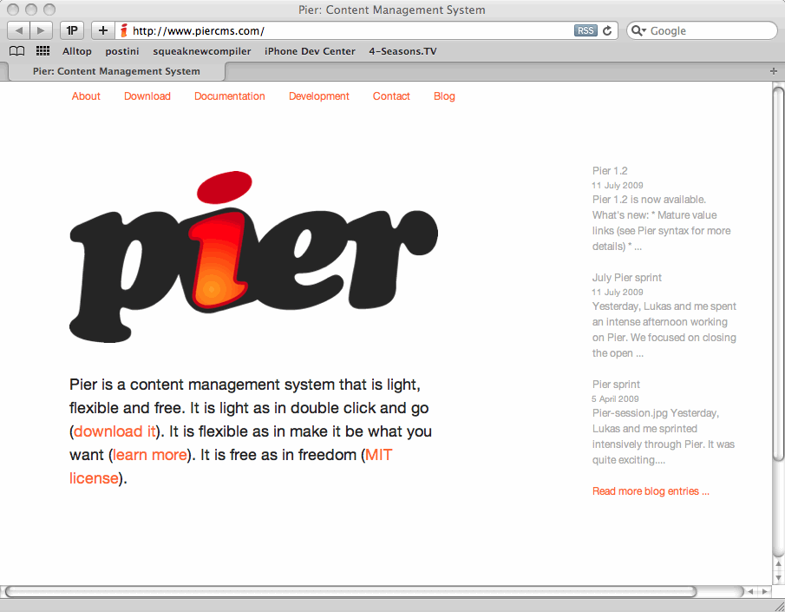
Pier

Slide 29
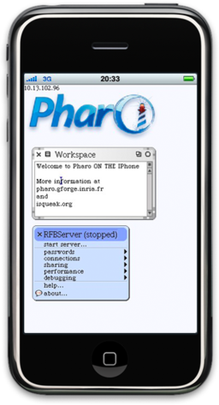
iPhone

Slide 30
Smalltalk with OO-Database
Pharo is the IDE

Slide 31
Companies
netstyle.ch
cmsbox.com
Pinesoft
Smallworks
Agilitic.be
Inceptive.be
10Pines
GemStone
SWEng
Denker2Denker
...

Slide 32
Universities
Annecy
Lugano
Bern
Douai
Lille
Santiago
Bruxelles
Limoge
...

Slide 33
Getting started
Model
Tools
Syntax

Slide 34
A Simple and Pure Model
Everything is an object instance of a class
Public methods
Protected attributes
Single inheritance

Slide 35
Everything happens by sending messages to objects
1000 factorial / 999 factorial
(Smalltalk isCool) ifTrue: [‘Yeahh’]
#(1 -2 3) collect: [ :each | each abs ]

Slide 36
Running Pharo

Slide 37
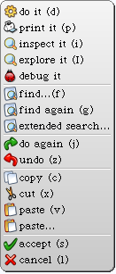
Do it, print it
You can evaluate
any expression anywhere
in Pharo

Slide 38
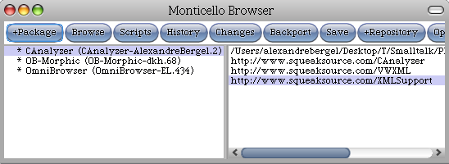
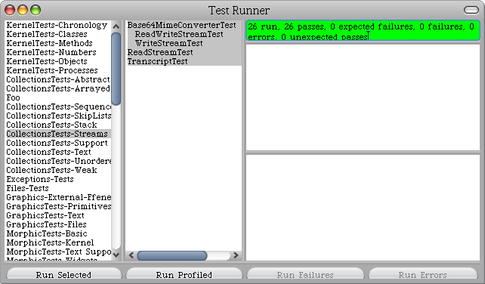
Standard development tools

Slide 39
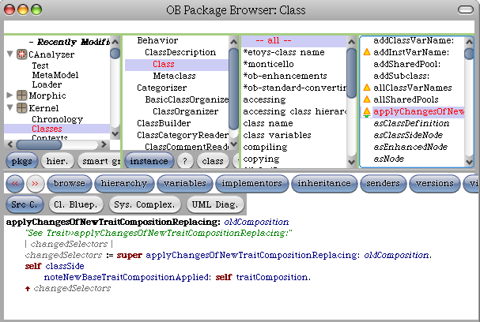
Standard development tools

Slide 40
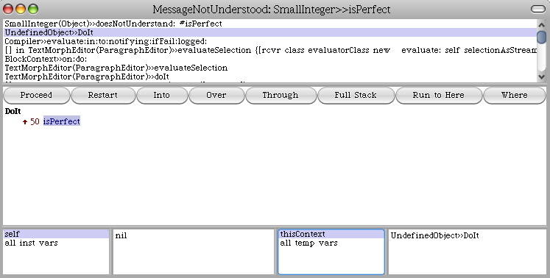
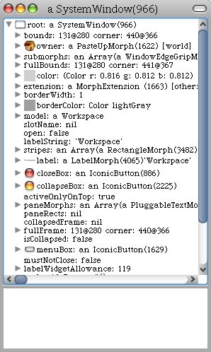
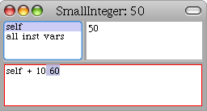
Debugger, explorer, inspector

Slide 41
Syntax in a nutshell

Slide 42
3 kinds of messages
5 factorial
Transcript cr
Unary messages
Binary messages
3 + 4
Keywords messages
3 raisedTo: 10 modulo: 5
Transcript show: 'hello world'

Slide 43
From Java to Smalltalk
postman.send(mail,recipient);

Slide 44
Removing
postman.send(mail,recipient);

Slide 45
Removing unnecessary
postman send mail recipient

Slide 46
But without losing information
postman send mail to recipient

Slide 47
postman send: mail to: recipient
postman.send(mail,recipient);

Slide 48
Precedence
(Msg) > Unary > Binary > Keywords
from left to right
No mathematical precedence

Slide 49
2 + 3 squared

Slide 50
2 + 3 squared
> 2 + 9

Slide 51
2 + 3 squared
> 2 + 9
> 11

Slide 52
Color gray - Color white = Color black

Slide 53
Color gray - Color white = Color black

Slide 54
Color gray - Color white = Color black
> aColor = Color black

Slide 55
Color gray - Color white = Color black
> aColor = Color black
> true

Slide 56
Statement and cascades
Temporary variables
Statement
| p pen |
p := 100@100.
pen := Pen new.
pen up.
pen goto: p; down; goto: p+p
Cascade

Slide 57
Block Closures: aka Function
fct(x) = x * x + x
|fct|
fct:= [:x | x * x + x].

Slide 58
Function Application
fct (2) = 6
fct (20) = 420
fct value: 2
> 6
fct value: 20
> 420
[:x | x * x + x] value: 2
>6
[:x | x * x + x] value: 20
>420

Slide 59
#(15 10 19 68) do:
[:i | Transcript show: i ; cr ]

Slide 60
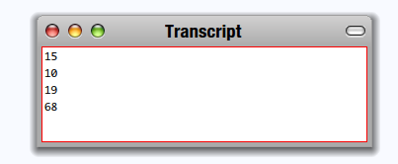
#(15 10 19 68) do:
[ :i | Transcript show: i ; cr ]

Slide 61
1 to: 100 do:
[ :i | Transcript show: i ; space]

Slide 62
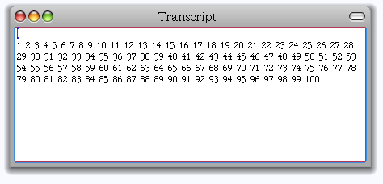
1 to: 100 do:
[ :i | Transcript show: i ; space]

Slide 63
1 to: 100 by: 3 do:
[ :i | Transcript show: i ; space]

Slide 64
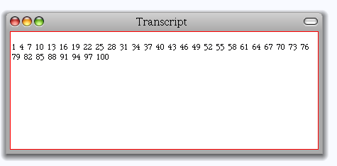
1 to: 100 by: 3 do:
[ :i | Transcript show: i ; space]

Slide 65
A typical method in Point
Method name
Argument
Comment
<= aPoint
"Answer whether the receiver is neither
below nor to the right of aPoint."
^ x <= aPoint x and: [y <= aPoint y]
Return
Binary message
Block
Instance variable
Keyword message
(2@3) <= (5@6)
true

Slide 66
Creating classes
Send a message to a class (!)
Number subclass: #Complex
instanceVariableNames: 'real imaginary'
...
category: 'ComplexNumbers'

Slide 67
1.0
+ Major Cleanups (MVC, eToys)
+ New UI Look / TrueType
+ Tools
+ Block Closures (thanks Qwak)
+ Lots of bugfixes and small improvements
+ Preferences clean up
+ MIT license clean

Slide 68
Update ~1200 Bug-reports closed
470 Updates
Release Candidate: October 2009

Slide 69
Future

Slide 70
...cleaner
started to run SmallLint... and fix

Slide 71
...better
I.1 has a lot of fixes and improvements

Slide 72
...smaller
small image is 2 Mb

Slide 73
...faster

Slide 74
What we dream about
A flexible infrastructure to be able to
reinvent itself
Better tools
next generation refactoring
Better infrastructure
Announcements
New compilers
First class packages
Minimal core
Logging
Integration Server....
So that people can invent their future

Slide 75
Everybody can help
Reporting bugs
Confirming bugs
Writing tests
Writing examples
Writing comments
Simple contributing fixes
Deep discussion...

Slide 76
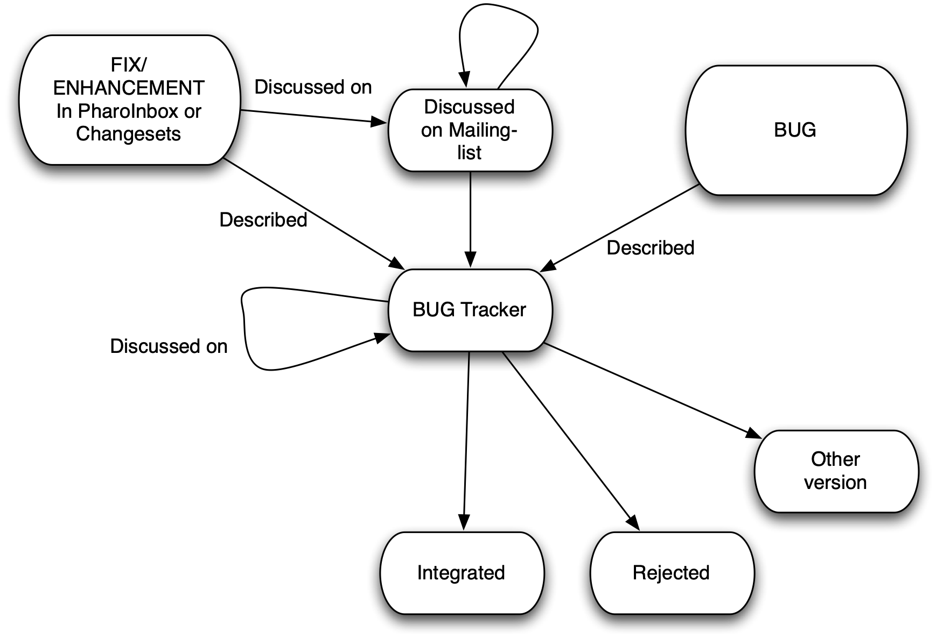
Process

Slide 77
Pharo Sprints
May 2008 Bern
July 2009 Bern
October 2009 Lille
November 2009 Buenos Ares
Free access

Slide 78
Books
Pharo by example vol. 1 is out
Pharo by example vol. 2 on preparation

Slide 79
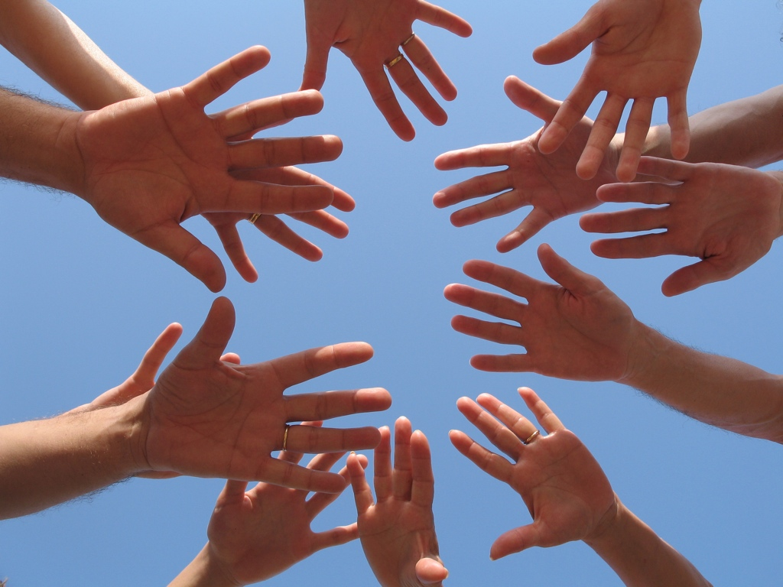
Thanks
Matthew Fulmer
Hilaire Fernandes
Julian Fitzell
Tudor Girba
Sean Glazier
Norbert Hartl
Dale Henrichs
Reinout Heeck
Eric Hochmeister
Keith Hodges
Henrik Sperre Johansen
Pavel Krivanek
Adrian Kuhn
Adrian Lienhard
Andreas Leidig
Mariano Martinez Peck
Dave Mason
John McIntosh
Johnaton Meichtry
Eliot Miranda
Hernan Morales Durand
Philipp Marshall
Jannick Menanteau
Yann Monclair
Oscar Nierstrasz
Hans Beck
Alexandre Bergel
Cedric Beler
Torsten Bergmann
Matthias Berth
Ralph Boland
Noury Bouraqadi
Brian Brown
Gwenael Casaccio
Damien Cassou
Nicolas Cellier
Gary Chambers
Miguel Coba
Gabriel Cotelli
Carlos Crosetti
Cyrille Delaunay
Simon Denier
Marcus Denker
Ramiro Diaz Trepat
Stephane Ducasse
Morales Durand Hernan
Stephan Eggermont
Luc Fabresse
David J Pennell
Joseph Pelrine
Alain Plantec
Damien Pollet
Lukas Renggli
Jorge Ressia
Mike Roberts
Robert Rothwell
David Rotlisberger
Michael Rueger
Bill Schwab
Niko Schwarz
Igor Stasenko
Francois Stephany
Serge Stinckwich
Mathieu Suen
Lawrence Trutter
Andrew Tween
martin von loewis
Andres Valloud
Juan Vuletich
Steven Wirts
Hernan Wilkinson

Slide 80
Join Us!
Creating good energy, software quality,
learning and having fun
http://pharo-project.org

