Slide 1
A clean, innovative, open-source Smalltalk environment
http://www.pharo-project.org

Slide 2
What?
A progressive, open-source Smalltalk platform for professional use.
Stable
Bugs fixed fast
But innovative

Slide 3
What?
A flexible environment to support the research of new language concepts.
Stable
Bugs fixed fast
But innovative

Slide 4
What?
Pharo = Language + IDE
Pure Object-Oriented Language
Dynamically Typed

Slide 6
Update ~750 Bug-reports closed
377 Updates
Release Planned: August 2009 ;)

Slide 7
Current Actions
Based on Squeak Smalltalk
+ Major Cleanups (MVC, eToys)
+ New UI Look / TrueType
+ Tools
+ Block Closures
+ Lots of bugfixes and small improvements
+ Preferences clean up
+ MIT license clean

Slide 8
What we dream about
Better tools
next generation refactoring
SmallLint ++
Other MOPs
First class slots
Better infrastructure
Announcements
New compilers
First class packages
Minimal core
“Metacello”
Logging
Integration Server....
That people can build their future

Slide 10
Pier

Slide 11
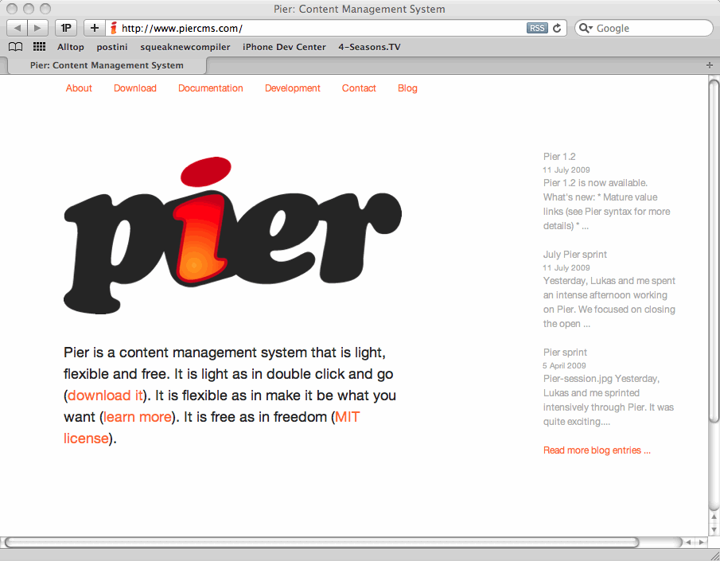
Pier

Slide 12
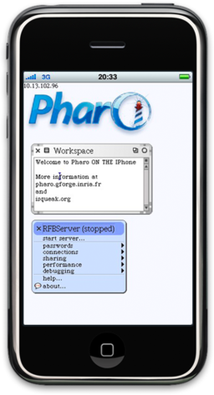
iPhone

Slide 13
Smalltalk with OO-Database
Pharo is the IDE

Slide 14
Companies
netstyle.ch
cmsbox
Pinesoft
Smallworks
Agilitic.be
Inceptive.be
GemStone
...

Slide 15
Universities
Annecy
Lugano
Bern
Douai
Lille
Santiago
Bruxelles
...

Slide 16
(Why? The little history)
1996: discover Smalltalk
1998: discover Squeak
~2000: harvesters 3.xx, 3.6, 3.7, started to clean
Responsible for Squeak3.9
Tried to clean without breaking unmaintained code
Called “random refactorer”, got bashed...
Marcus got burnt, Stef wanted to look at Python, Ruby...
Saw lot of people turn off by Squeak lack of consideration for good code
Pharo is keeping our smalltalk inside flame burning

Slide 17
Future

Slide 18
...cleaner
started to run SmallLint... and fix

Slide 19
...smaller
Pavel’s image is 2 Mb

Slide 20
...faster

Slide 21
Everybody can help
Reporting bugs
Confirming bugs
Writing tests
Writing examples
Writing comments
Simple contributing fixes
Deep discussion...

Slide 22
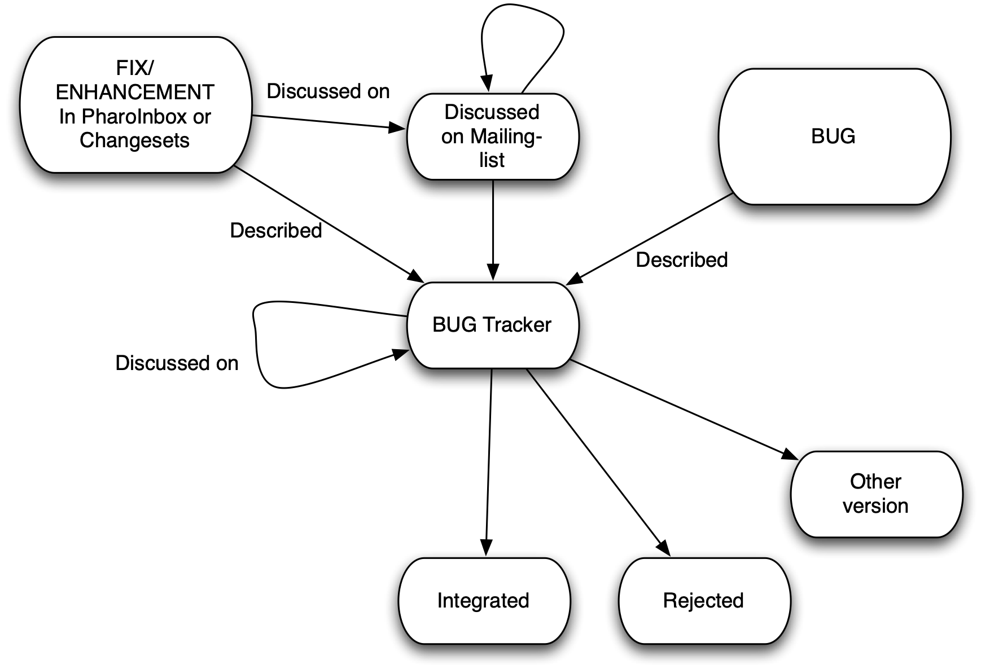
Process

Slide 23
Pharo Sprints
May 2008 Bern
July 2009 Bern
October 2009 Lille
November 2009 Buenos Ares
Free access
Possible funding support for October 2009

Slide 24
Books
Pharo by example is out
Pharo by example vol. 2 on preparation

Slide 25
Thanks
Matthew Fulmer
Hilaire Fernandes
Julian Fitzell
Tudor Girba
Sean Glazier
Norbert Hartl
Dale Henrichs
Reinout Heeck
Eric Hochmeister
Keith Hodges
Henrik Sperre Johansen
Pavel Krivanek
Adrian Kuhn
Adrian Lienhard
Andreas Leidig
Mariano Martinez Peck
Dave Mason
John McIntosh
Johnaton Meichtry
Eliot Miranda
Hernan Morales Durand
Philipp Marshall
Jannick Menanteau
Yann Monclair
Oscar Nierstrasz
Hans Beck
Alexandre Bergel
Cedric Beler
Torsten Bergmann
Matthias Berth
Ralph Boland
Noury Bouraqadi
Brian Brown
Gwenael Casaccio
Damien Cassou
Nicolas Cellier
Gary Chambers
Miguel Coba
Gabriel Cotelli
Carlos Crosetti
Cyrille Delaunay
Simon Denier
Marcus Denker
Ramiro Diaz Trepat
Stephane Ducasse
Morales Durand Hernan
Stephan Eggermont
Luc Fabresse
David J Pennell
Joseph Pelrine
Alain Plantec
Damien Pollet
Lukas Renggli
Jorge Ressia
Mike Roberts
Robert Rothwell
David Rotlisberger
Michael Rueger
Bill Schwab
Niko Schwarz
Igor Stasenko
Francois Stephany
Serge Stinckwich
Mathieu Suen
Lawrence Trutter
Andrew Tween
martin von loewis
Juan Vuletich
Steven Wirts
Hernan Wilkinson

Slide 26
Join Us!
Creating good energy, software quality,
learning and having fun
http://pharo-project.org

