Slide 1
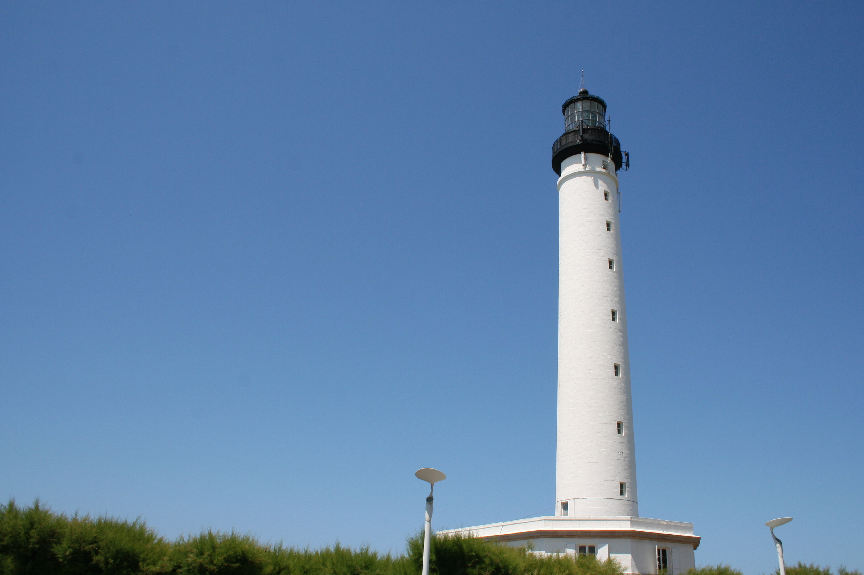
Pharo: Live objects for complex projects
http://stephane.ducasse.free.fr
http://www.pharo.org

Slide 2
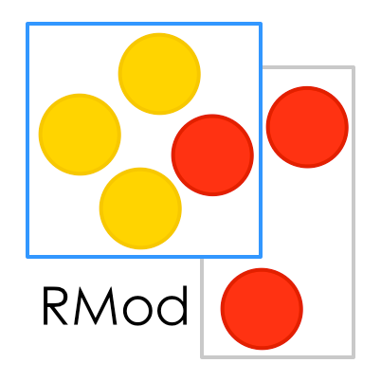

Slide 3
A word of presentation

Slide 4
Expert in language design
Traits in Php7.0, Perl60
Influenced Traits in Scala

Slide 5
Expert in maintenance
Program analysis, Metamodels, visualization, testing, refactorings, metrics….

Slide 6
Pharo!
System: Pure object language + full IDE
Powerful, elegant and fun to program
Great community
Living system under your fingers
Works on Mac OSX, Linux(es), iOS, Windows, Pi, and “android”
100% MIT

Slide 7
Elegant!
Full syntax on a postcard
Simple and powerful objet model

Slide 8
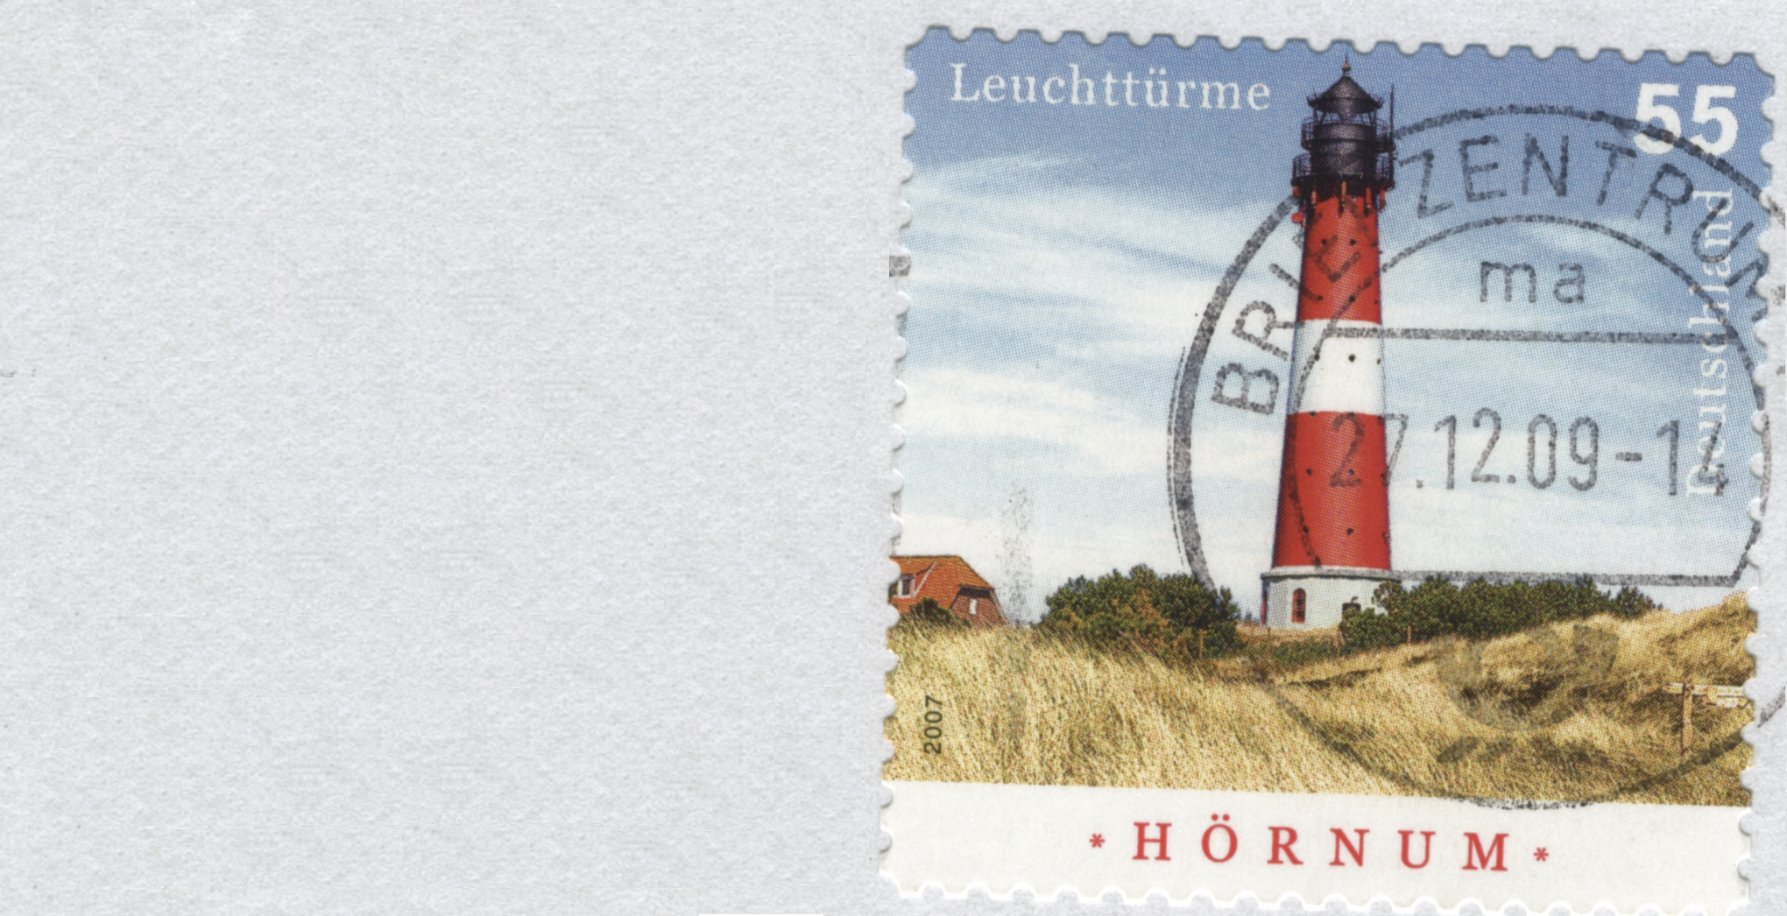

Slide 9
Yes the full Syntax!

Slide 10
Yes there is nothing else…

Slide 12
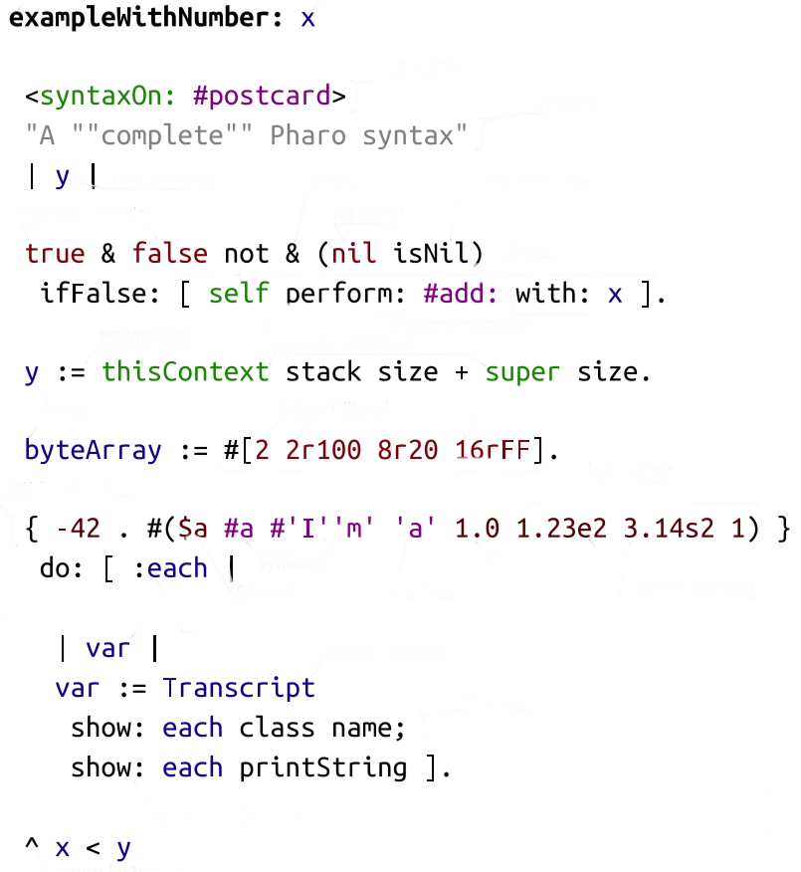

Slide 13
method
parameter
annotation
comment
return

Slide 14
parameter
local var
affectation
instance var
local var

Slide 15
closure
arg closure

Slide 16
binary msg
keyword msg
unary msg
cascade
separator
binary msg

Slide 17
array
character
symbol
number
string

Slide 18
A Pure World of Objects
Only objects + messages + closures!
mouse, booleans, arrays, numbers, strings, windows, scrollbars, canvas, files, trees, compilers, sound, url, socket, fonts, text, collections, stack, shortcut, streams, …

Slide 19
A Full Uniform Model
Dynamically typed
Everything is an object instance of a class
All methods are public virtual
All attributes are protected
Single inheritance with traits

Slide 20
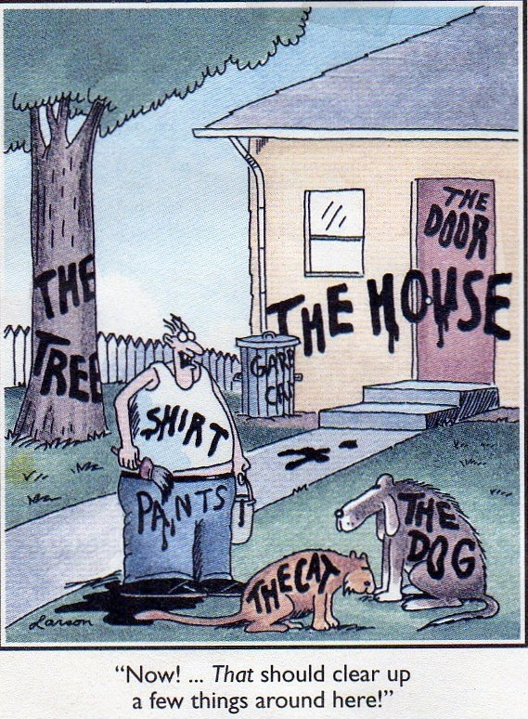
Less is more!
No constructors, no static methods, no operators
No type declaration, no primitive types,
No interfaces, no need for factory
No packages/private/protected modifiers
No parametrized types
No boxing/unboxing
Still powerful

Slide 21
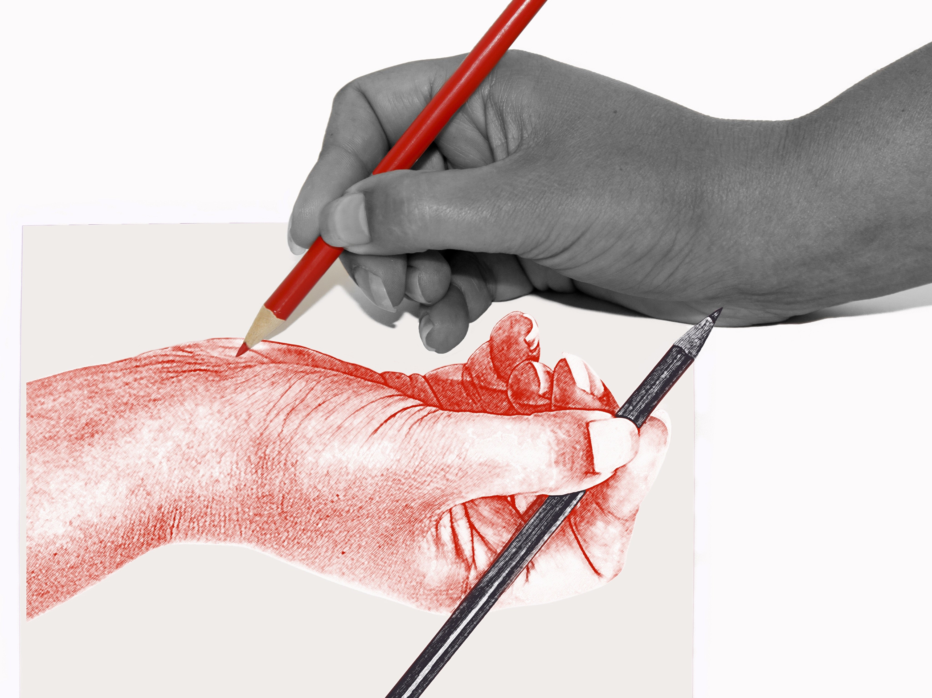
Fully Written in Itself
Everything is written in Pharo
One simple syntax/model to access everything

Slide 22
Pharo is highly immersive

Slide 23
Immersing…
Pharo is not a blackbox
Pharo is fully inspectable and reflective
but there is more

Slide 24
You are immersed and interacting
You can interact with live objects

Slide 26
We can do the same with web app, sockets, networks, sensors, living programing….

Slide 27
Hackers
scripting live the coffee machine

Slide 28
Hackers @
work

Slide 29
Our goal...

Slide 30
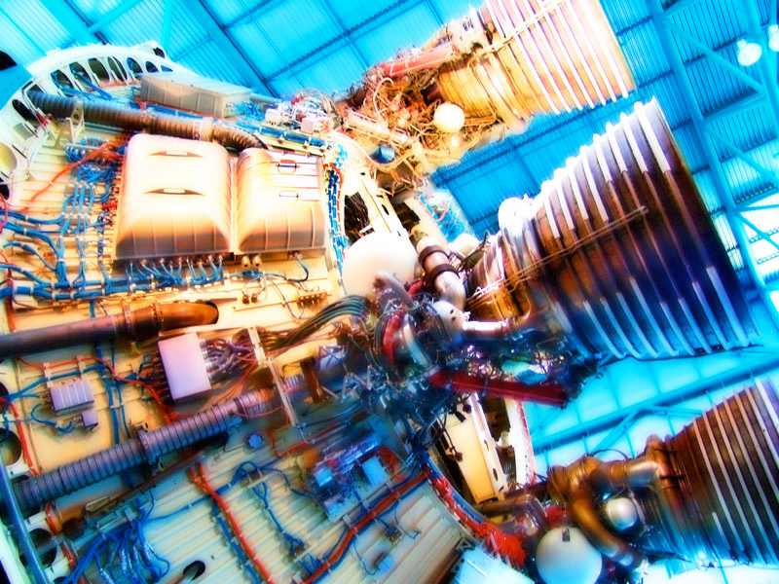
A powerful engine
to invent (y)our future

Slide 31
An ecosystem where innovation/business bloom

Slide 32
… that **you** can make money with Pharo.
… to be able to invent solutions to existing problems.
… a powerful innovative dynamic language where we can build (y)our future.

Slide 33
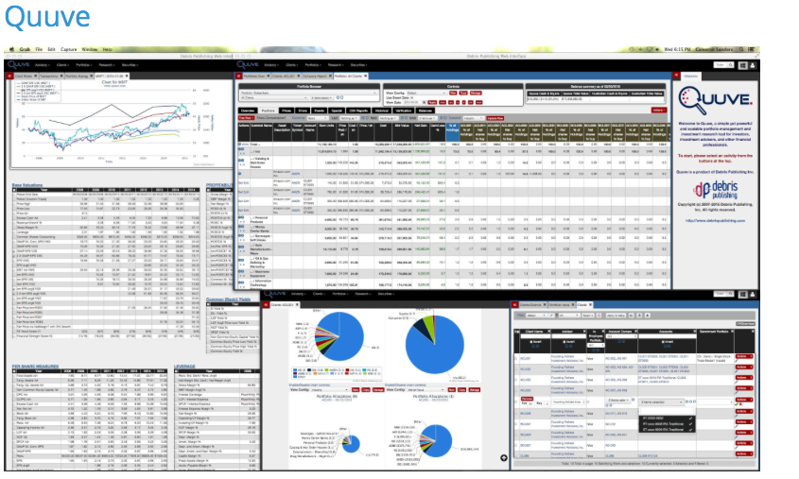
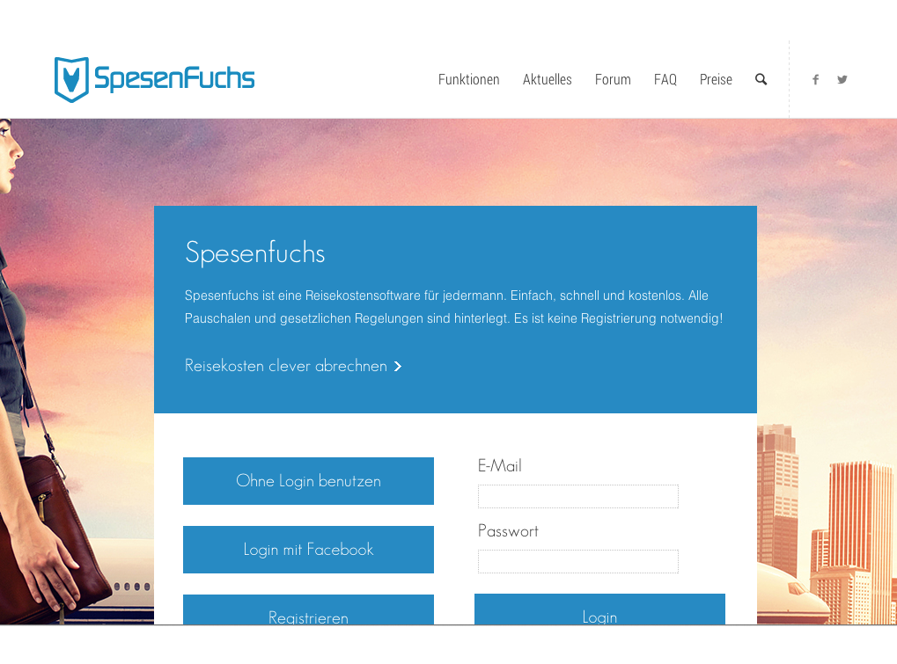
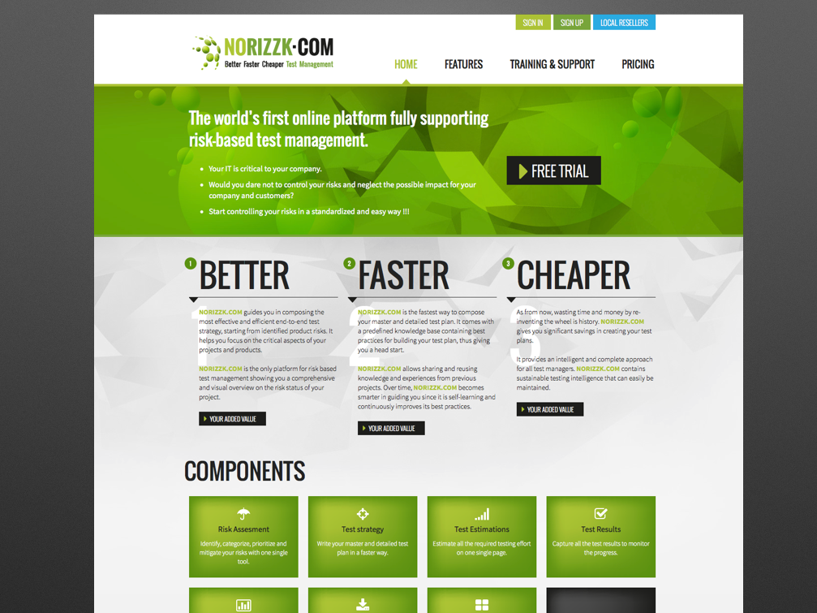
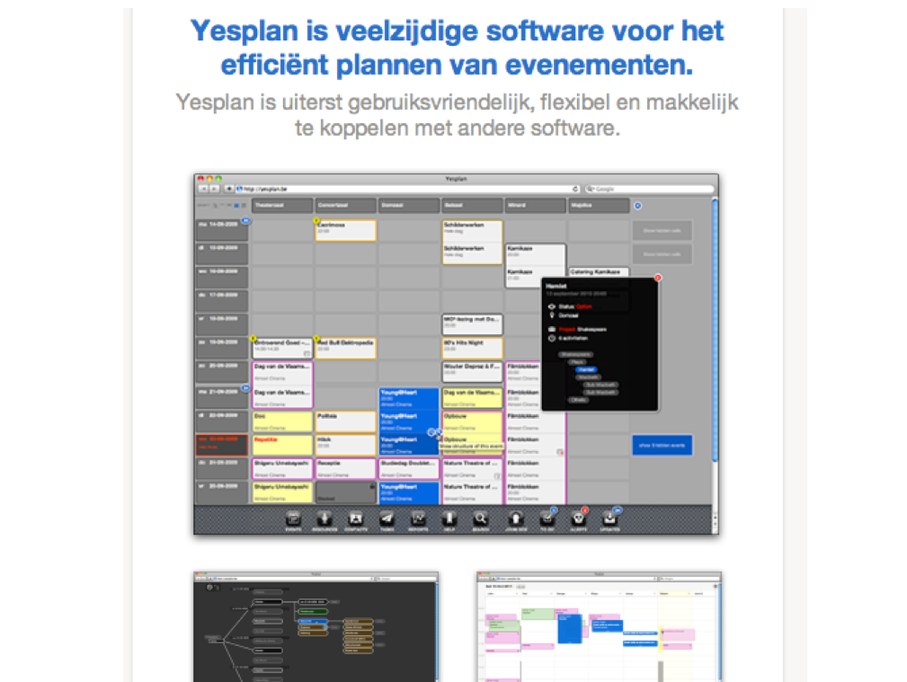
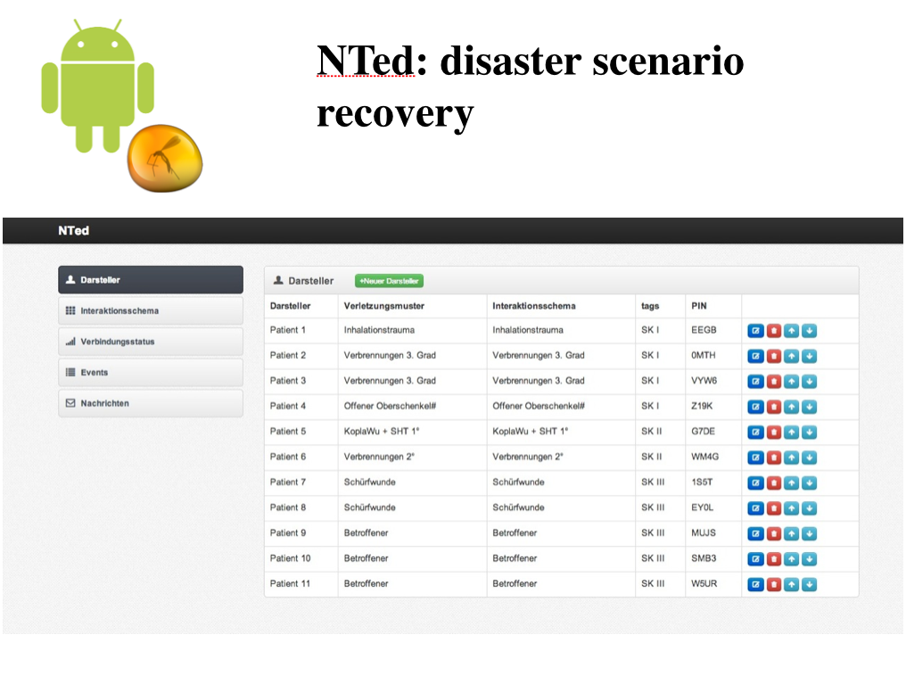
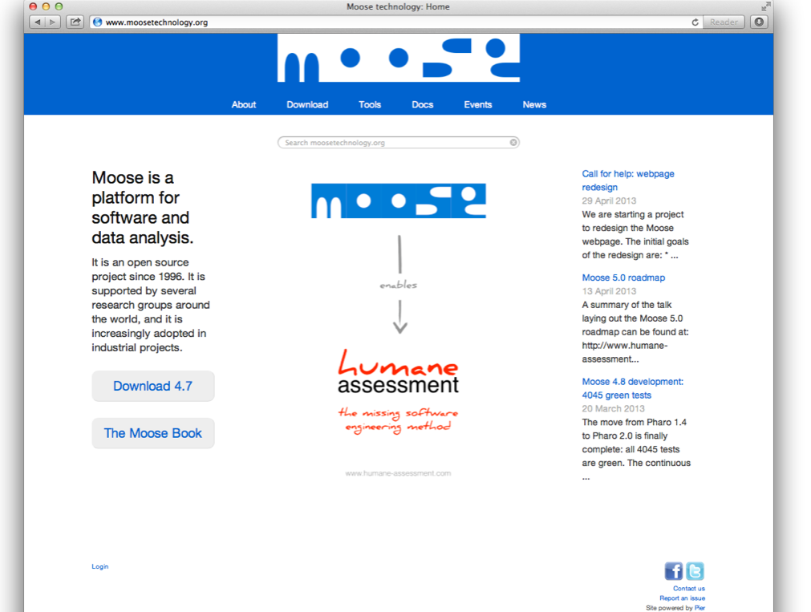
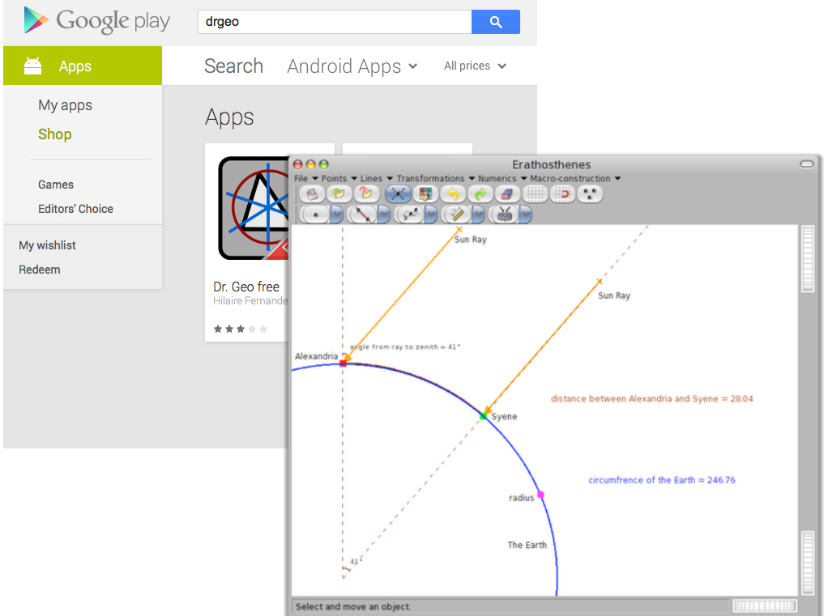
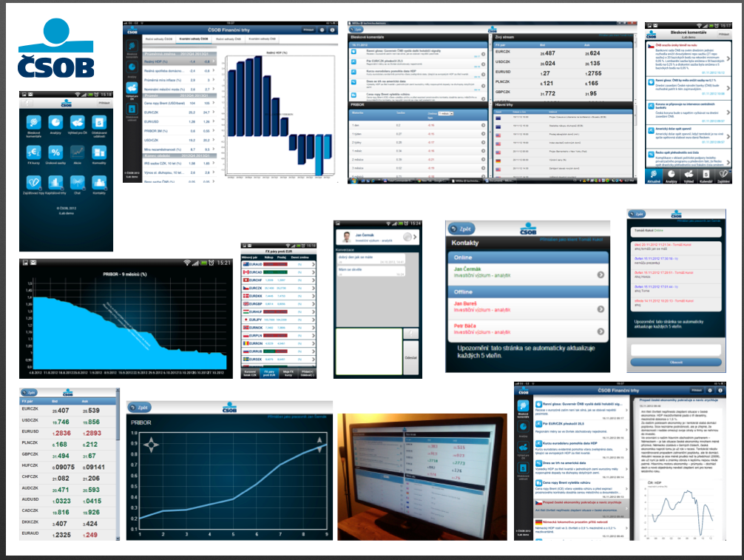
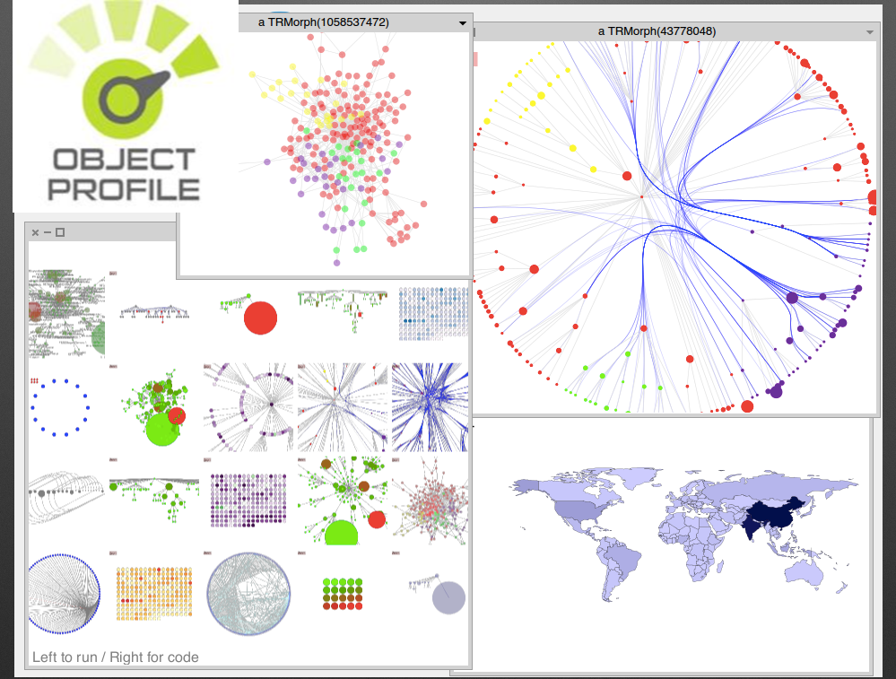
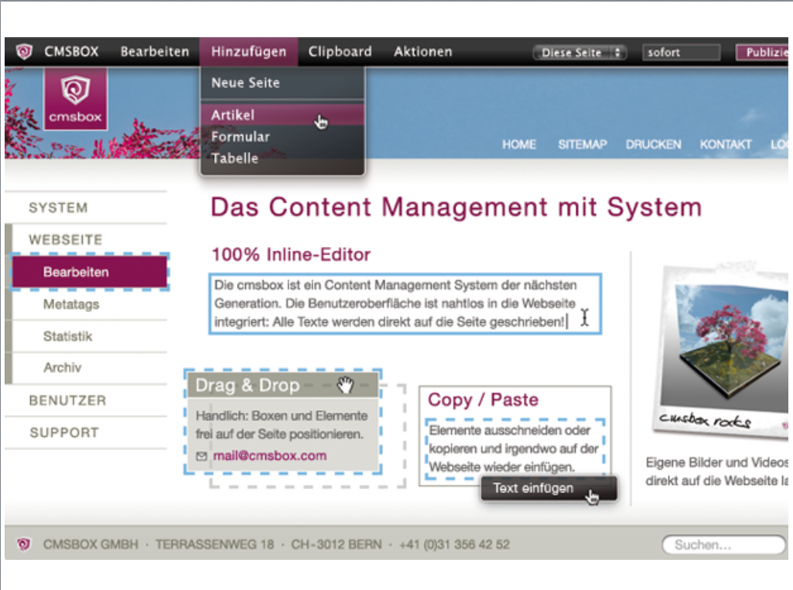
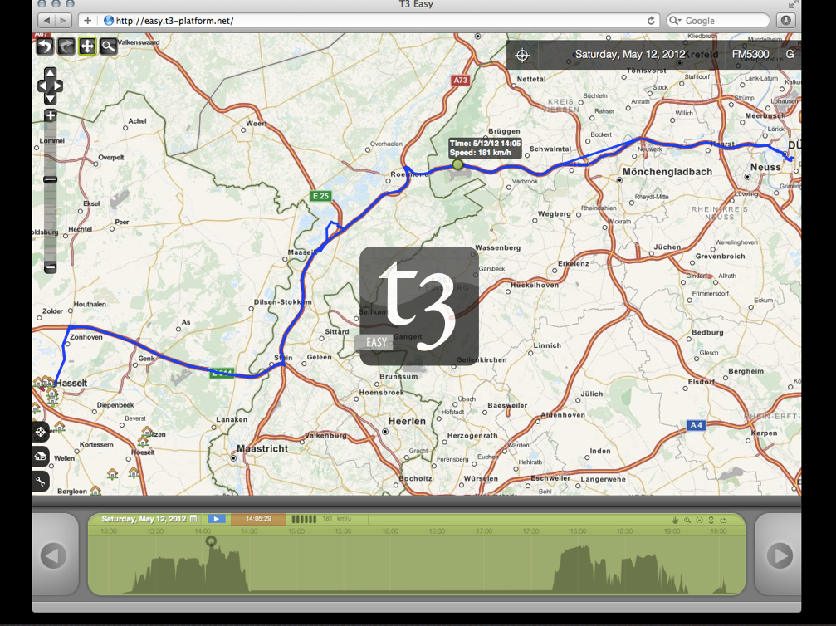

Slide 34
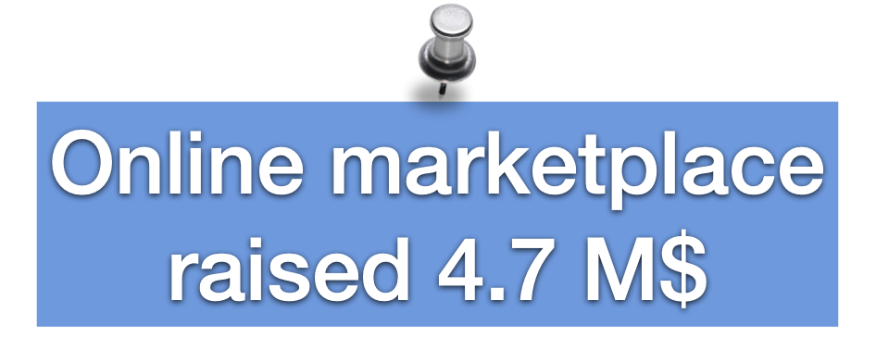

Slide 35
Pharo in ATM like Device in Moscow

Slide 36
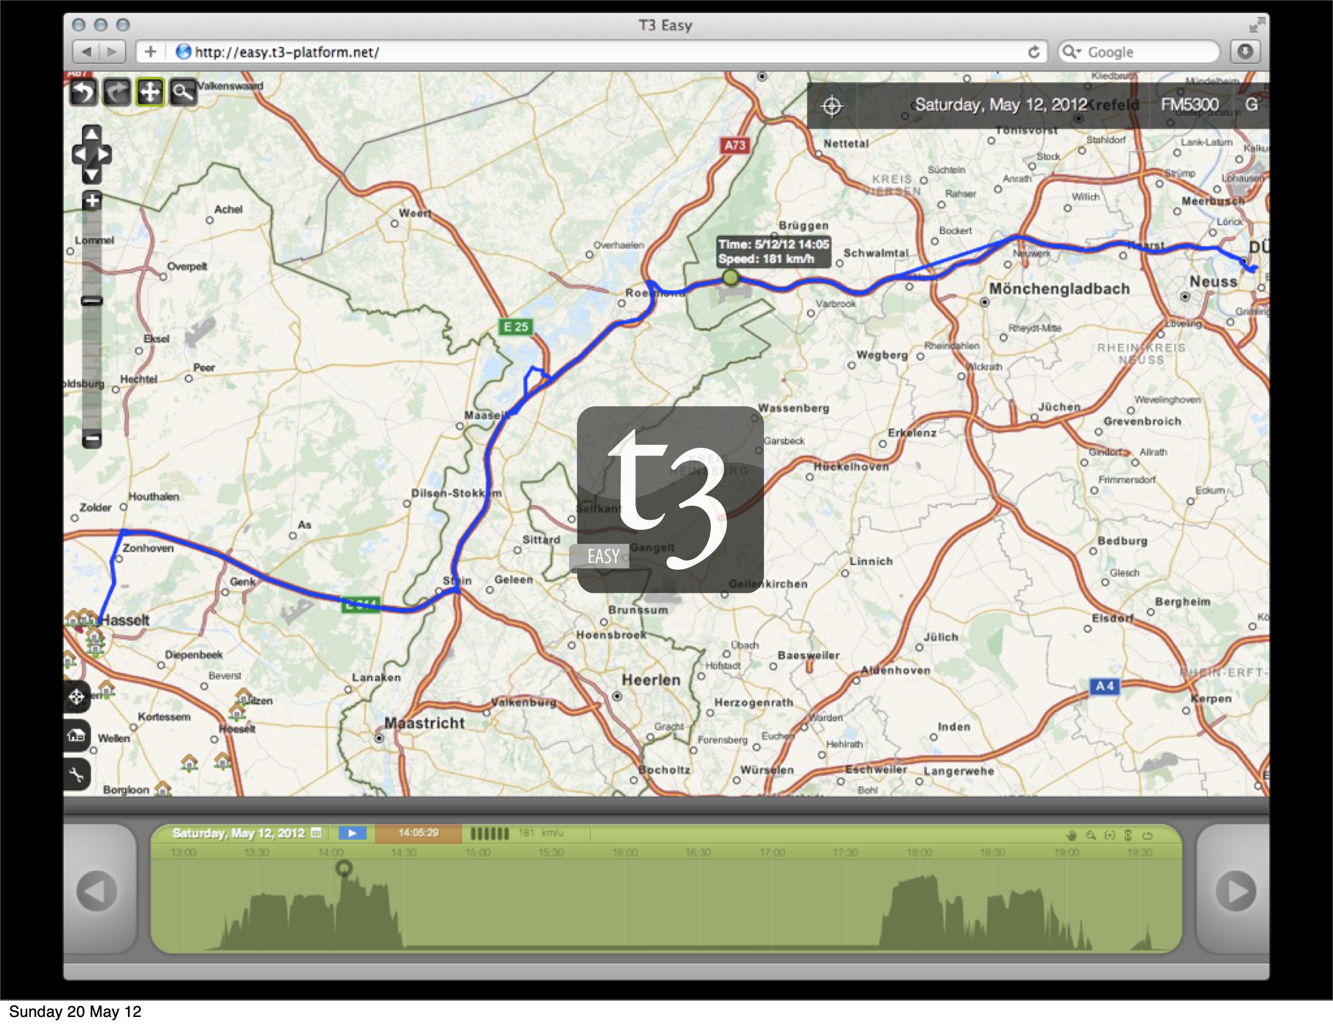
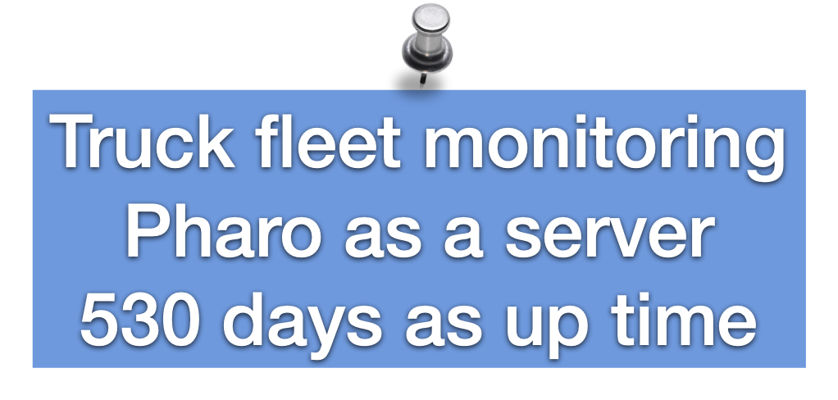

Slide 37
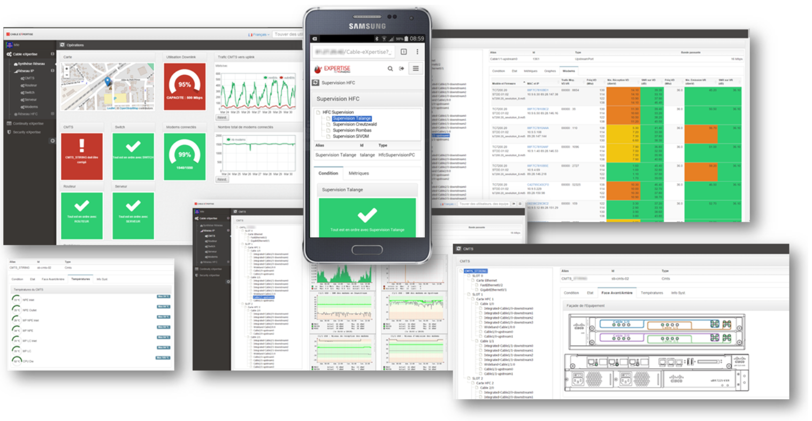

Slide 38
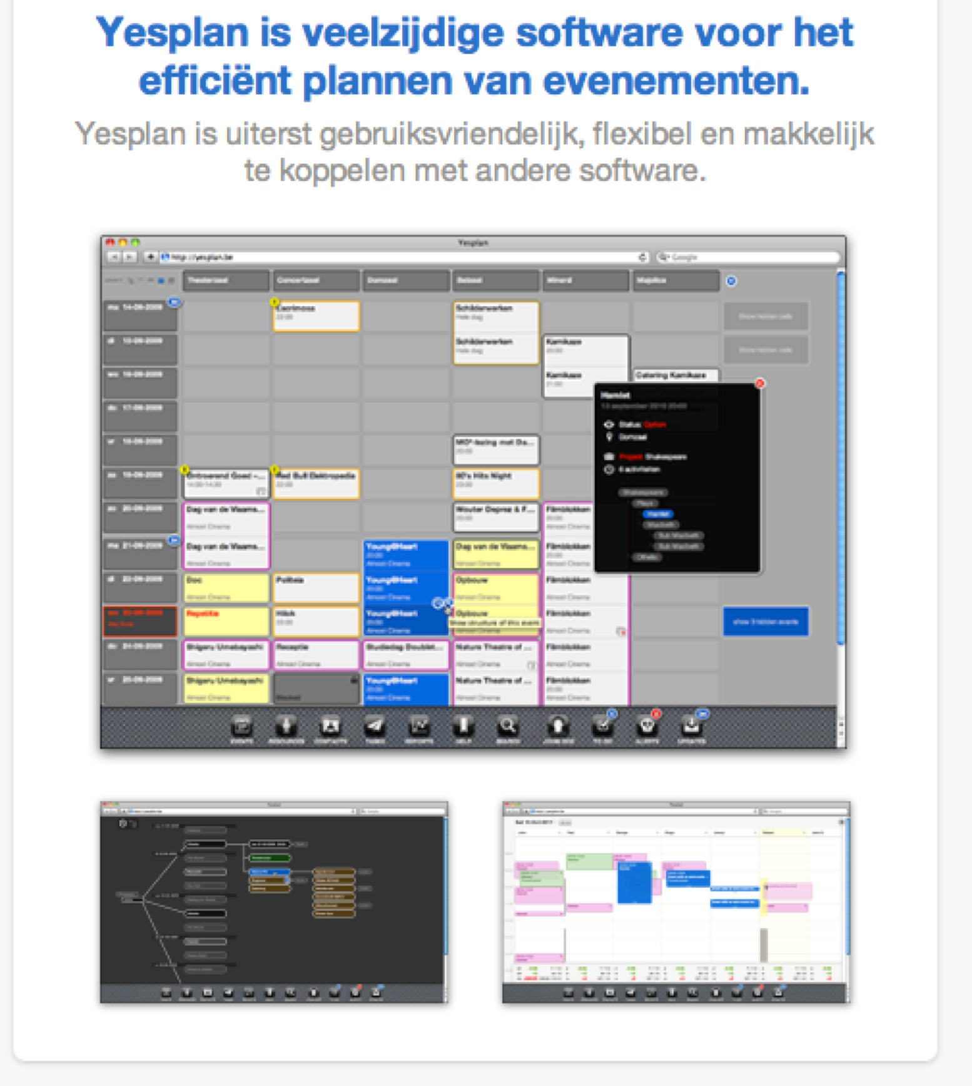

Slide 39
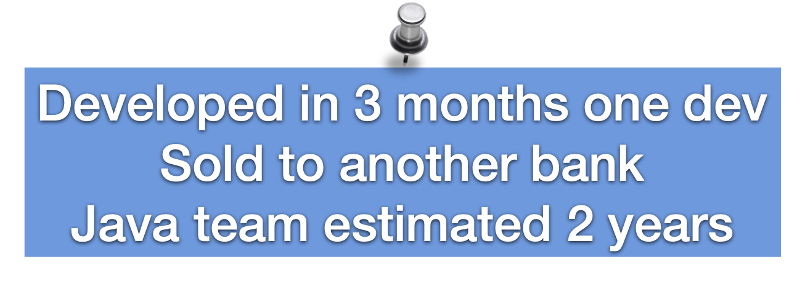

Slide 42
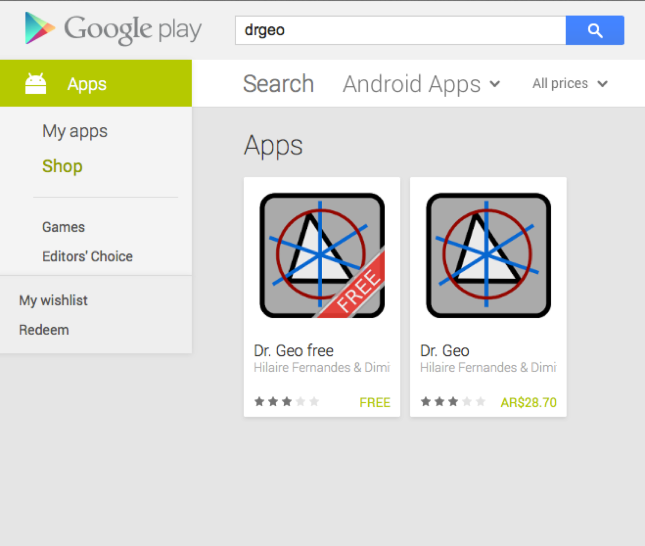
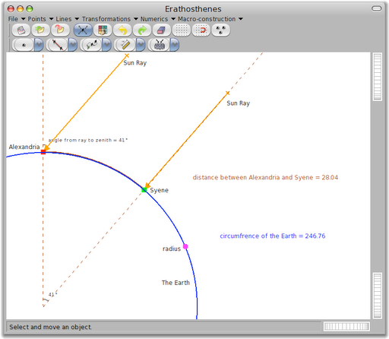

Slide 43
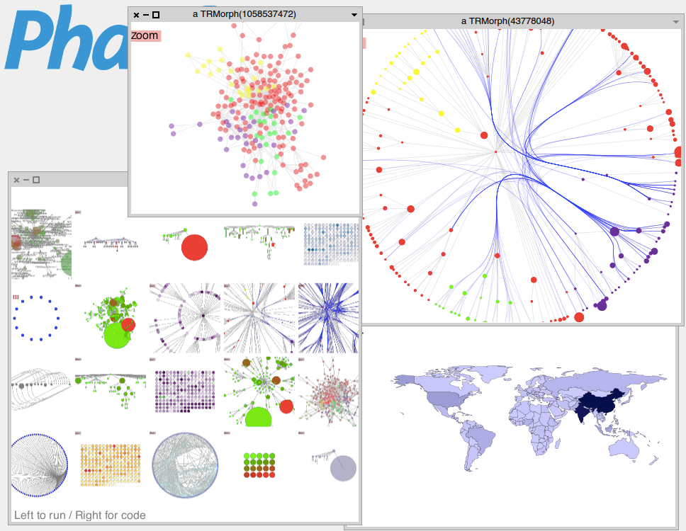

Slide 44
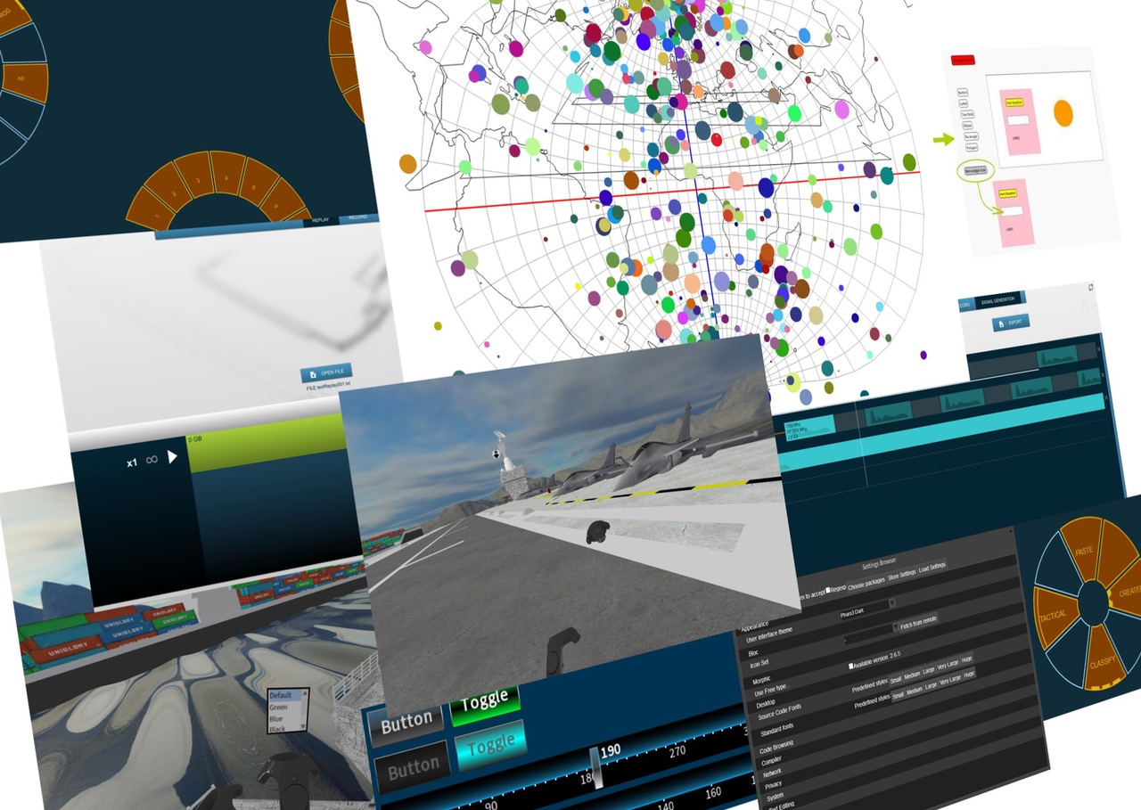
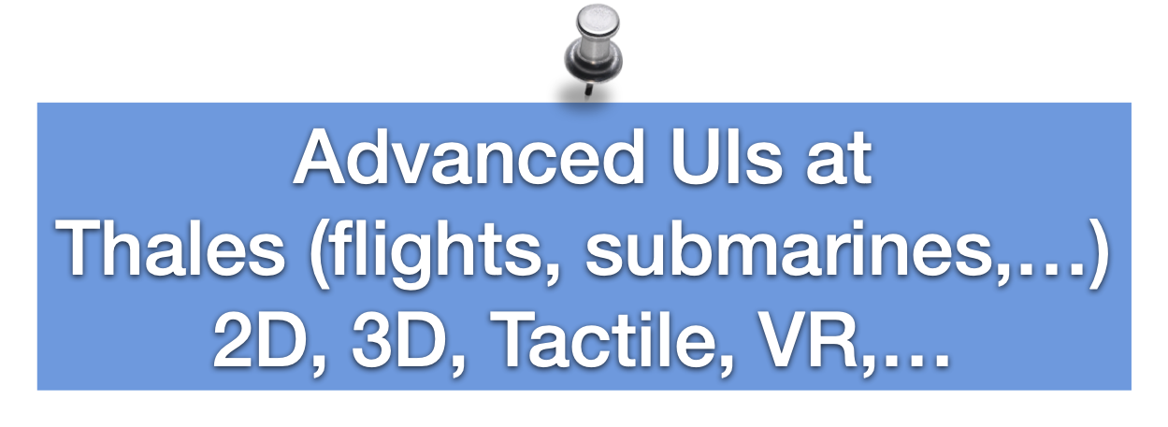

Slide 45
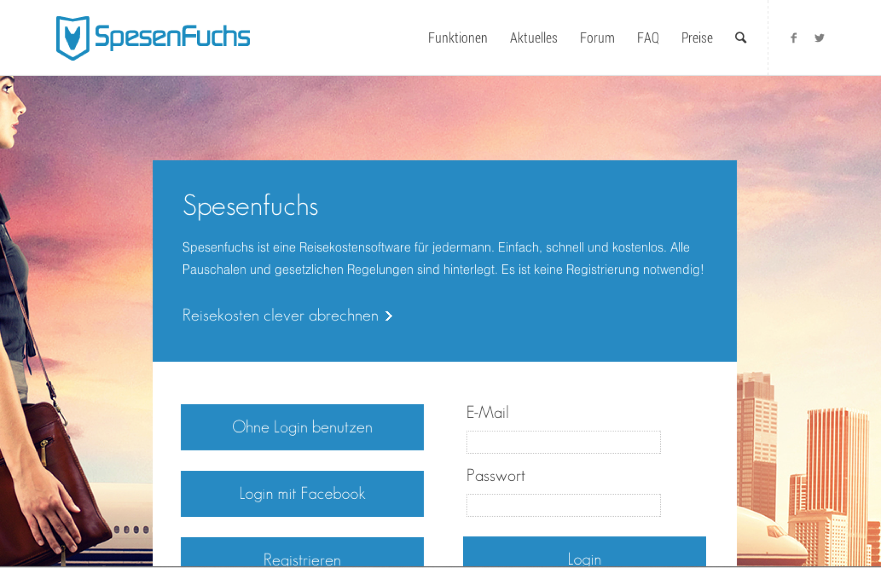

Slide 46
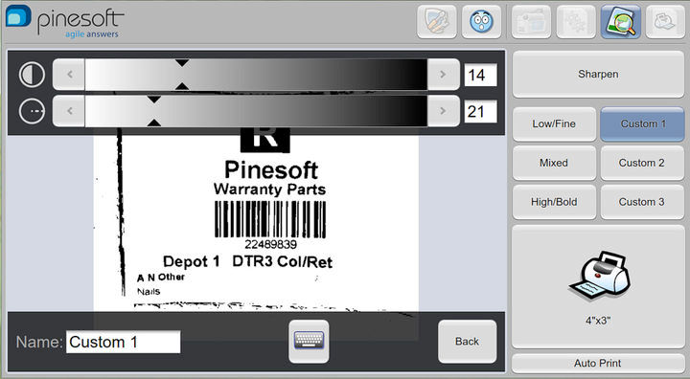

Slide 47
A cool community

Slide 48
More Pharo's Teachers
• Uni. of Buenos Aires • Uni. of Bern • Uni. of Maroua • Uni. of Brussels • Ecole des Mines de Douai • Uni. de Savoie • CULS Prague • Uni. of Quilmes • Uni. of La Plata • Northern Michigan Uni. • Uni. Technologica Nacional (UTN) • Uni. Catholic of Argentina • Uni. of Santiago • Uni. Policnica de Catalunya • Uni. de Bretagne Occidentale • Uni. of Tomsk • Uni. of Fernhagen • IT University of Copenhagen • Uni. Cat del Sacro Cuore of Brescia • Uni. of Yaounde • Uni. Maroua • Uni. of Lomé • INFI • Uni. of Lyon • Uni. of Cagliari • Uni. of Cordoba • Uni. Ryerson • Uni. Comchabamba • Uni. Monterrey • USTH • ENIT

Slide 49
International Research Groups
Lafhis (AR)
SCG (CH) CAR (FR) RMOD (FR)
Ummisco (IRD)
Reveal (CH)
Lysic (FR)
ENSTA-Bretagne (FR)
CEA-List (FR)
Ryerson (CAN)
OC (FR)
CCMI-FIT (CZ)
ASERG (BR)
Pleiad (CL) Macau (UNO)
Cirad (FR)
USTH (Vietnam)
Soft-Qual (Serbia)
Uni. Quilmes (AR)
ENIT (FR)
Cochabamba (Bo)
Maroua (CAM)
ETS (CAN)

Slide 50
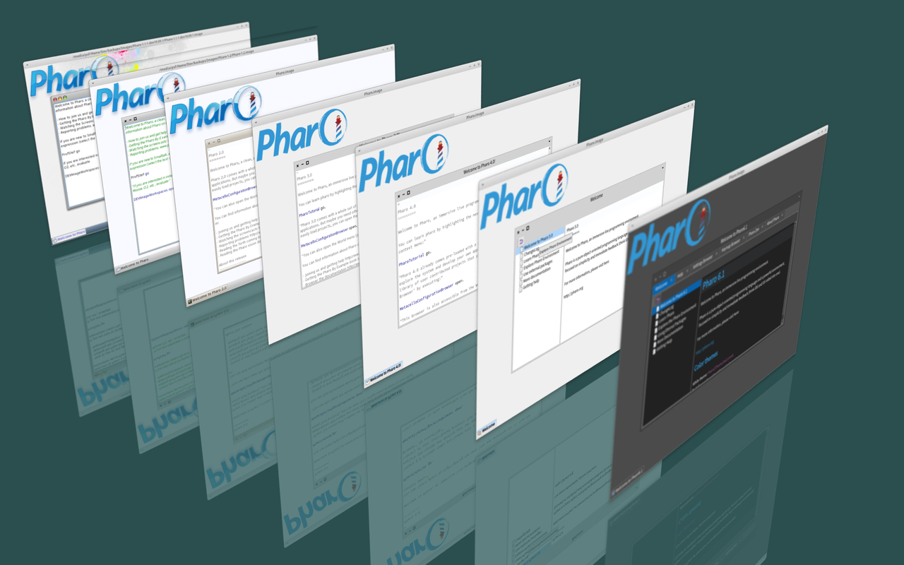
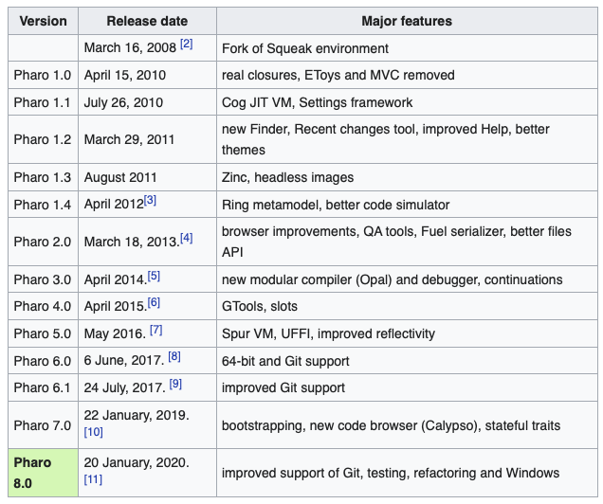
Since May 2008

Slide 51
Pharo in Numbers
Since 2008
Language Core + IDE + Tools + Frameworks
710 packages (tests included)
~ 25000 tests
5 platforms
# 9 400 classes
# 130 000 methods
61 Mb (64 bits)
http://github.com/pharo-project/Pharo (~220 forks, 15/123 contributors)
Growing ecosystem
polymath
pharo-graphics
pharo-gis
pharo-container
pharo-ai

Slide 52
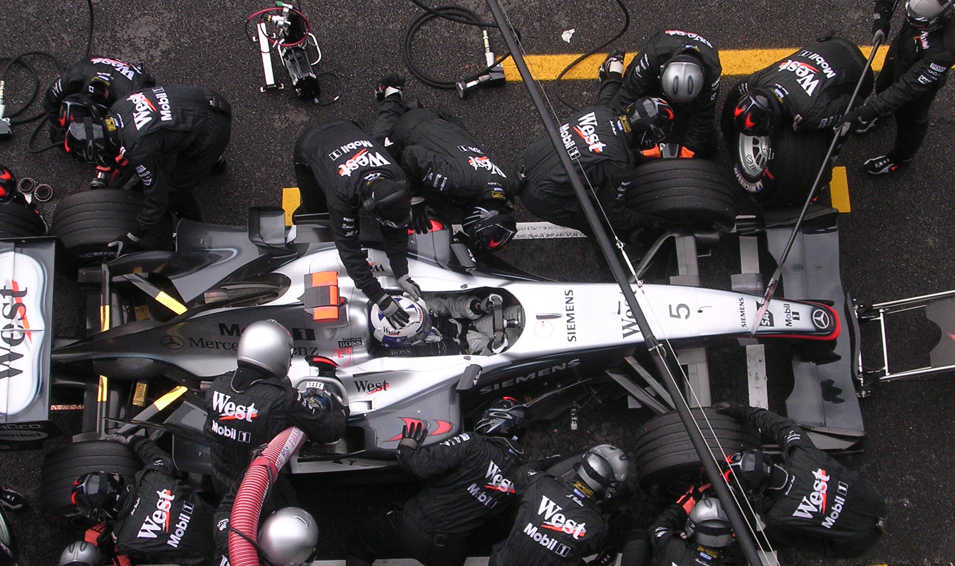
Pharo is our vehicle
We improve it everyday

Slide 53
Of course not everything
is perfect :)
But it feels like

Slide 54
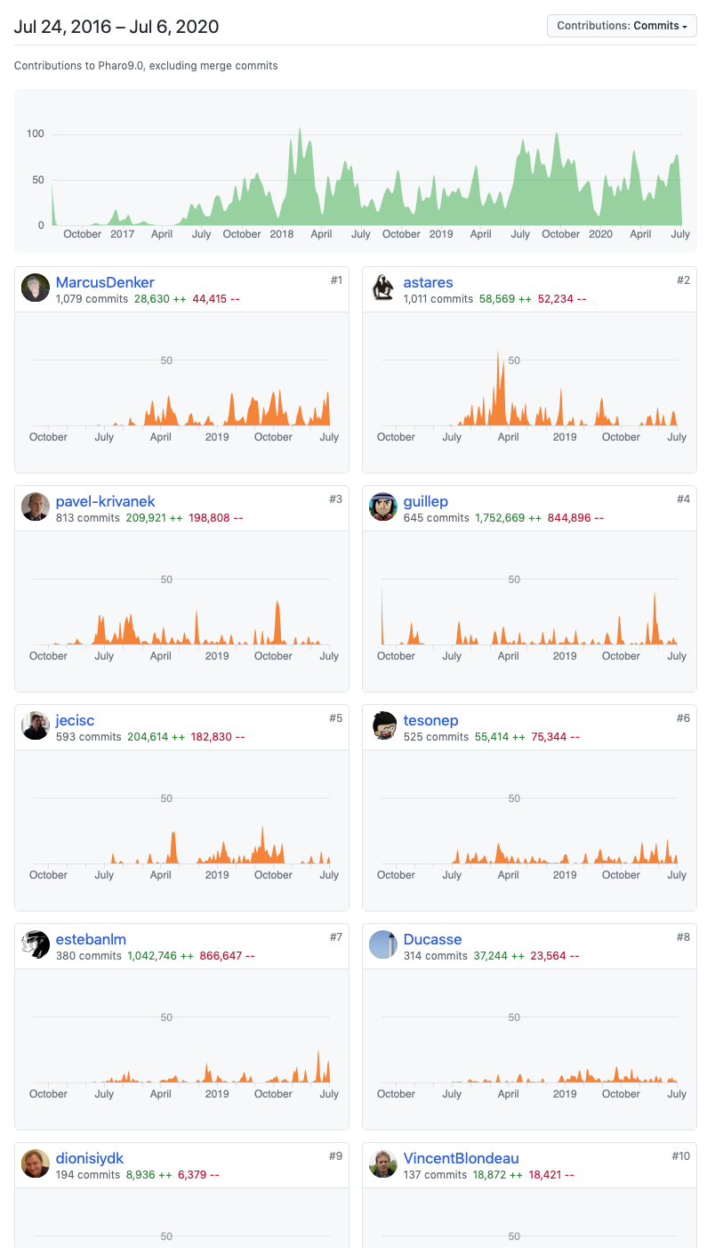
Not a single head
project
No truck factor
With multiple subprojects
Tools
UI, graphics
vcs

Slide 55
Pharo
is yours

Slide 56
Amazing moldable tools

Slide 57
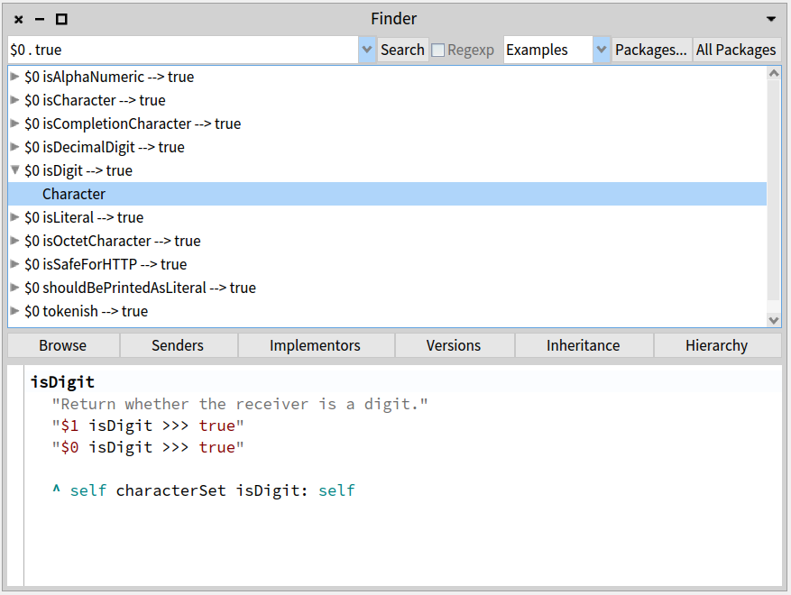
Example-based finder

Slide 58
Customized object interaction/presentation

Slide 59
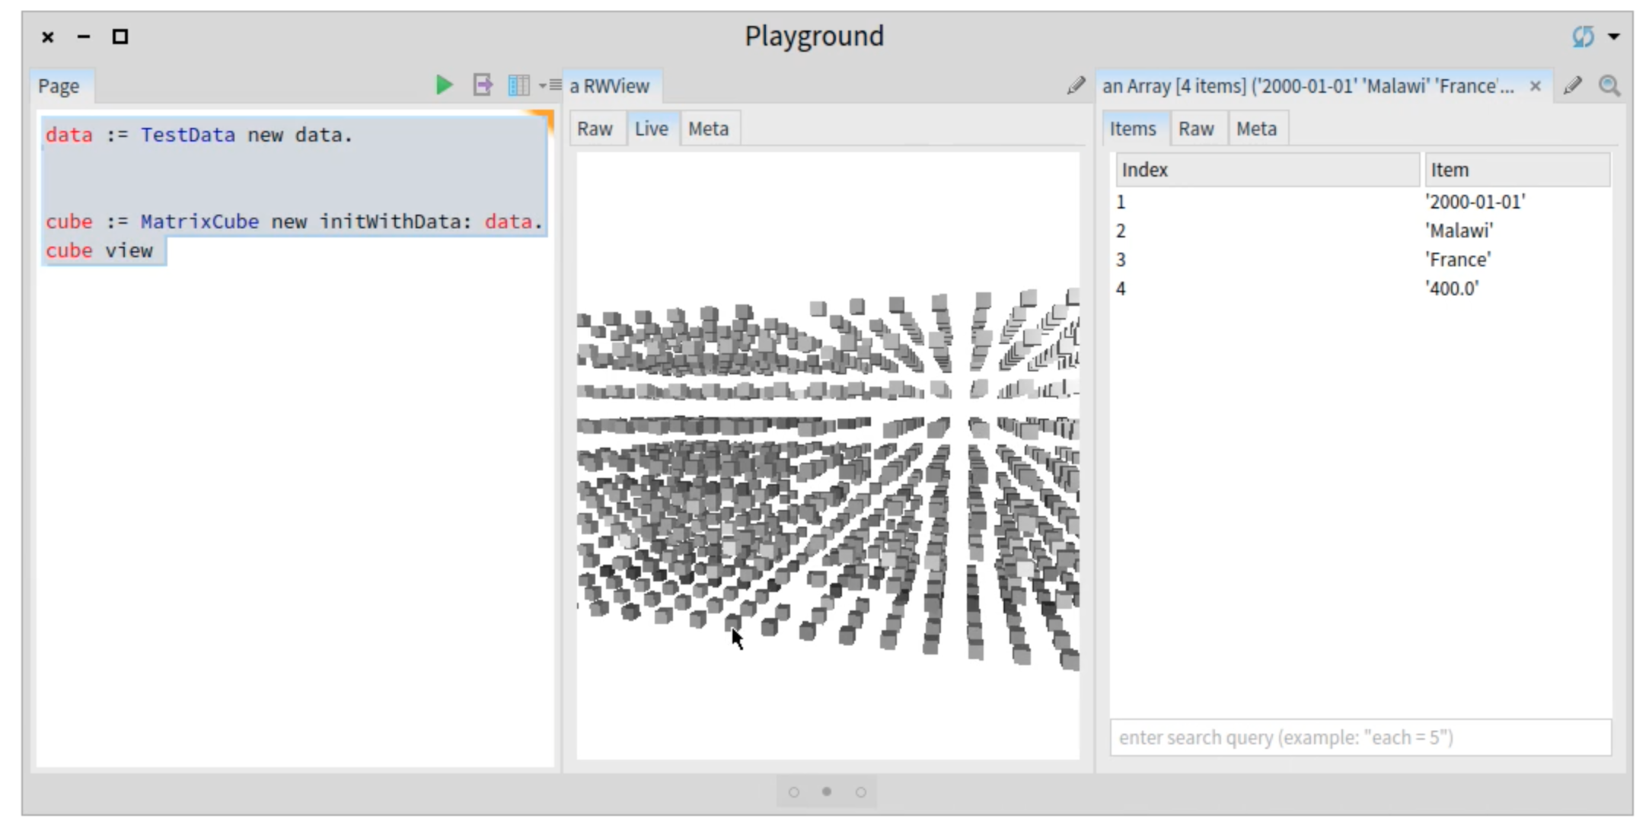

Slide 60
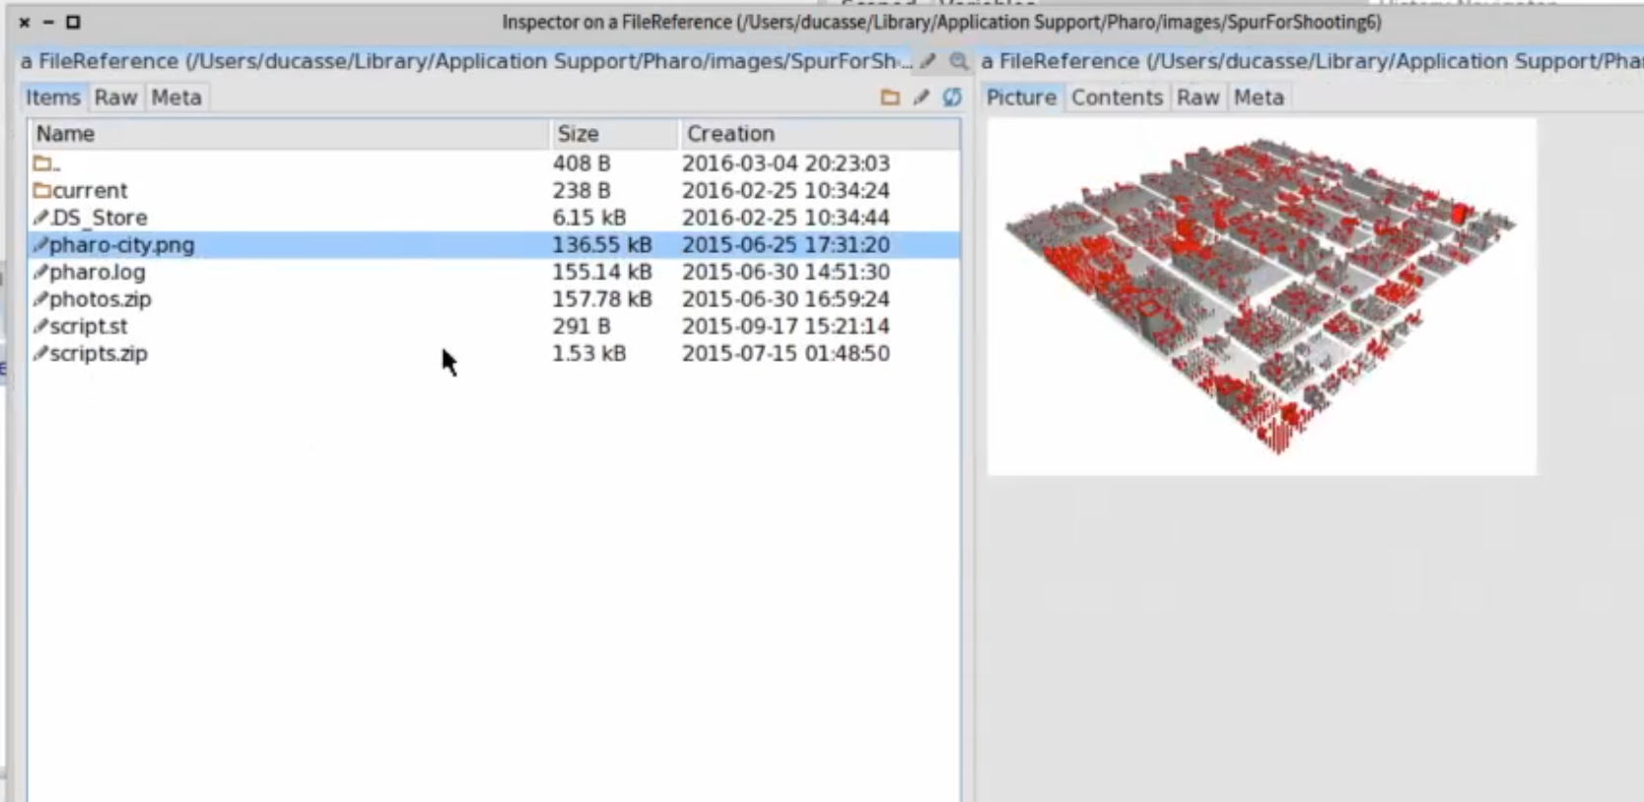

Slide 61
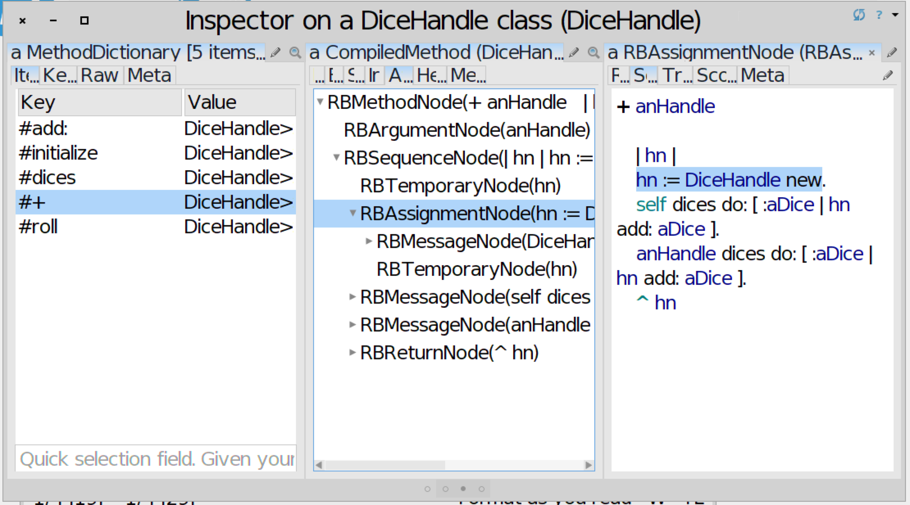

Slide 62
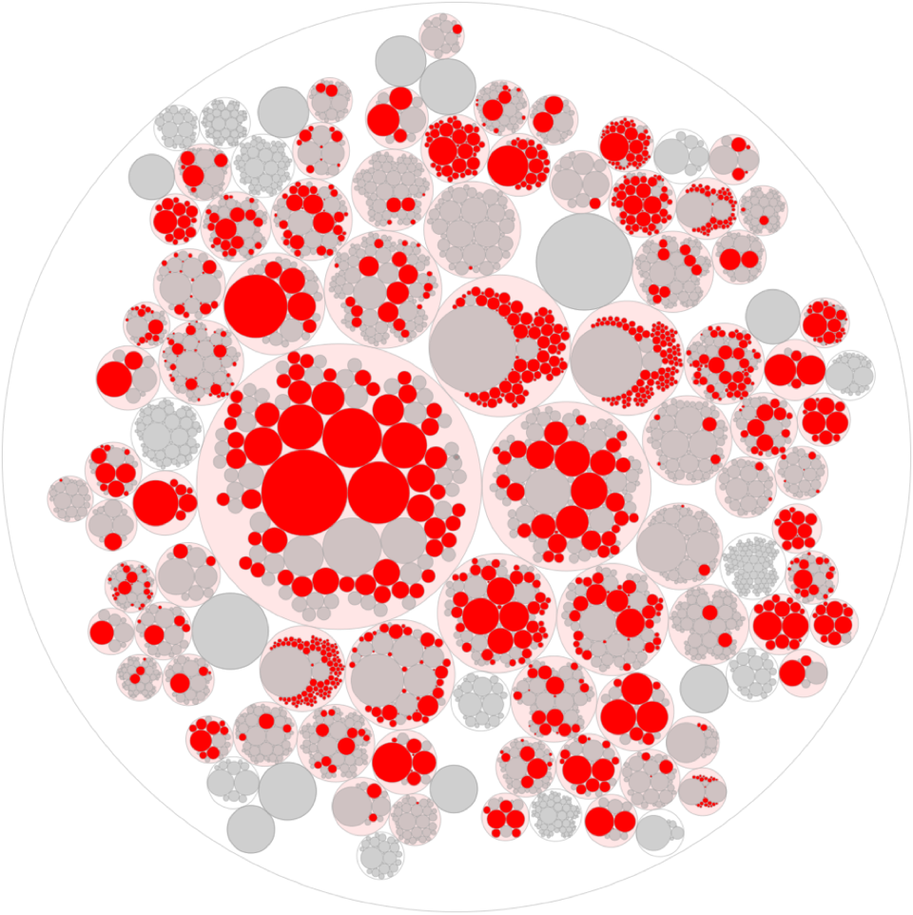
# of specific views developed by the community

Slide 63
Hot update on the spot customizable debugger

Slide 64
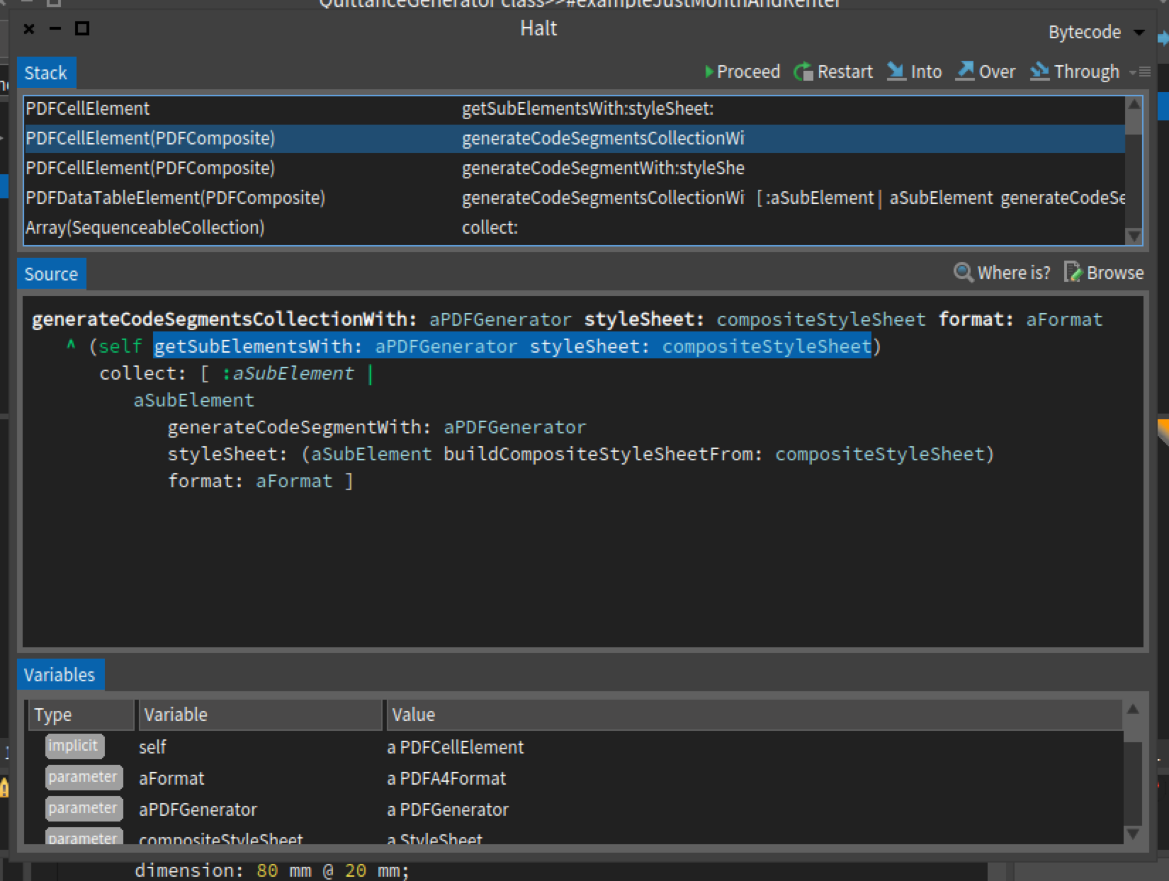

Slide 65
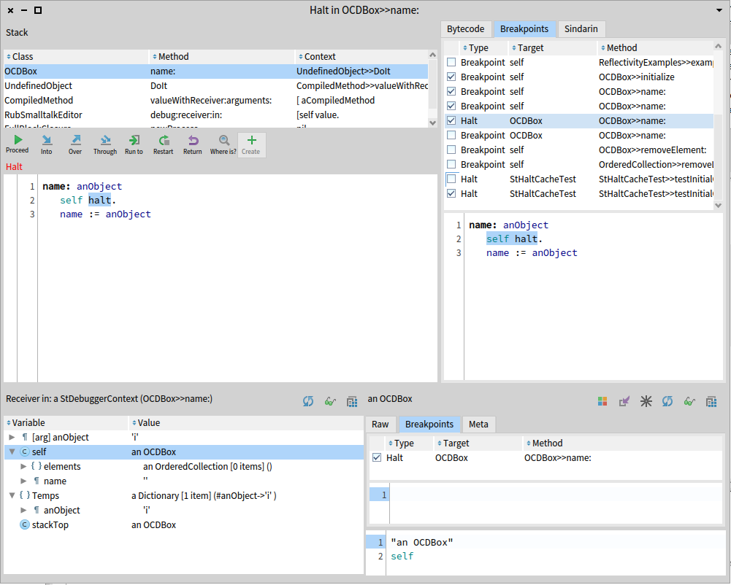
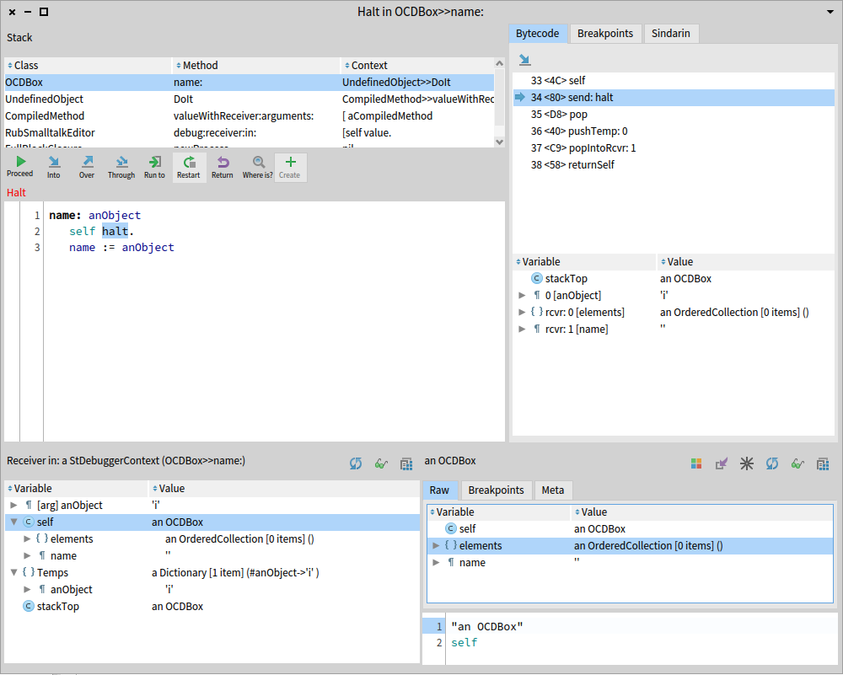
specific view

Slide 66
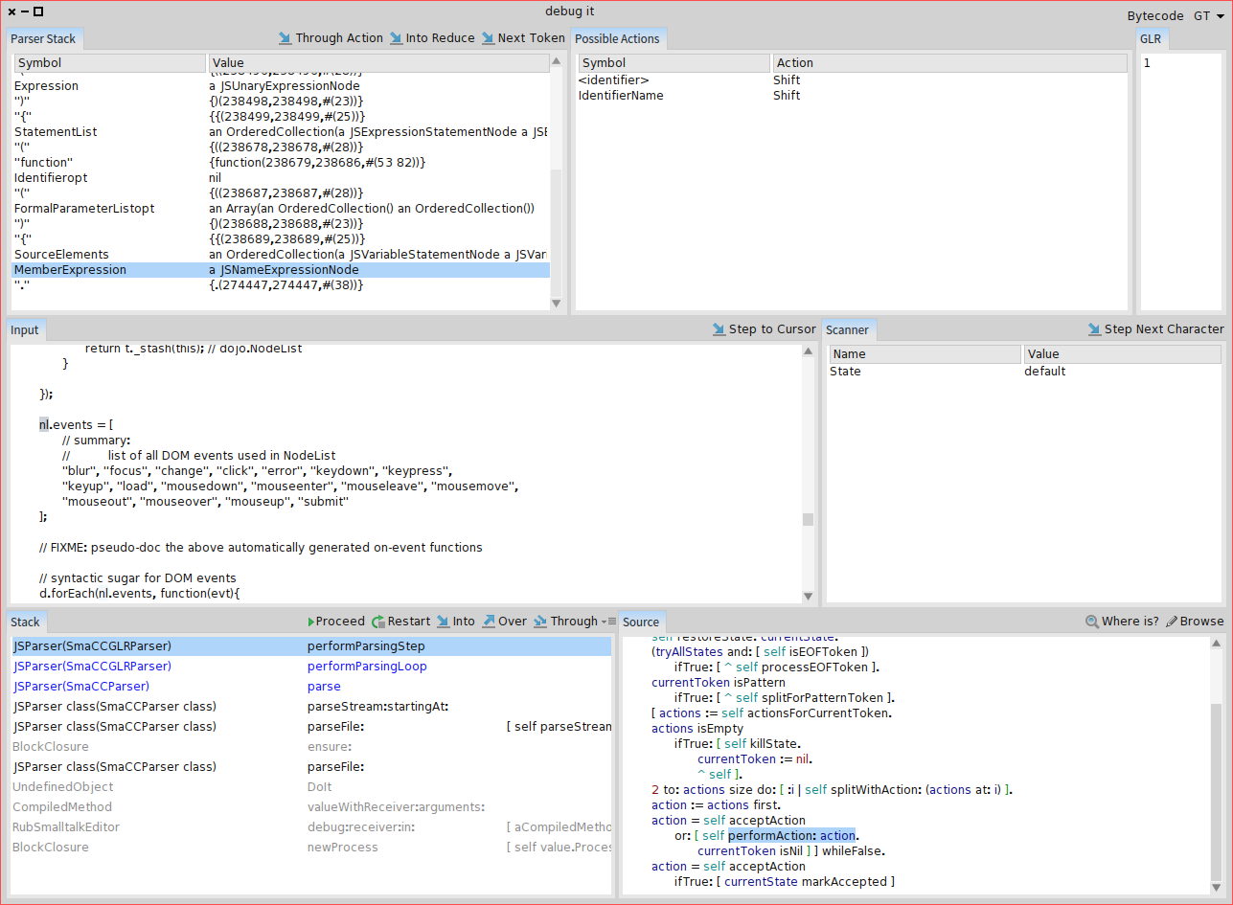
Hot update on the spot customizable debugger
A specific
parser compiler
debugger
Notes:
The top part of the debugger has the parser stack and potential actions. When you select either a node or token in the parser stack, the text in the input pane is highlighted. It should also update the possible actions list, but I haven’t implemented that yet — only the top of stack’s actions are currently displayed. If the parser is a glr parser, then it shows the glr list of all the potential parses. It should allow the user to select a different potential parse and see the stack for that parse, but that hasn’t been implemented yet. The scanner table only displays items when the debugger is in the middle of scanning the next token. Finally, I attached the normal debugger’s stack and source panes at the bottom so that you can do normal step/send debugger.
I implemented some step actions. The “Through Action” steps through the next shift/reduce/accept action. “Into Reduce” steps until a reduce method is run. The reduce methods are one place where a user can have code that isn’t automatically generated so I wanted to make it easy to step to their code. “Next Token” steps until we get another token from the scanner. Both the “Step to Cursor” and “Step Next Character” step in the scanner until some position is hit.
Both of the step actions can be slow when you are parsing a large file. I’d like to be able to run the code at normal speed, but insert a breakpoint (or something similar) that would break the code when the position is met. For example, in the step actions, I could just check at the end of executing SmaCCScanner>>step method if the position is at the desired location. Since the position only changes during the execution of this method, I don’t need to keep checking the condition while executing any other code.

Slide 67
Pharo Pro users
Get productivity boost
Xtreme TDD
write test,
test fails
code in debugger
Notes:
The top part of the debugger has the parser stack and potential actions. When you select either a node or token in the parser stack, the text in the input pane is highlighted. It should also update the possible actions list, but I haven’t implemented that yet — only the top of stack’s actions are currently displayed. If the parser is a glr parser, then it shows the glr list of all the potential parses. It should allow the user to select a different potential parse and see the stack for that parse, but that hasn’t been implemented yet. The scanner table only displays items when the debugger is in the middle of scanning the next token. Finally, I attached the normal debugger’s stack and source panes at the bottom so that you can do normal step/send debugger.
I implemented some step actions. The “Through Action” steps through the next shift/reduce/accept action. “Into Reduce” steps until a reduce method is run. The reduce methods are one place where a user can have code that isn’t automatically generated so I wanted to make it easy to step to their code. “Next Token” steps until we get another token from the scanner. Both the “Step to Cursor” and “Step Next Character” step in the scanner until some position is hit.
Both of the step actions can be slow when you are parsing a large file. I’d like to be able to run the code at normal speed, but insert a breakpoint (or something similar) that would break the code when the position is met. For example, in the step actions, I could just check at the end of executing SmaCCScanner>>step method if the position is at the desired location. Since the position only changes during the execution of this method, I don’t need to keep checking the condition while executing any other code.

Slide 68
The Pharo Stack is Gorgeous
Seaside, Rest, Zinc Rest, WebSockets
Magritte (meta application generator)
STON, JSON, LDAP...
Zinc, Zodiac(HTTPS), Oauth, ...
mySql/postgres… / NoSQL/ Mongo / Gemstone :)

Slide 69
Dynamic Web Applications with Seaside
http://book.seaside.st

Slide 70
A powerful, innovative and flexible framework
Dedicated to build complex Web applications
Live coding and debugging
Support reusable Web components
Secure by default
Web 2.0 support (Ajax, ...)
REST integration

Slide 71
Concentrate on
your application ...

Slide 72
... no manual
request parsing

Slide 73
... no XML
configuration files

Slide 74
Natural application
flow

Slide 75
Do not think in terms of pages…

Slide 76
..., but in stateful components

Slide 77
Pharo as a DSL for generating valid HTML

Slide 78
Secure by default
no injection

Slide 79
Development tools

Slide 80
http://books.pharo.org

Slide 81
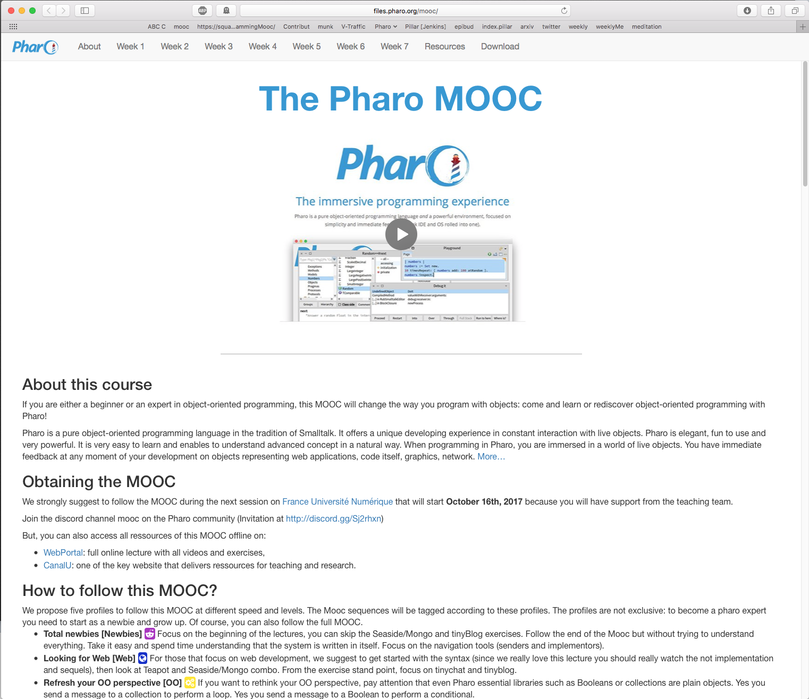
http://mooc.pharo.org

Slide 82
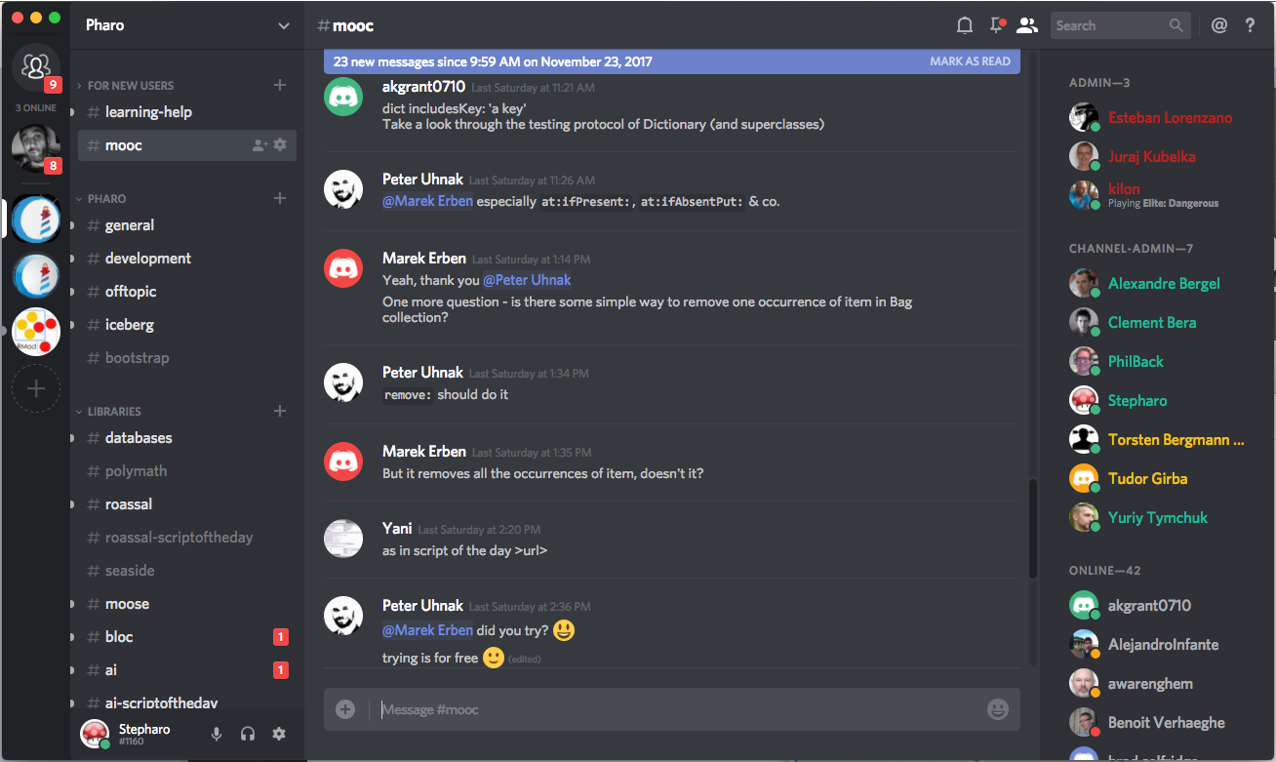
https://discord.gg/QewZMZa

Slide 83
About documentation
Full access to the system internal documentation
http://books.pharo.org
https://github.com/pharo-open-documentation/pharo-wiki
https://github.com/pharo-open-documentation/awesome-pharo

Slide 84
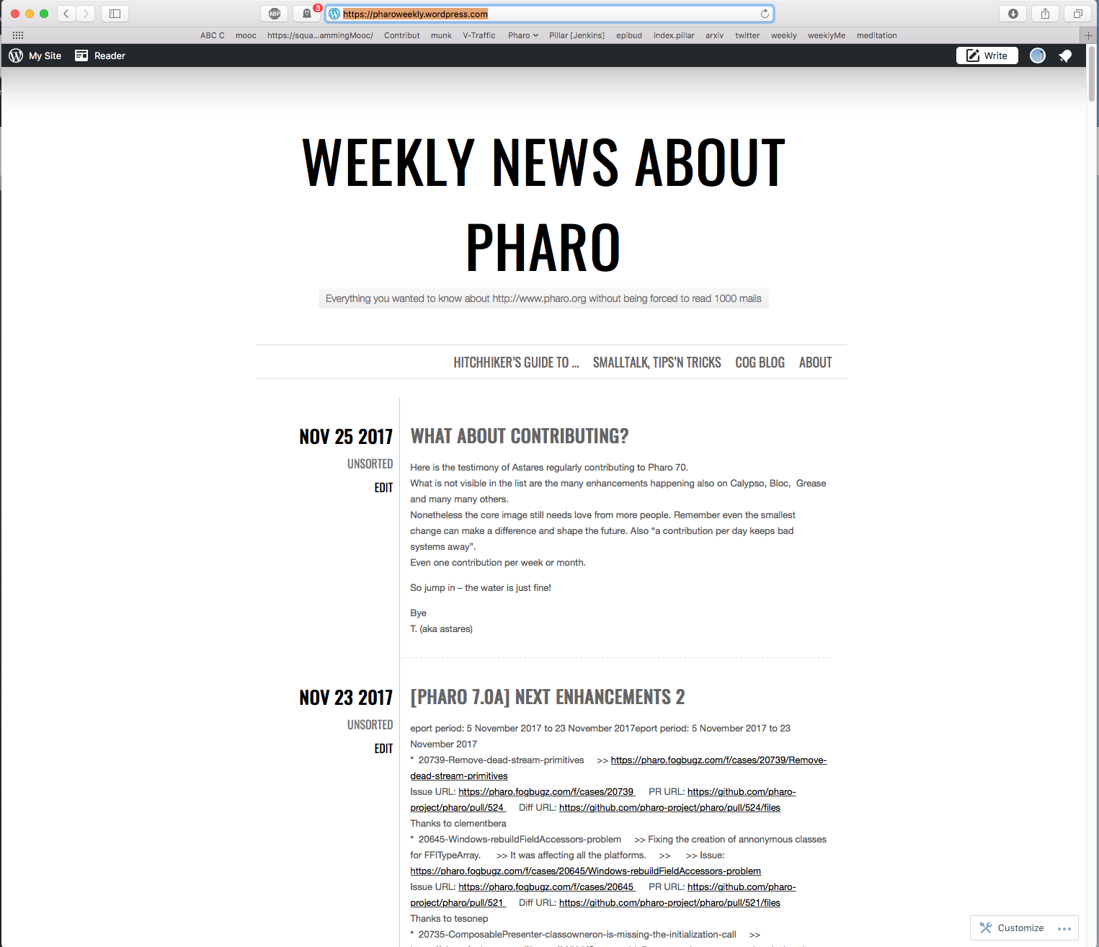
https://pharoweekly.wordpress.com

Slide 85
For research
Modelling complex systems
Moose ~ 150 packages to model Java, Ada, C++, Power
Creating DSLs
Gorgeous tools: advanced debuggers, git…
Writing your own tools
Access to full stack (UX Interaction) and community
Web stack
Scripting visualisation with Roassal

Slide 86
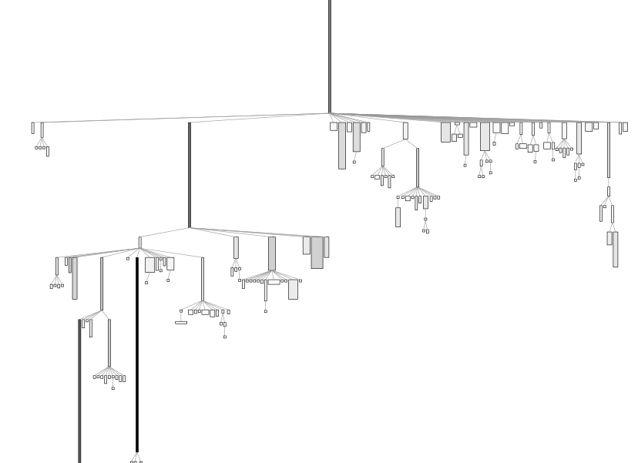
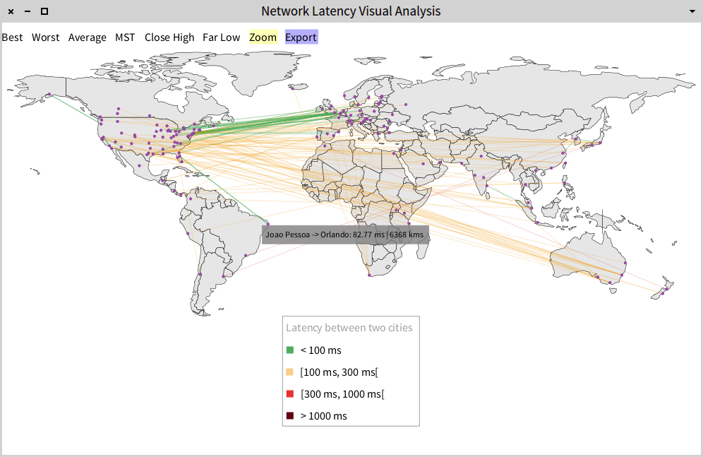
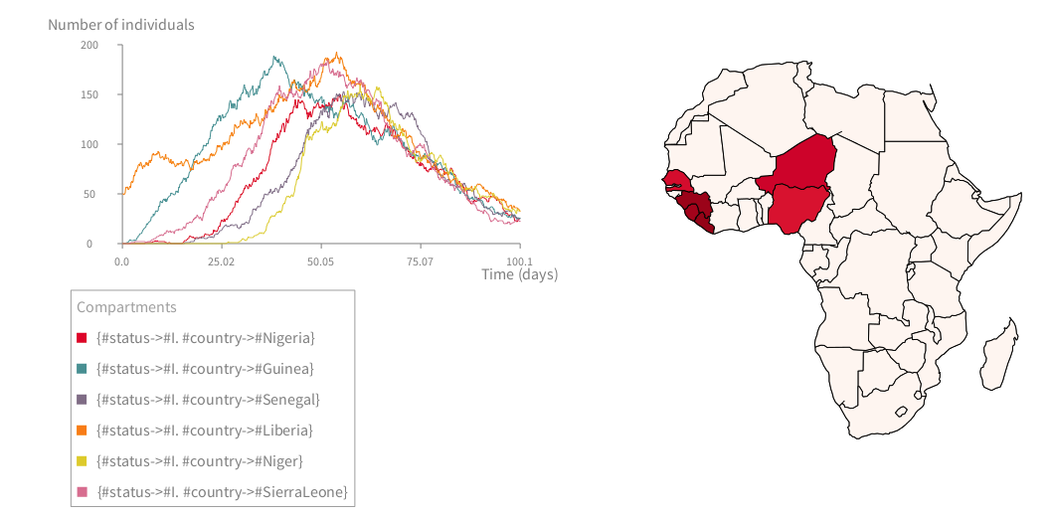
Scripting visualisations
b := RTMondrian new.
b shape rectangle
withBorder;
width: [ :cls | cls numberOfVariables * 5 ];
height: [ :cls | cls numberOfMethods ].
b nodes: Collection withAllSubclasses.
b edges connectToAll: [ :cls | cls subclasses ].
b layout tree.
b normalizer
normalizeColorAsGray: [ :cls |
cls numberOfLinesOfCode ].
b

Slide 87
One hour about Basic
https://pharoweekly.wordpress.com/2020/05/24/roassal-1-hour-xp-assembly-code-of-gwbasic/

Slide 89
Fun, simple
Pure & elegant
Productive
Empowering
Addictive
Full access

