Slide 1
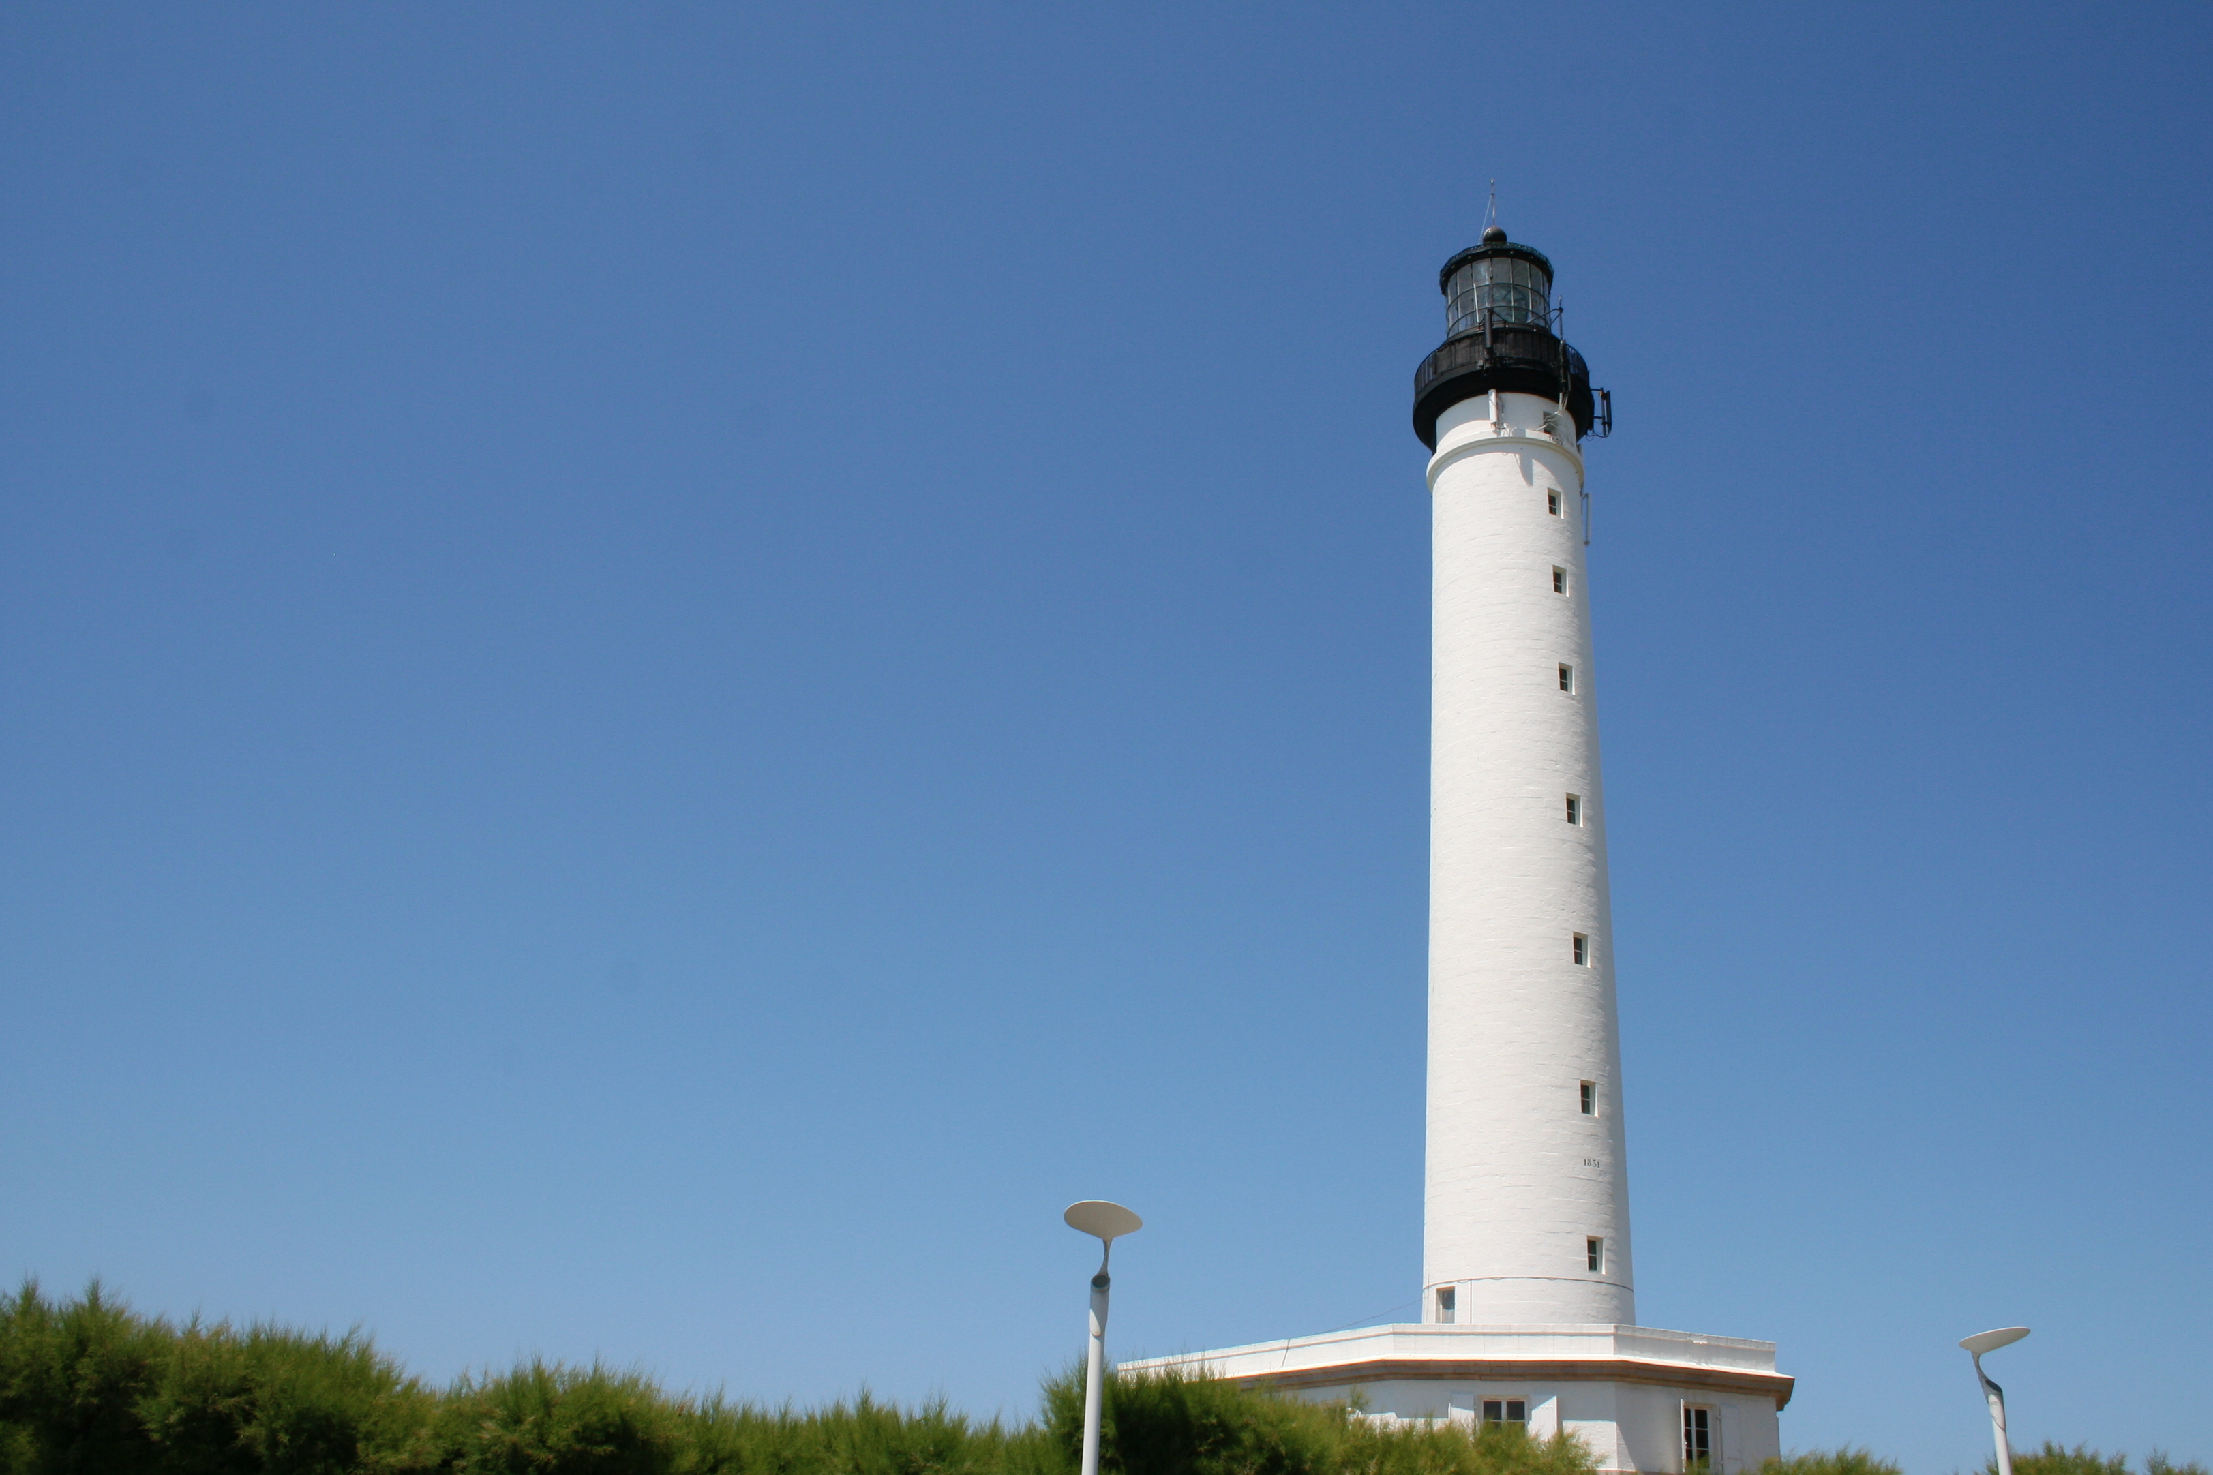
Pharo: Live objects for complex projects
http://stephane.ducasse.free.fr
http://www.pharo.org

Slide 2
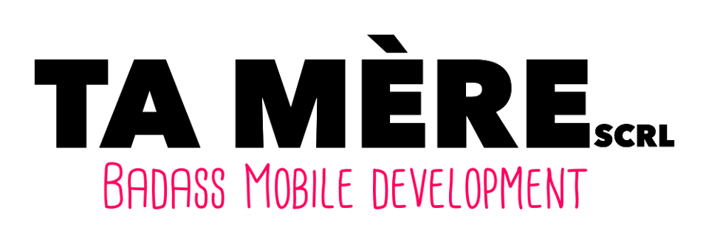

Slide 3
A word of presentation

Slide 4
Inria:
- 8 labs
- 200 teams
- 3300 researchers
- Excellence in research
- Transfert (impact on real life)
- Minister of Education and industry

Slide 5
Expert in language design
Traits in Php7.0, Perl60,
Influenced Traits in Scala, groovy
ClassBoxes
Pharo

Slide 6
Expert in Software Evolution
Program analysis, Metamodels, visualization, testing, refactorings, metrics….

Slide 7
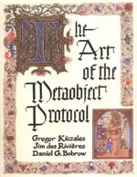
Language love
Born in Lisp,
Loved Scheme, CLOS’MOP
Discovered Smalltalk in 96
Discovered Squeak in 98
Maintained Squeak 3.9
2008 created pharo

Slide 8
Building specific analysis tools for important running business software (Ada, Cobol, 4D, C, C++, Java…)
Dedicated tools to support decision making process
Notes:
On the maintenance aspect one key element of transfert is the company we will
create in 2013.
Synectique is focusing on Information Systems languages.
It offers dedicated tools to support decision making.
It won an OSEO emergence prize and we got some first large clients.

Slide 9
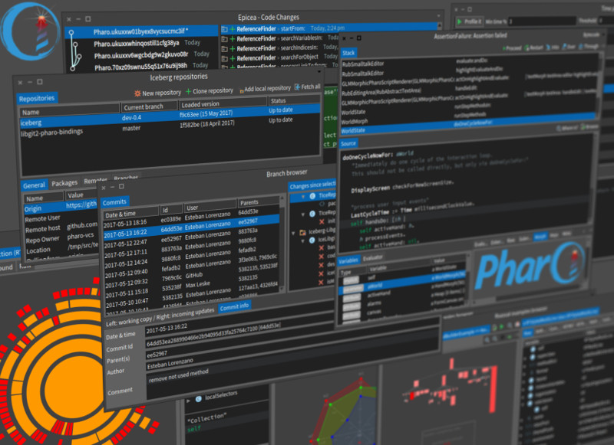
Pharo?

Slide 10
Pharo!
System: Pure object language + full IDE
Powerful, elegant and fun to program
Great community / industrial consortium
Living system under your fingers
Works on Mac OSX, Linux, iOS, Android, Windows, Pi - 100% MIT

Slide 11
Elegant!
Full syntax on a postcard
Simple and powerful objet model

Slide 12
Full Syntax!

Slide 13
Yes! Nothing else

Slide 14
Full Syntax!

Slide 15
| a |
a := 40 + 2.
^ a

Slide 16
Unary messages
Date today, 9 squared
“Operators” Binary
4 + 3
‘Black ’, ‘Chocolate ’, ‘is good’
Keywords messages
2 between: 0 and: 10
2.betweenAnd(0, 10)

Slide 17
Lexical closures: Blocks
closure definition
[:x | x + 5]
closure execution
[:x | x + 5] value: 37
>>> 42

Slide 18
Control flow op are messages
Weather today isRaining
ifTrue: [ self takeUmbrella]
ifFalse: [ self takeSunglasses]
Yes we send messages to Boolean objects

Slide 19
Iterators
#( 1 -2 -3 4 -5) collect: [:each | each abs]
>>> #( 1 2 3 4 5)

Slide 20
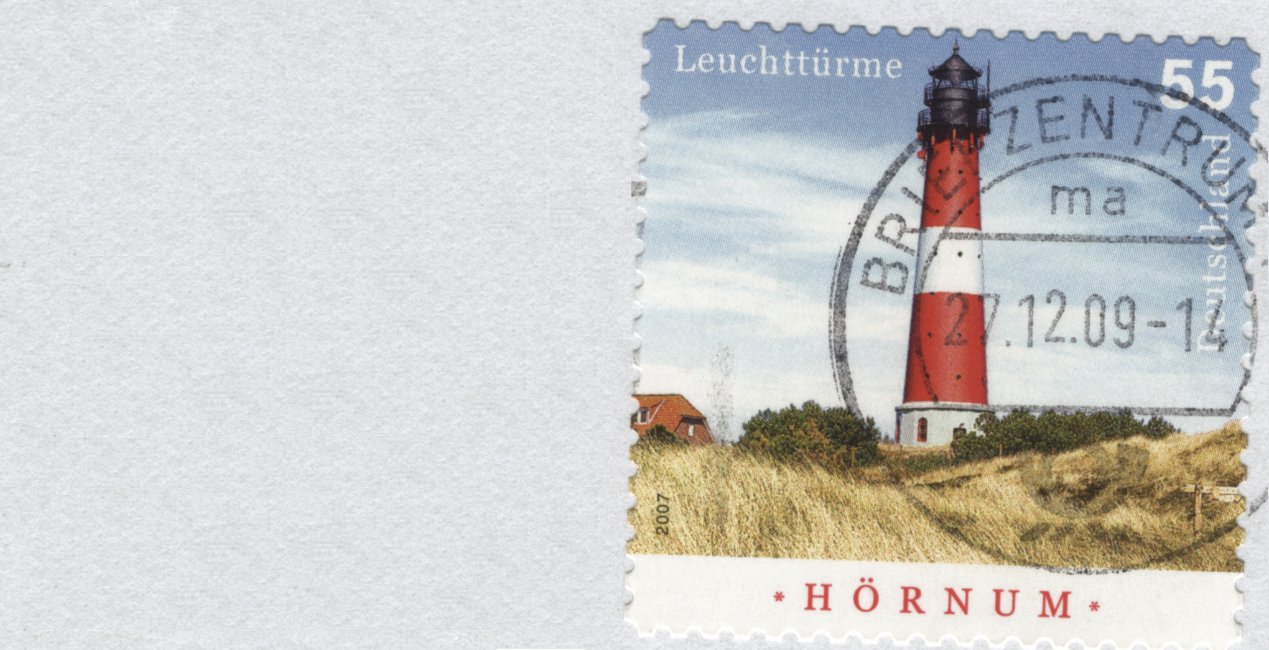
Full Model!
Dynamically typed
Everything is an object instance of a class
All methods are public virtual
All attributes are protected
Single inheritance
Stateful Traits
Closures everywhere

Slide 21
For the advanced users
Classes are objects
Instance variables are first class
MOP for read/write
stack can be reified on demand
AST can be fully annotated and transformed on the fly during execution

Slide 22
Focus on intrinsic complexity
Eliminate accidental complexity

Slide 23
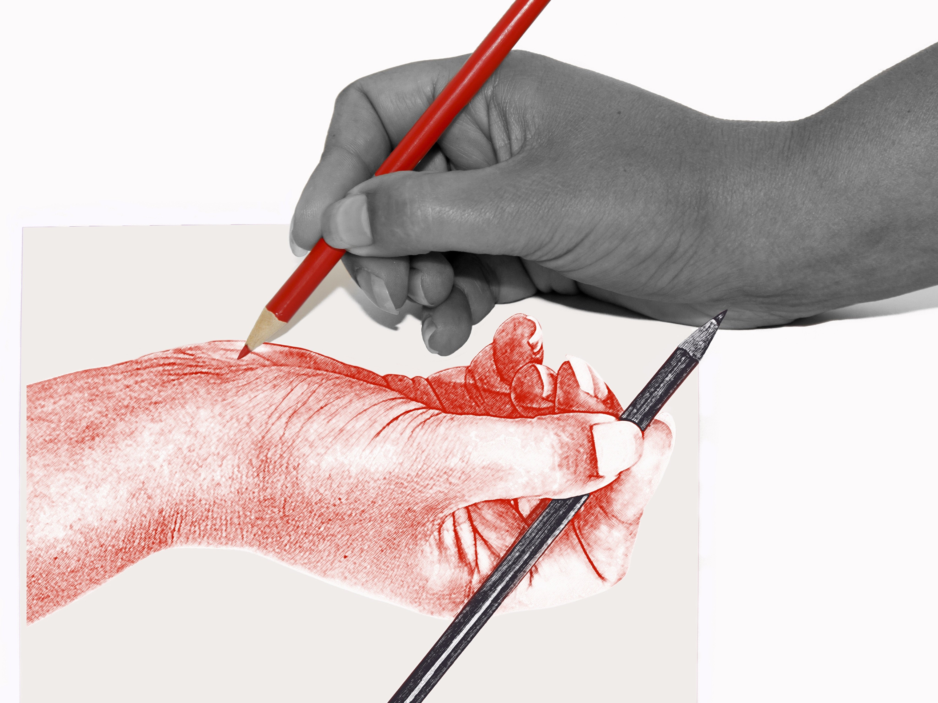
Fully Written in Itself
Everything is written in Pharo
One simple syntax to rule
them all

Slide 24
Learn
Adapt
Modify

Slide 25
Pharo is highly immersive

Slide 26
Most languages do not expose much of their internals

Slide 28
Looking inside
Introspection is a first step
Pharo is fully inspectable and reflective

Slide 29
Immersed and interacting
You interact with objects
You modify objects life

Slide 31
We can do the same with web app, sockets, networks, sensors, living programing….

Slide 32
Pharo’s goal...

Slide 33
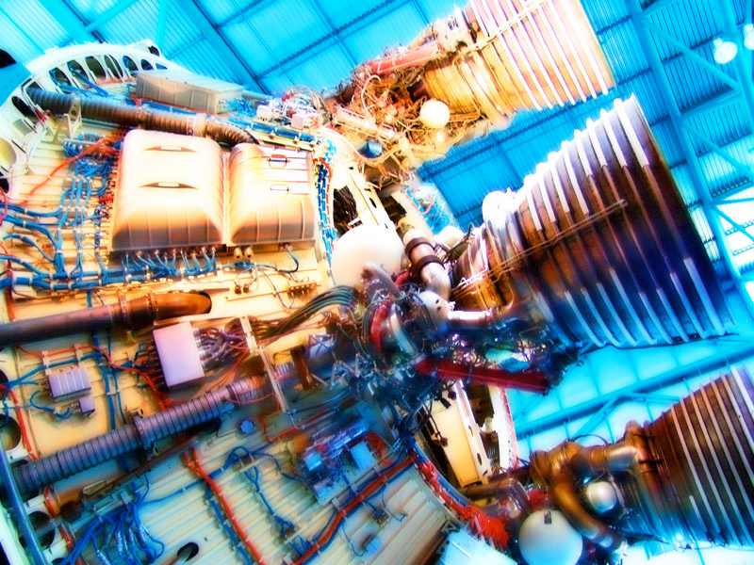
A powerful engine
to invent (y)our future

Slide 34
An ecosystem where innovation/business bloom

Slide 35
… **you** can make money with Pharo.
… to be able to invent solutions to existing problems.
… a powerful innovative dynamic language where we can build (y)our future.

Slide 36
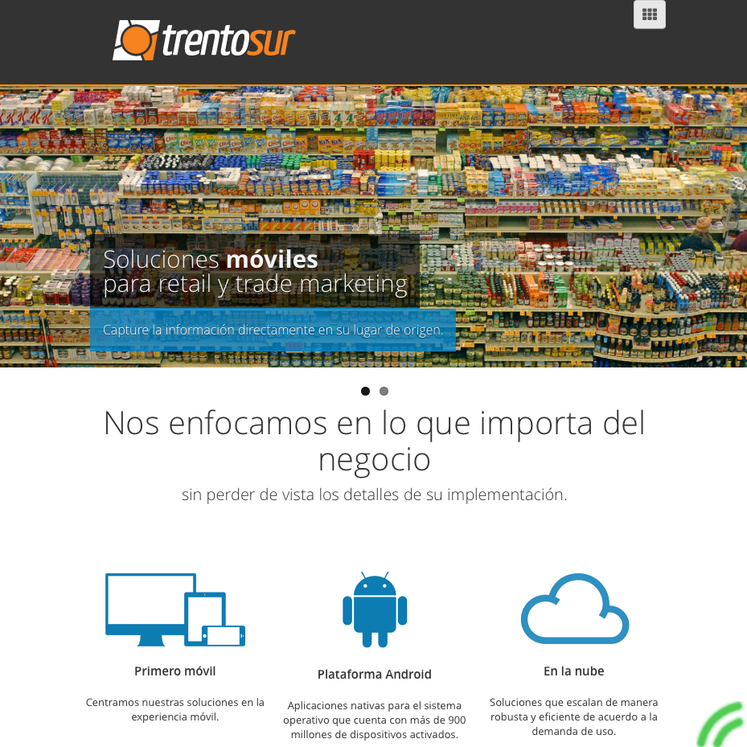
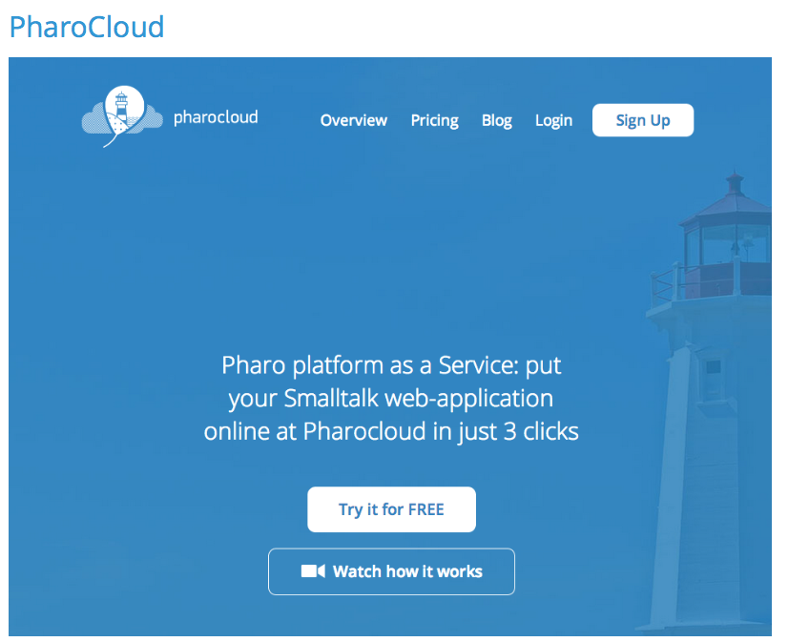
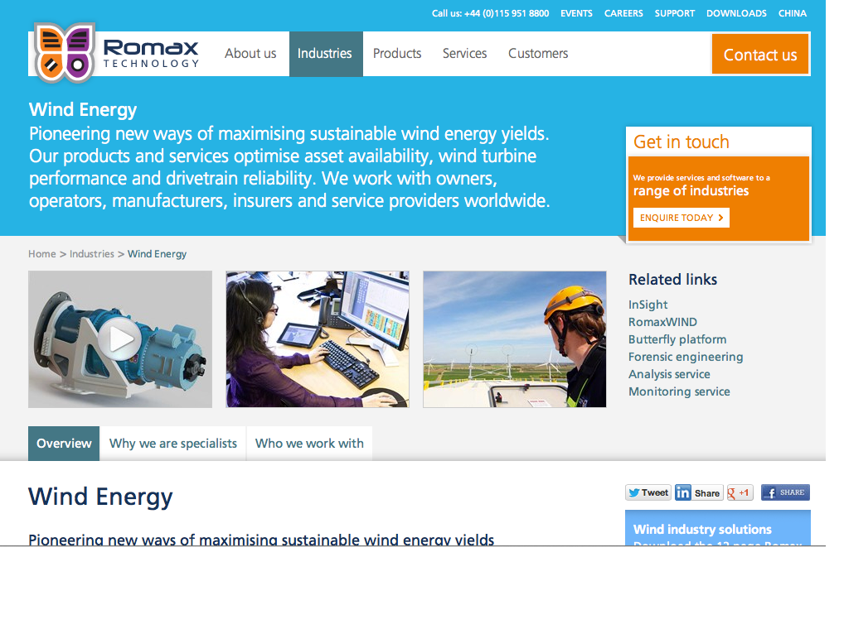
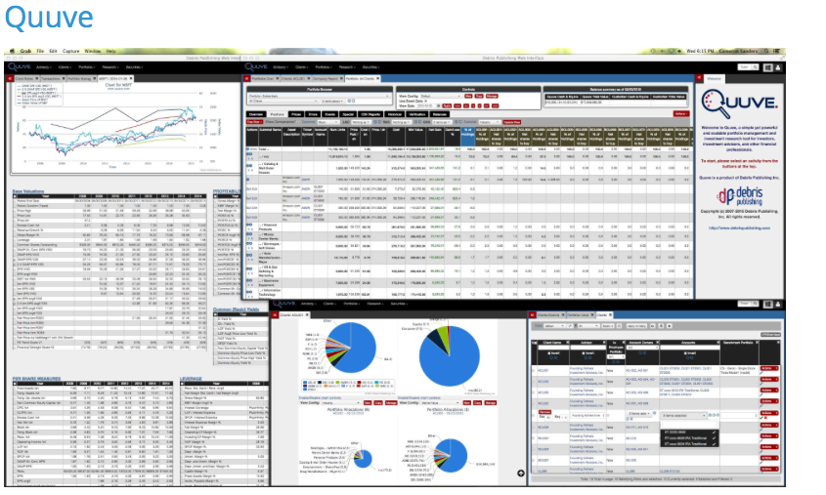
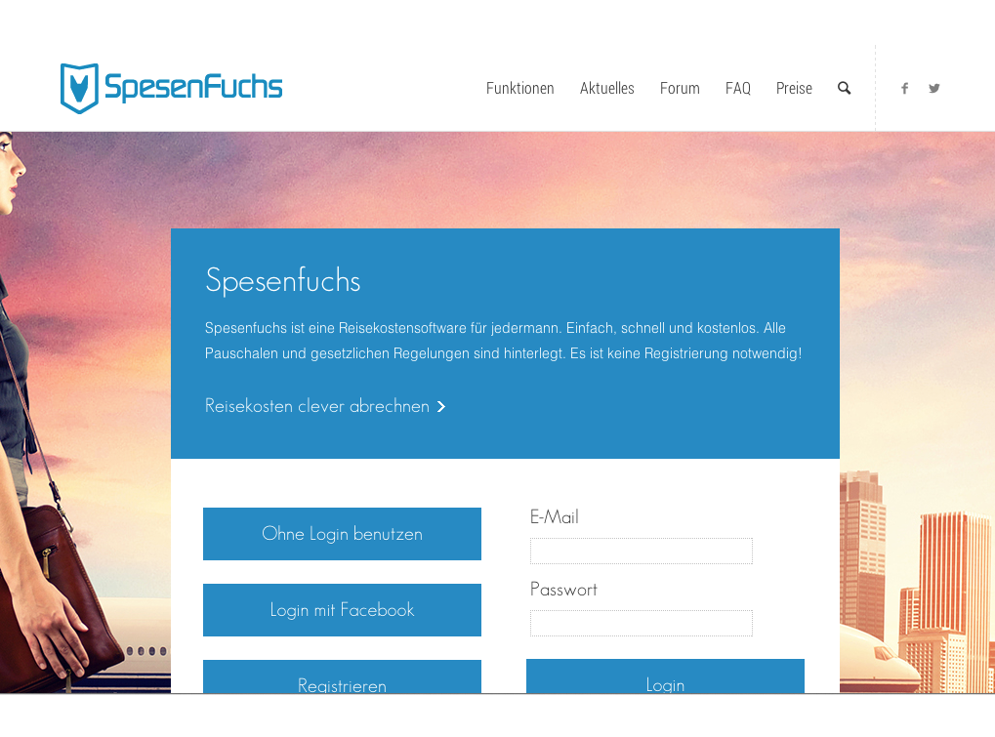
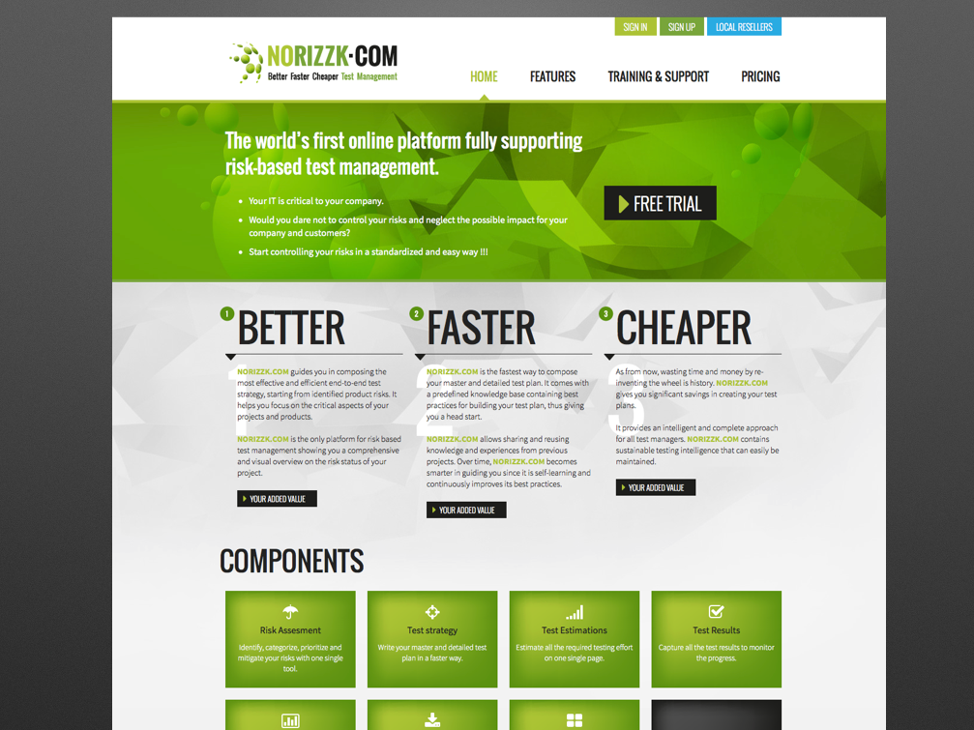
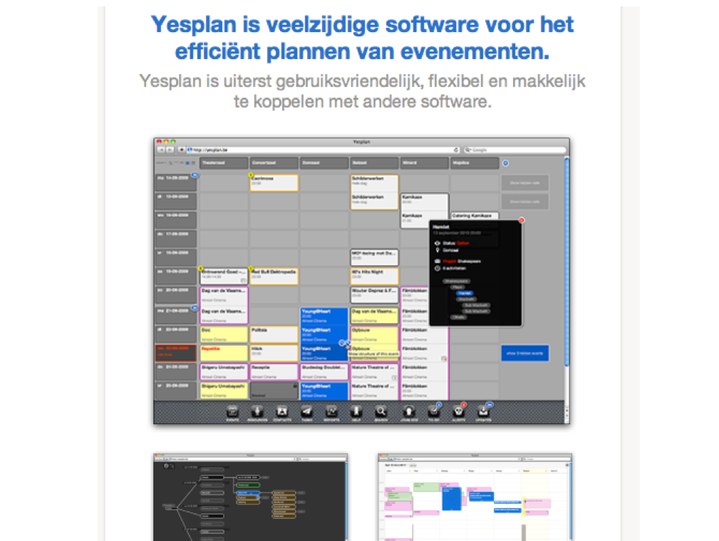
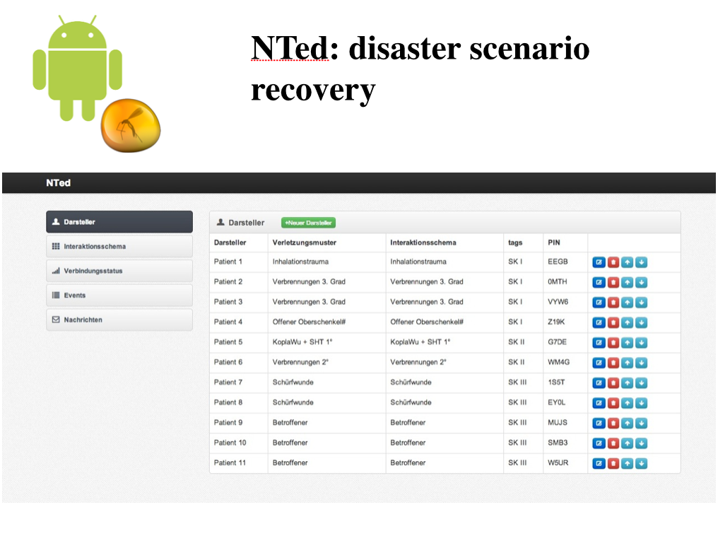
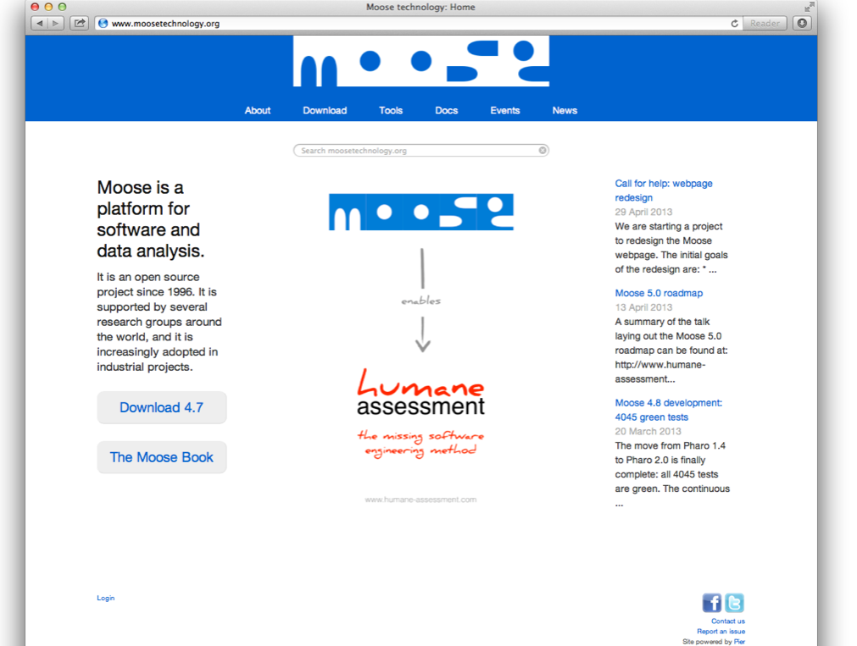
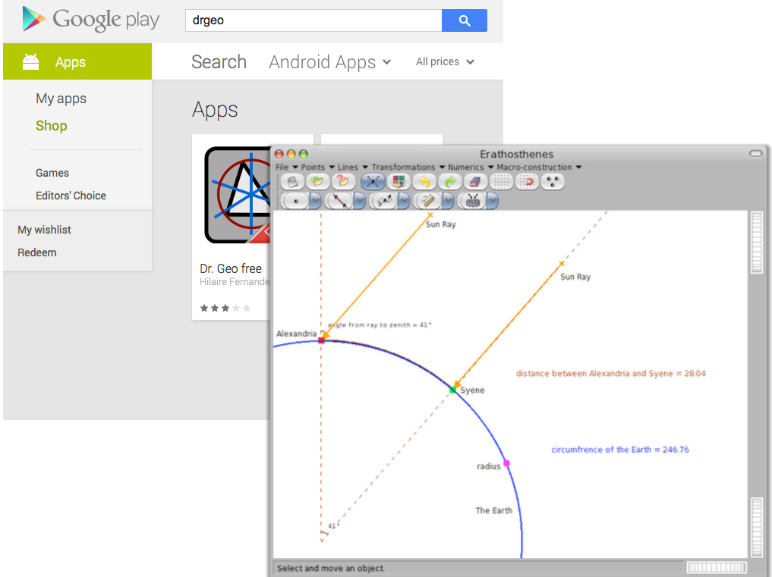
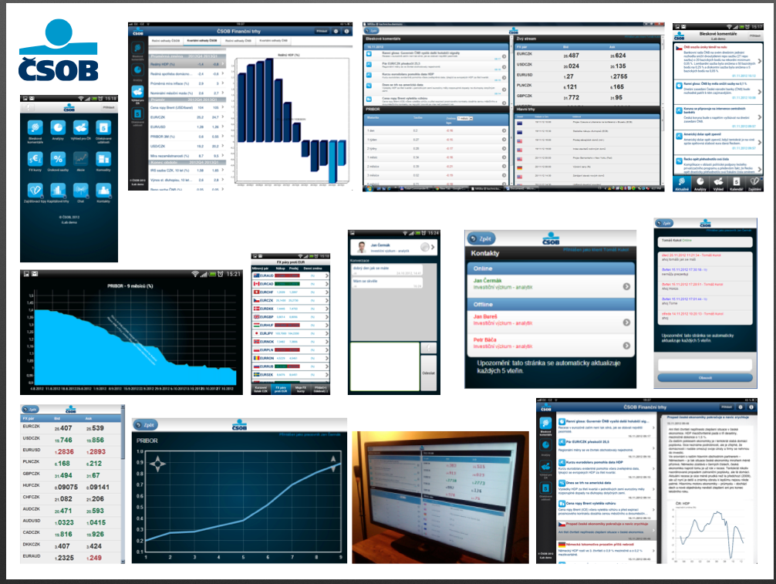
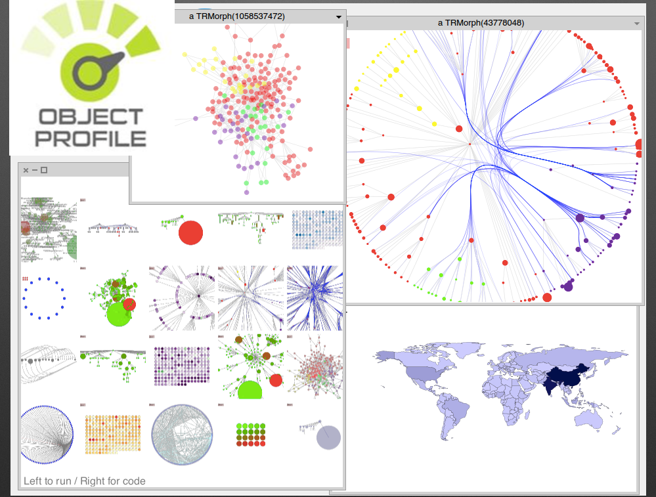
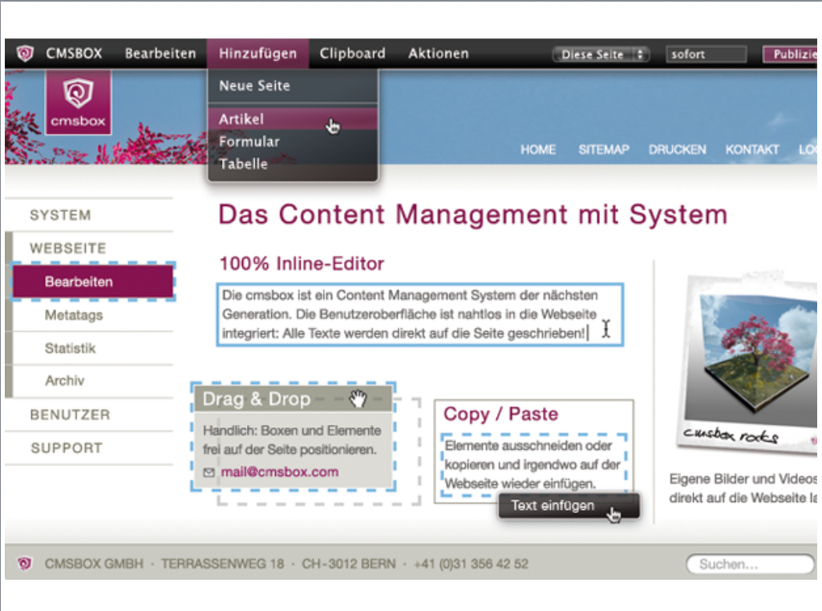
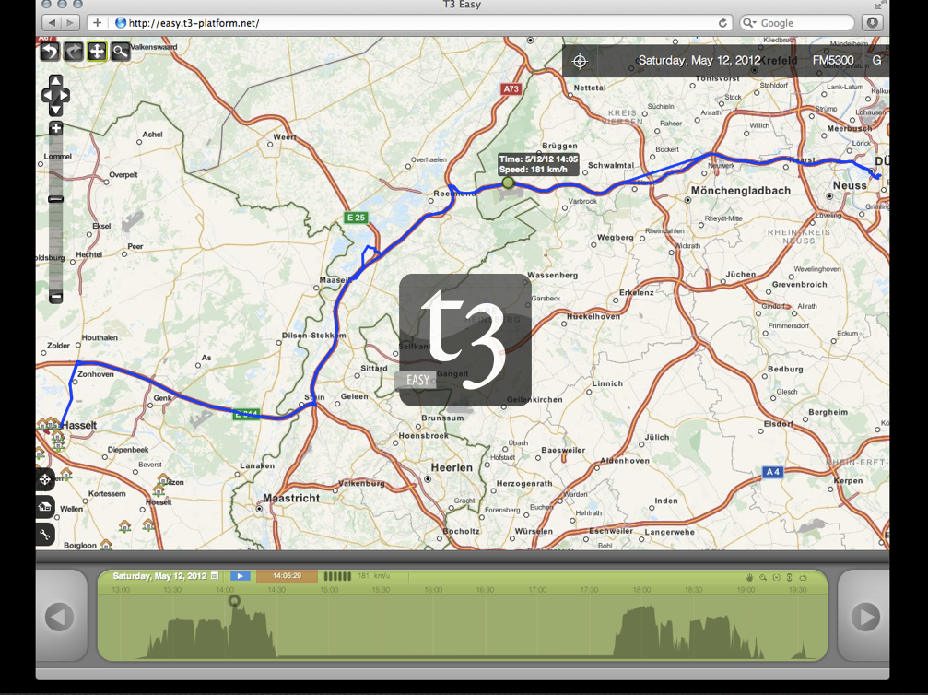

Slide 37
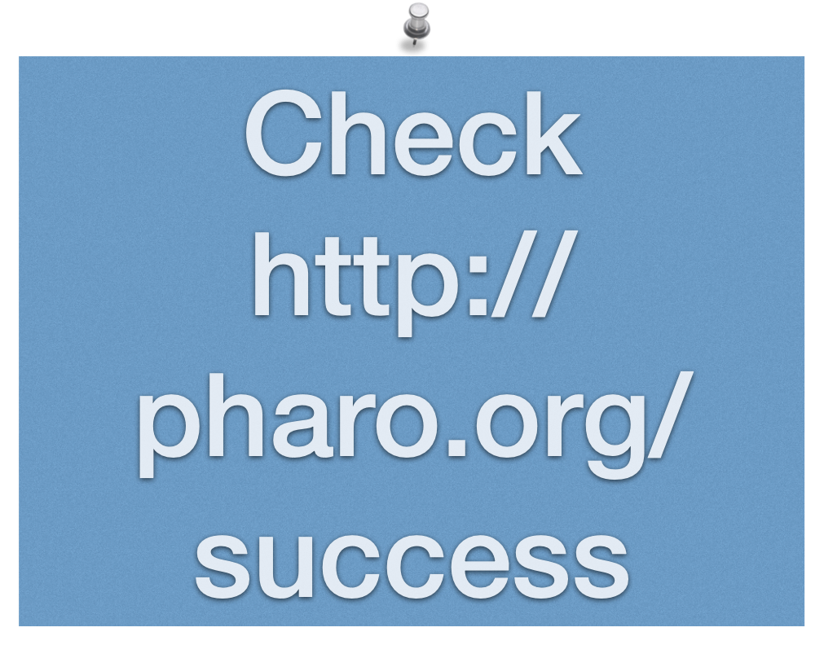

Slide 38
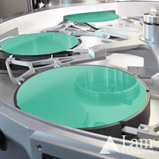
LAMRC
Back-End Wafer-Level Packaging
Your mobile hardware as a high-chance to have been produced by a robot controlled via a smalltalk

Slide 39
LAMRC
Back-End Wafer-Level Packaging
Your mobile hardware as a high-chance to have been produced by a robot controlled via a smalltalk

Slide 40
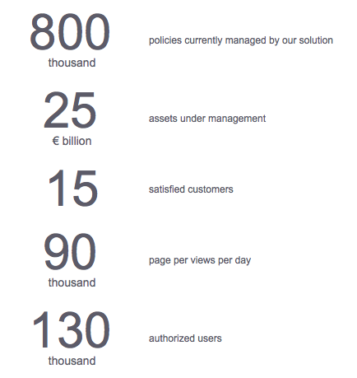
LifeWare
30 Millions lines of code…
Kent Beck is one of the founders

Slide 41
Pharo in ATM like Device in Moscow

Slide 42
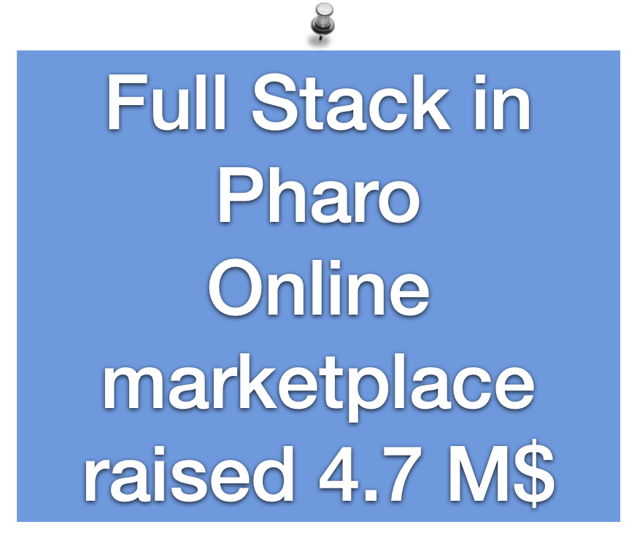

Slide 43
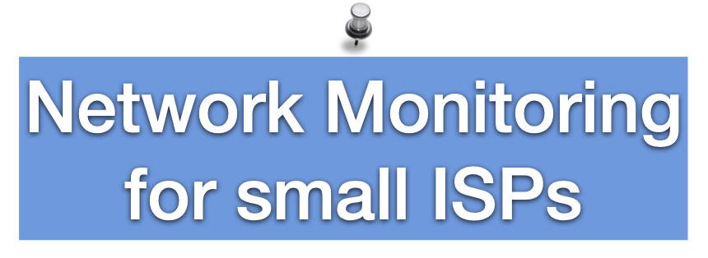
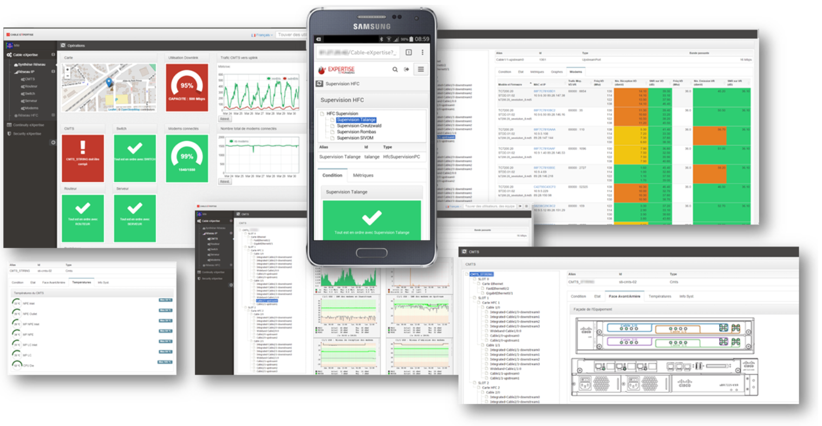

Slide 44
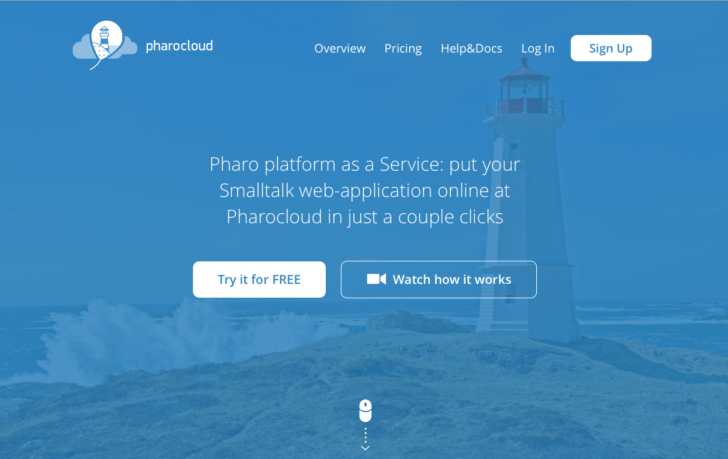
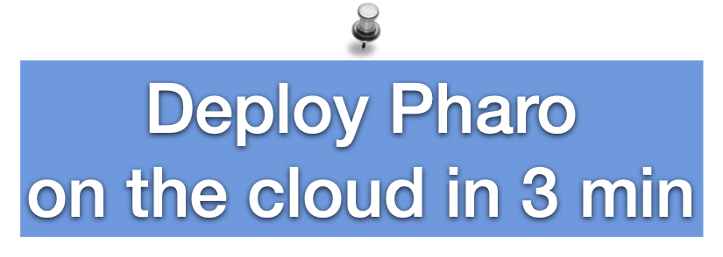

Slide 45
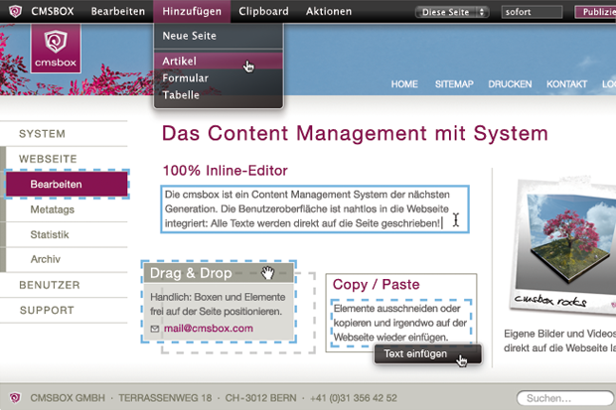

Slide 46
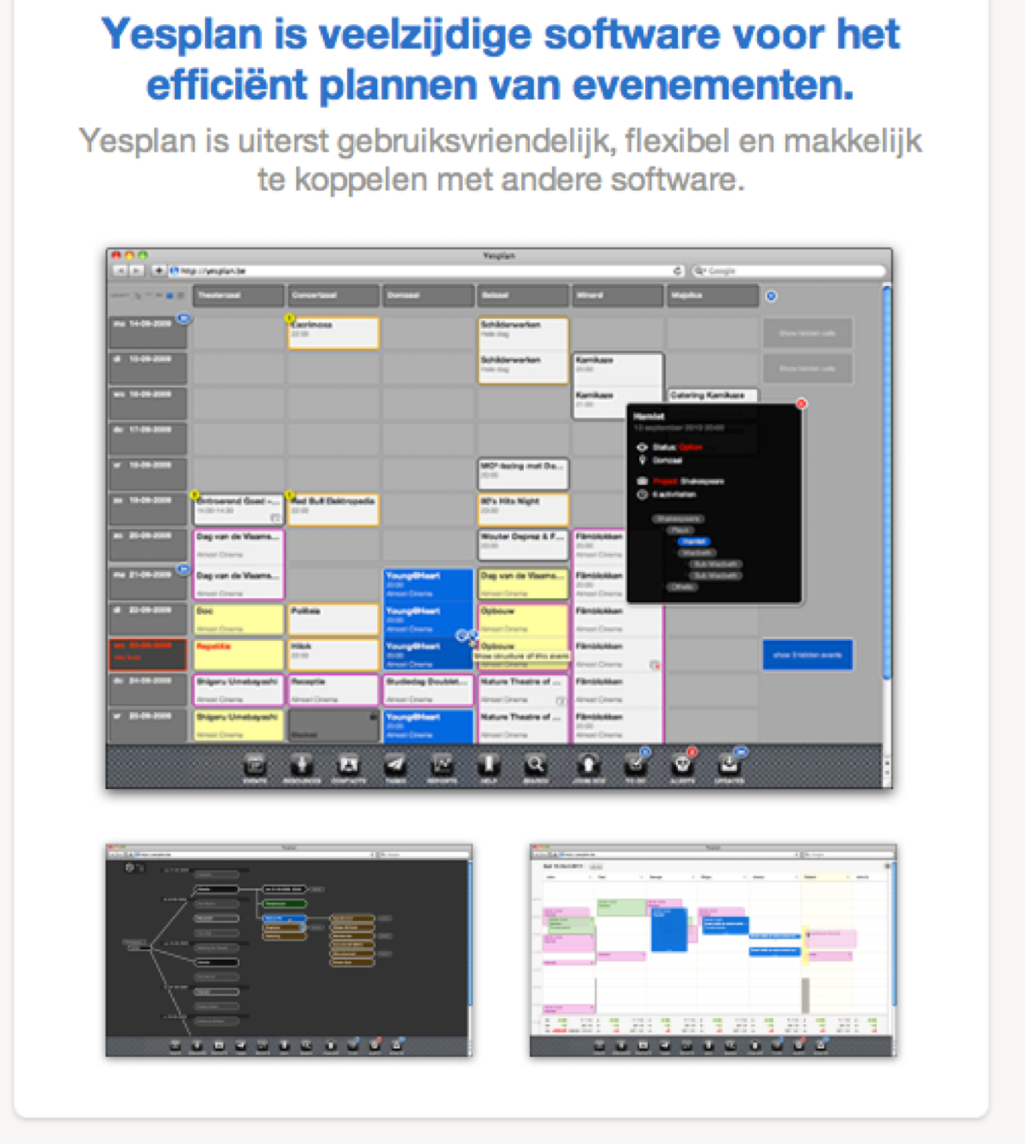

Slide 48
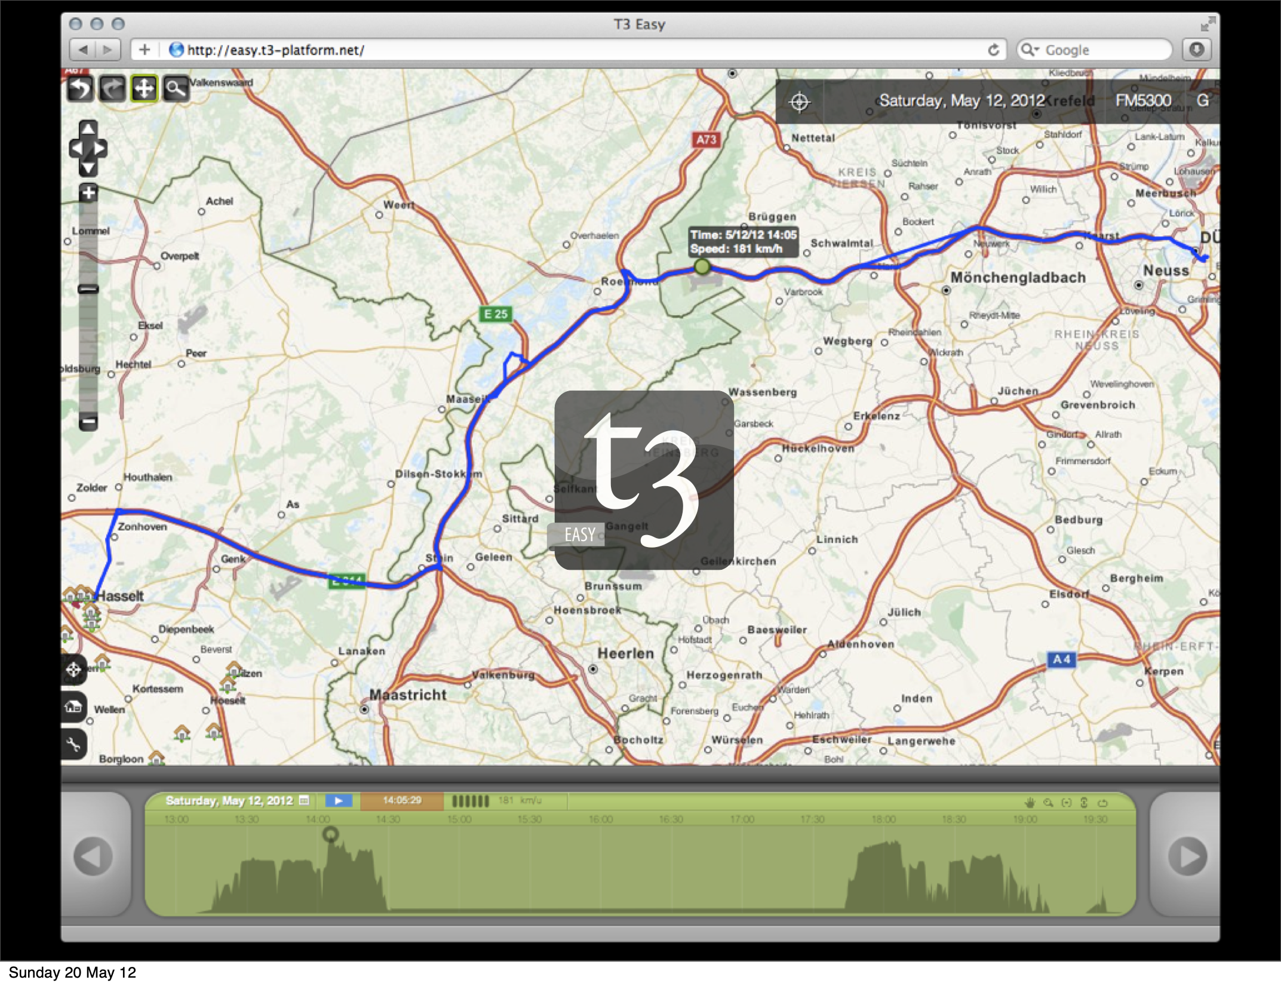
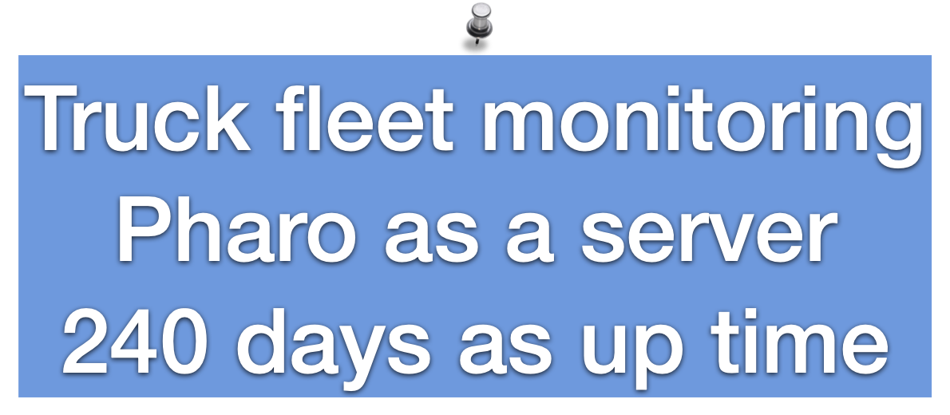

Slide 53
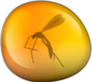
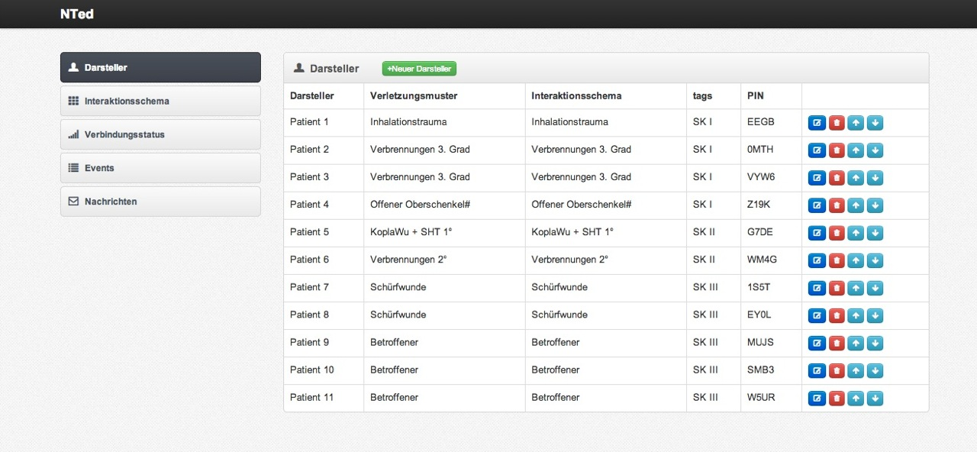
NTed: disaster scenario recovery

Slide 54
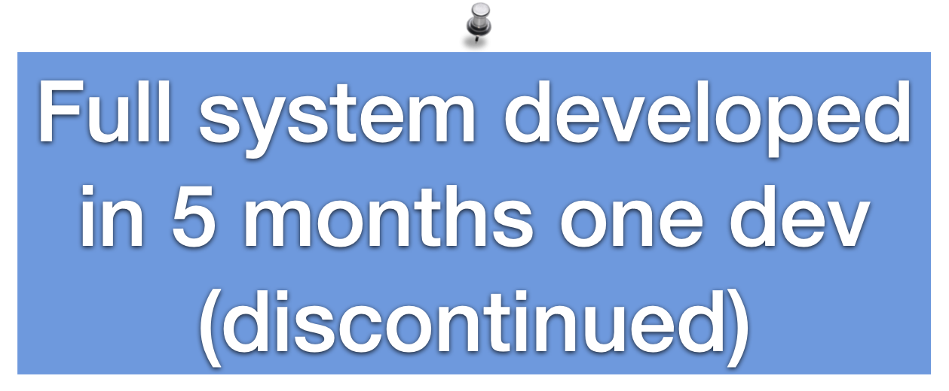

Slide 55
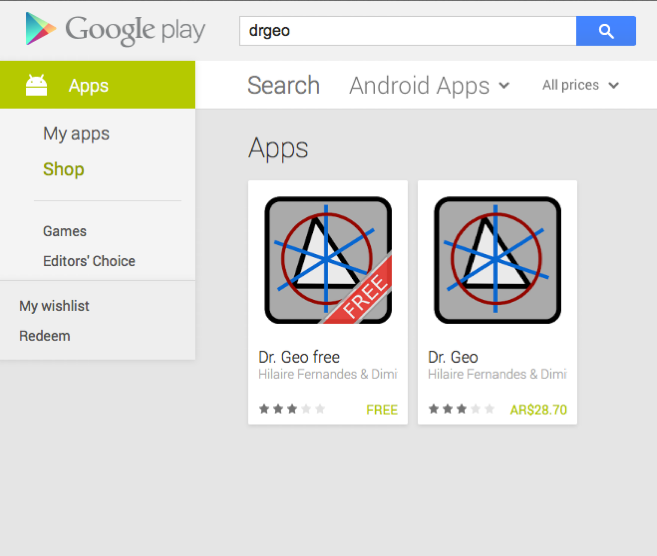
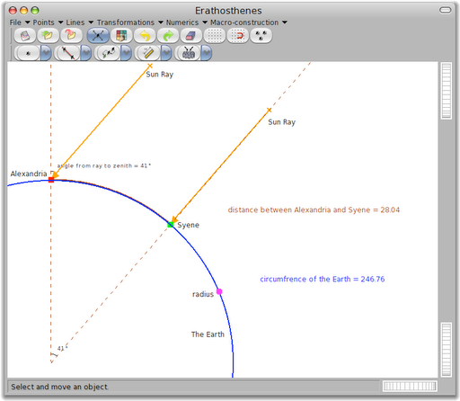

Slide 56
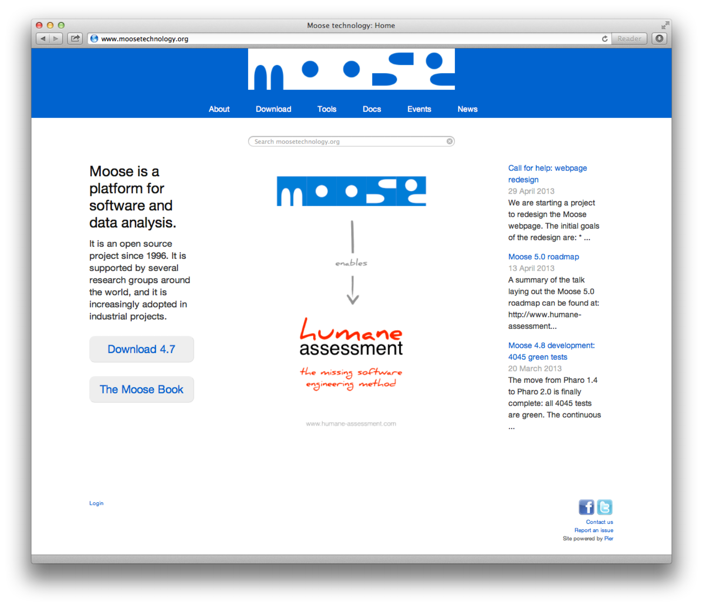

Slide 57
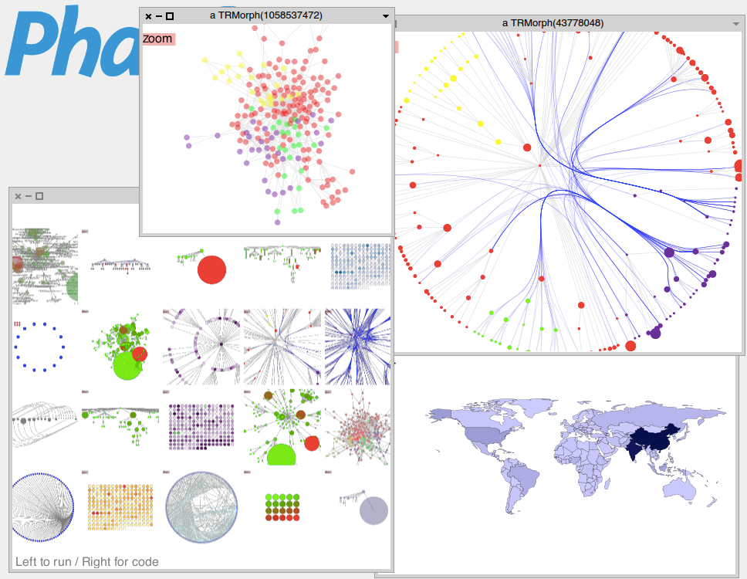
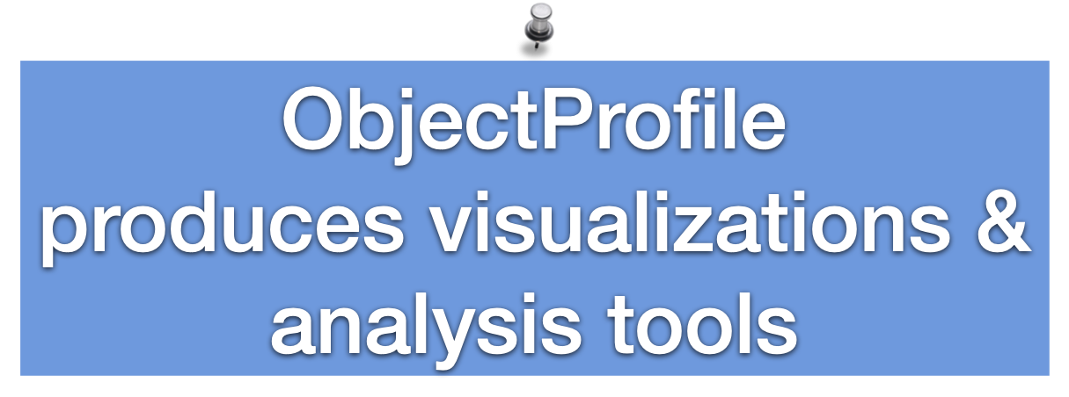

Slide 60
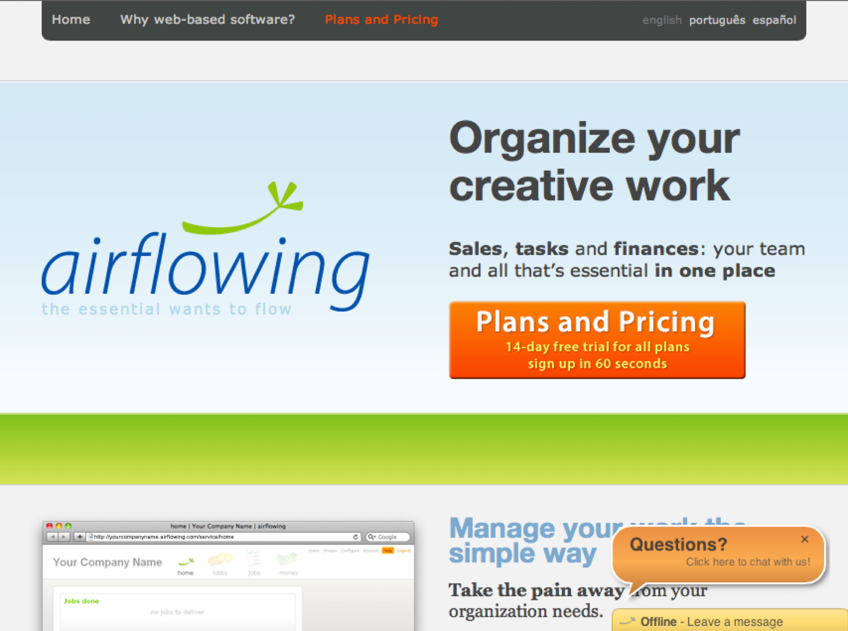

Slide 62
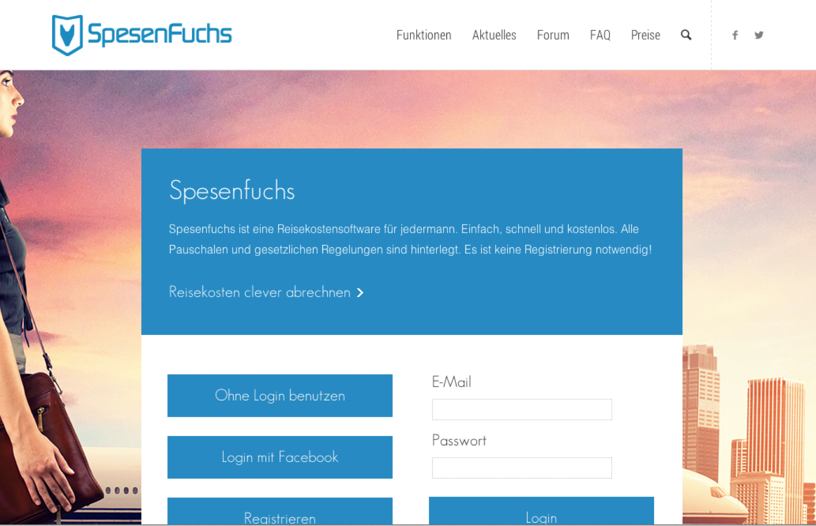

Slide 64
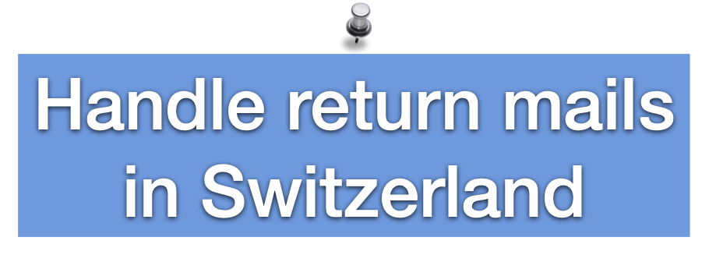
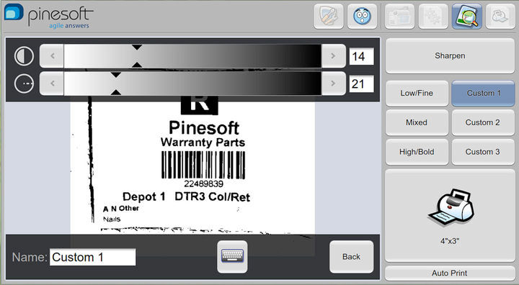

Slide 66
https://mercapabbaco.com/?idioma=en

Slide 67
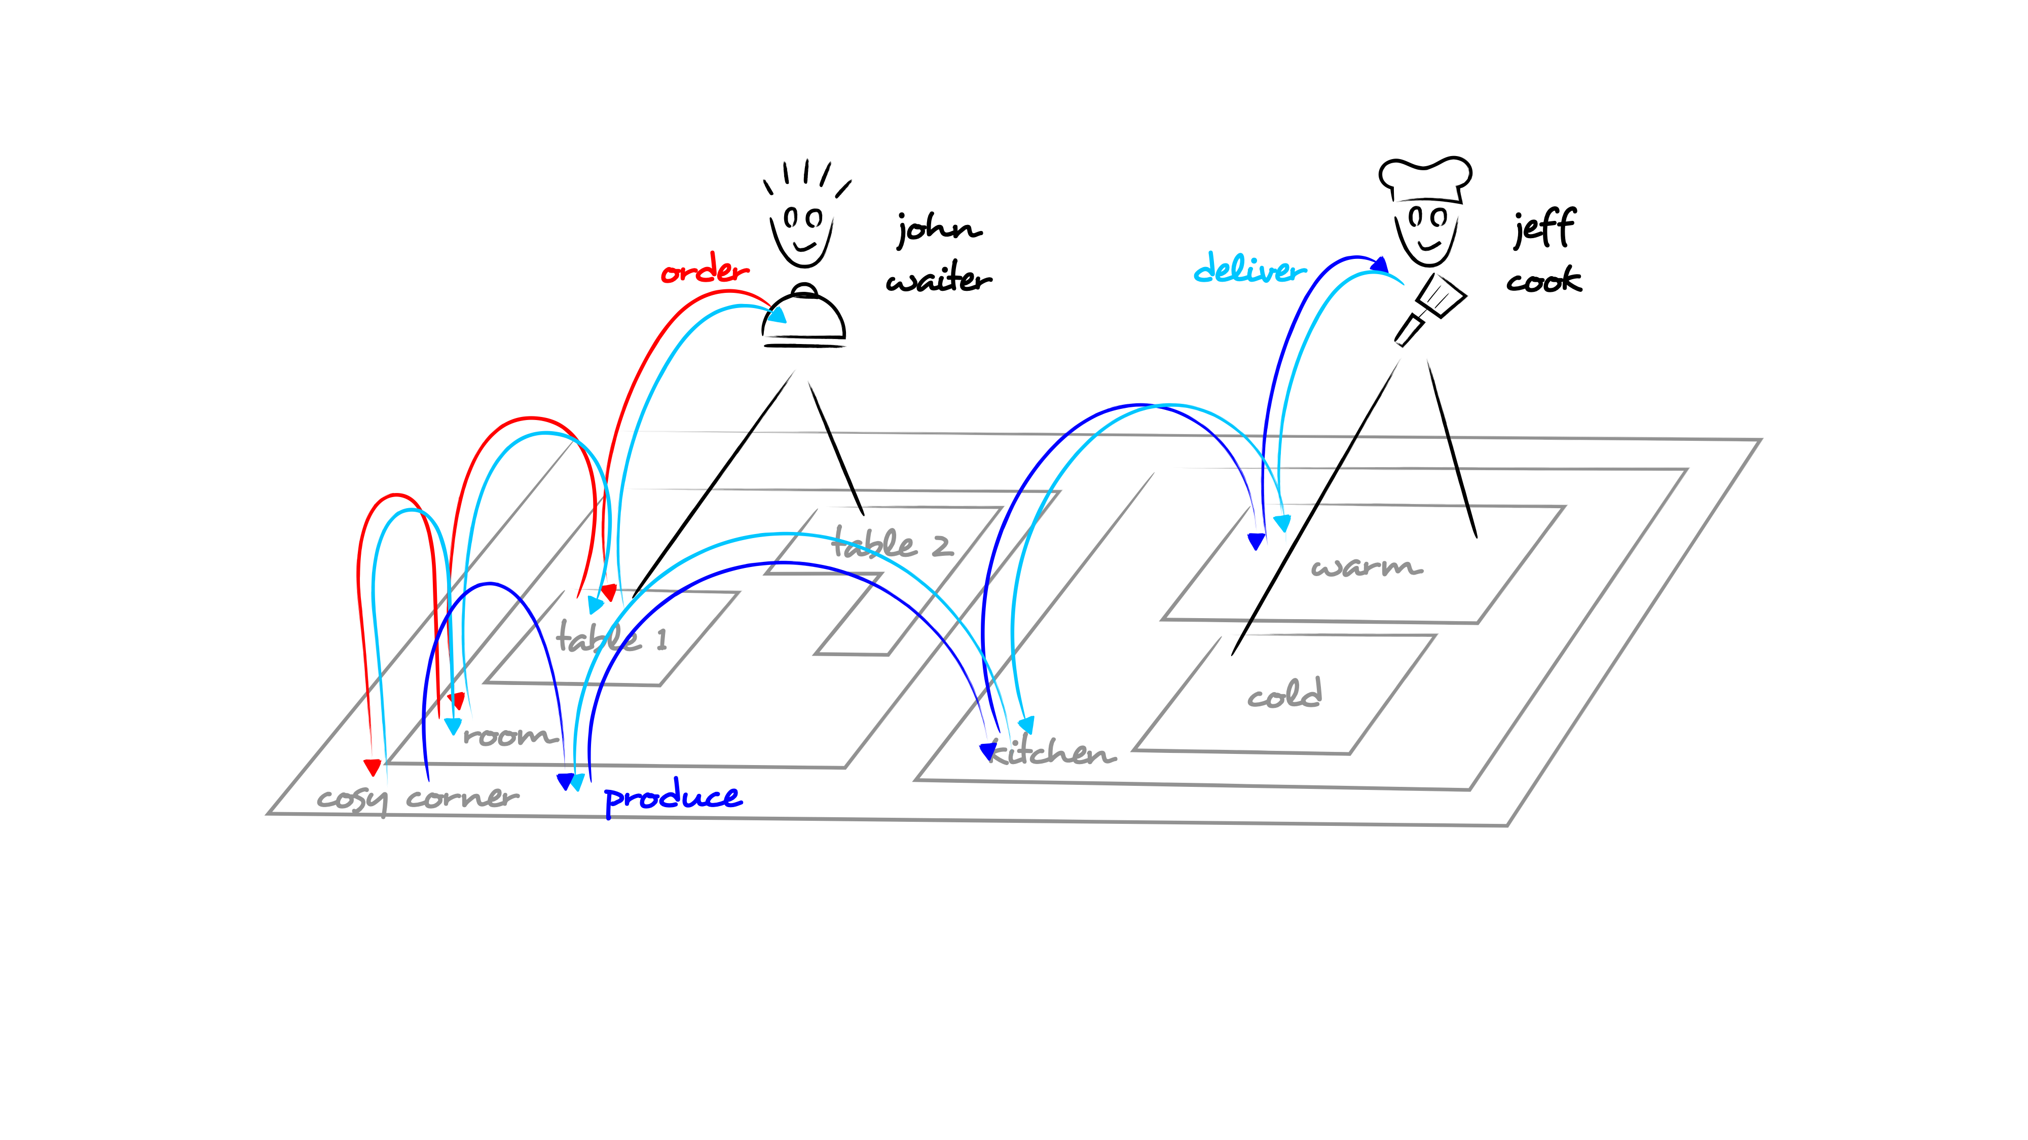
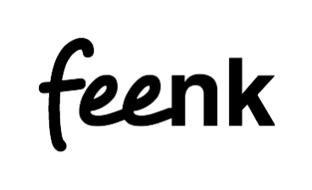
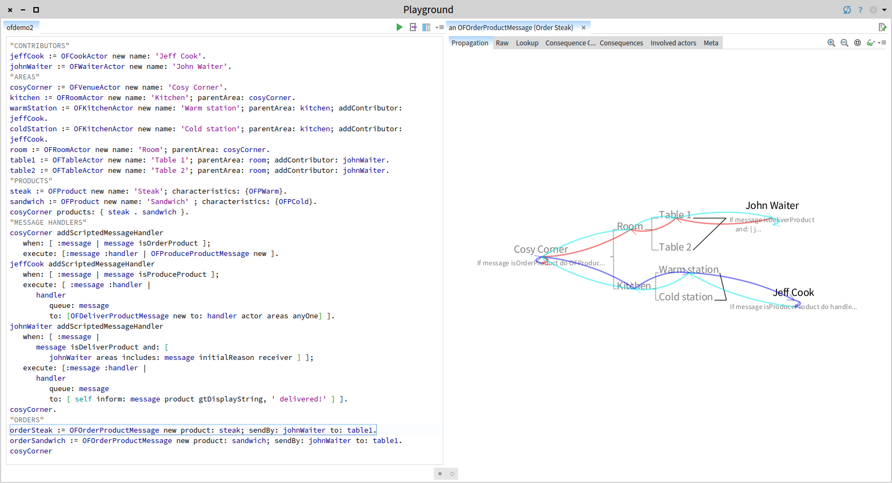
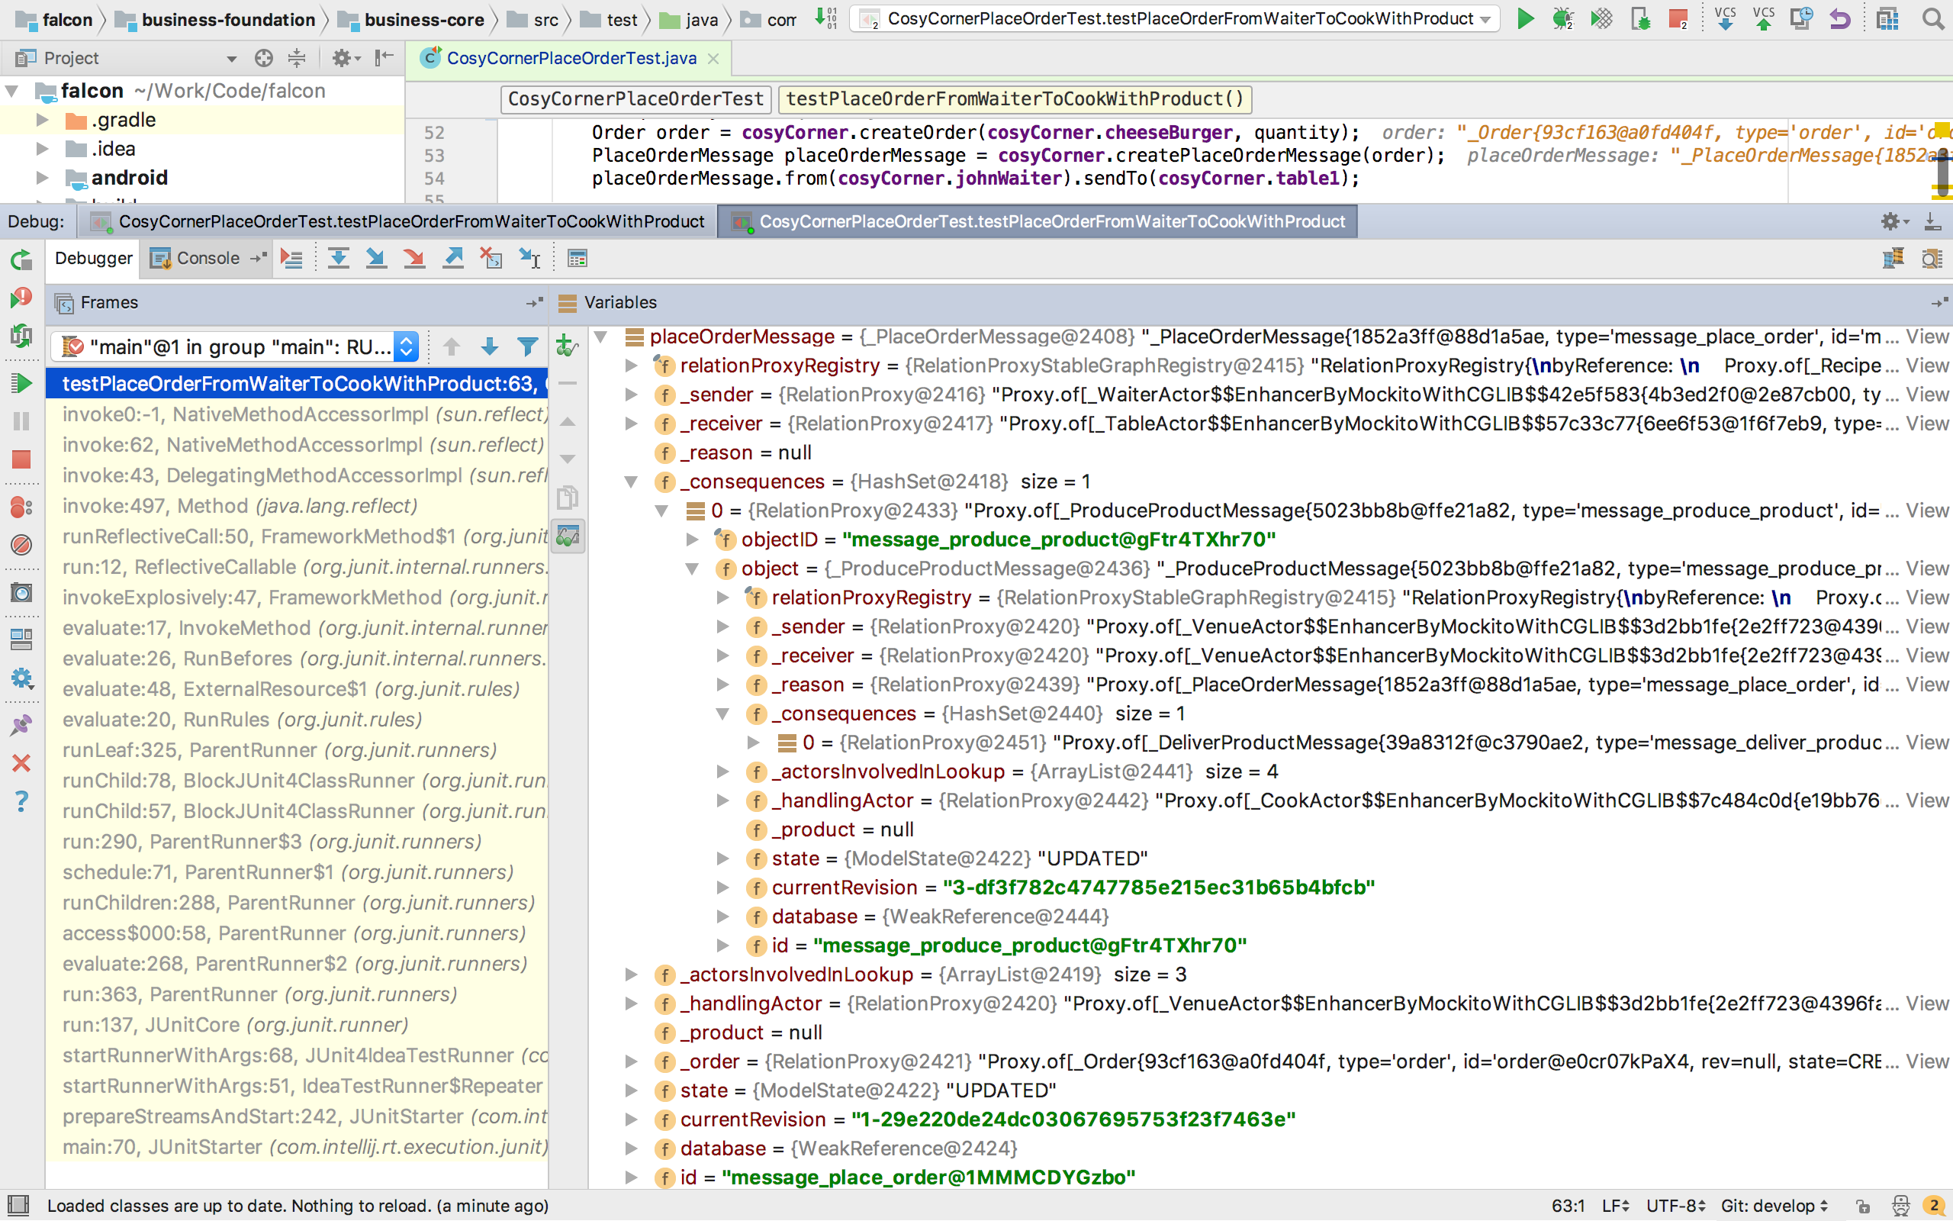

Slide 68
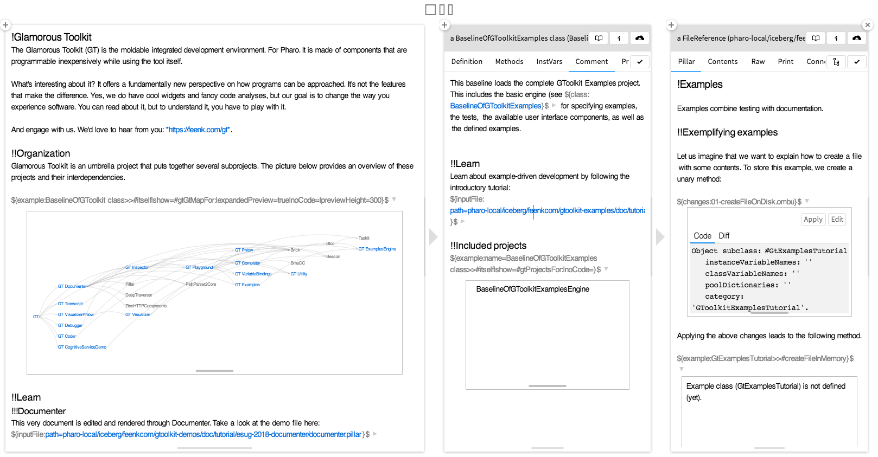
feenk.com/gt

Slide 72
Remember?
Our goal...

Slide 73
A powerful engine
to invent (y)our future

Slide 74
An ecosystem where innovation/business bloom

Slide 75
Industrial consortium
consortium.pharo.org

Slide 76
No marketing
No hype
Adults deciding to use
Understanding strengths and weaknesses

Slide 77
We are a cool community

Slide 78
Some Pharo's Teachers
• Univ. of NoviSad • Uni. of Buenos Aires • Uni. of Bern • Uni. of Maroua • Uni. of Brussels • Ecole des Mines de Douai • Uni. de Savoie • Ivan Franko Nat. Uni. • Czech Technical Uni. • CULS Prague • Uni. of Quilmes • Uni. of La Plata • Northern Michigan Uni. • Uni. Technologica Nacional (UTN) • Uni. Catholic of Argentina • Uni. of Santiago • Uni. Policnica de Catalunya • Uni. de Bretagne Occidentale • Uni. of Tomsk • Uni. of Fernhagen • IT University of Copenhagen • Uni. of Yaounde • Uni. Lille • INFTI • Uni. of Lyon • Univ. of Montpellier • Uni. of Cordoba • Uni. of Yamanashi Gakuin •Uni. of Monterrey

Slide 79
Some Research Groups
Lafhis (AR)
SCG (CH) CAR (FR) RMOD (FR)
Ummisco (IRD)
Reveal (CH)
Lysic (FR)
CEA-List (FR)
Uqbar (AR)
OC (FR)
CCMI-FIT (CZ)
ASERG (BR)
Pleiad (CL)
SoftQual(Serb)
SRA (Jap)
GL (Bol)
UFMG (Br)
ETS (Can)
U.Chi (Can)
Soft (Be)
…

Slide 80
http://mooc.pharo.org

Slide 81
http://discord.gg/Sj2rhxn

Slide 82
http://books.pharo.org

Slide 83
https://pharoweekly.wordpress.com

Slide 84
Pharo is our vehicle
We improve it everyday

Slide 85
For us Pharo is the beginning of the journey and we are building the road

Slide 86
Stop!!!!!
Let us think a bit

Slide 87
A Pure OO World
Only objects + messages +
closures!
mouse, booleans, arrays, numbers, strings, windows, scrollbars, canvas, files, trees, compilers, sound, url, socket, fonts, text, collections, stack, shortcut, streams, …

Slide 88
Customize object interaction/presentation to focus on YOUR domain

Slide 90
Traditionally a file reference…

Slide 91
A file browser…

Slide 93
Hot update on the spot customizable debugger

Slide 95
Hot update on the spot customizable debugger
Notes:
The top part of the debugger has the parser stack and potential actions. When you select either a node or token in the parser stack, the text in the input pane is highlighted. It should also update the possible actions list, but I haven’t implemented that yet — only the top of stack’s actions are currently displayed. If the parser is a glr parser, then it shows the glr list of all the potential parses. It should allow the user to select a different potential parse and see the stack for that parse, but that hasn’t been implemented yet. The scanner table only displays items when the debugger is in the middle of scanning the next token. Finally, I attached the normal debugger’s stack and source panes at the bottom so that you can do normal step/send debugger.
I implemented some step actions. The “Through Action” steps through the next shift/reduce/accept action. “Into Reduce” steps until a reduce method is run. The reduce methods are one place where a user can have code that isn’t automatically generated so I wanted to make it easy to step to their code. “Next Token” steps until we get another token from the scanner. Both the “Step to Cursor” and “Step Next Character” step in the scanner until some position is hit.
Both of the step actions can be slow when you are parsing a large file. I’d like to be able to run the code at normal speed, but insert a breakpoint (or something similar) that would break the code when the position is met. For example, in the step actions, I could just check at the end of executing SmaCCScanner>>step method if the position is at the desired location. Since the position only changes during the execution of this method, I don’t need to keep checking the condition while executing any other code.

Slide 96
Working on future debuggers
Object-centric: halt on specific object life time actions
Replay
Fully Scriptable
Open research
Back in time debuggers for real
First class execution operators

Slide 97
Pharo is research friendly

Slide 98
We are ready to help you validate
your ideas

Slide 99
We can be guinea pigs,…well kind of

Slide 100
Actively supporting research
SCG (Uni. Bern)

Slide 101
Best Paper Award @ ICPC’19
Kubelka, Bergel, Robbes,
“Live Programming and Software Evolution: Questions during a Programming Change Task”

Slide 102
DrTests: a plugin-based architecture to plug test analyses…

Slide 103
We validated our 25000 tests for Rotten Green Tests (ICSE’19)

Slide 104
Test Amplification
by S. Demeyer, H. Rocha, M. Abdi

Slide 105
Code Review
by A. Bachelli, ObjectProfile

Slide 106
Some last moments of fun…

Slide 107
I want my halt to only stop when called from THAT test!

Slide 108
mycode
self haltIf: #testMy
…

Slide 109
How to define a control flow halt in 5 lines of code?

Slide 110
haltIf: aSelector
| cntxt |
cntxt := thisContext.
[ cntxt isNil ] whileFalse: [
cntxt selector = aSelector
ifTrue: [ self halt ].
cntxt := cntxt sender ]

Slide 111
Dynamically rewriting deprecated calls @ runtime?

Slide 112
You run your tests and your code and your tests use the new API!

Slide 113
crLog: aString
self
deprecated: 'Please use trace* methods instead.'
transformWith:
'`@receiver crLog: `@statements1'
-> '`@receiver crTrace: `@statements1'.
self crTrace: aString

Slide 114
You run your tests and your code and your tests use the new API!

Slide 115
transform
| node rewriteRule aMethod |
aMethod := self contextOfSender method.
node := self contextOfSender sourceNodeExecuted.
rewriteRule := self rewriterClass new
replace: rule key with: rule value.
(rewriteRule executeTree: node)
ifFalse: [ ^ self signal ].
node replaceWith: rewriteRule tree.

Slide 116
Ready to collaborate
Provide qualitative assessment of results when analyses are performed on Pharo
Explain how to collect data from our users
Provide feedback on articles :)

