Slide 1
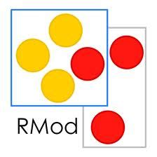
Analysing Microsoft Access Projects: Building a Model in a Partially Observable Domain
Santiago Bragagnolo, Nicolas Anquetil, Stéphane Ducasse, Seriai Abderrahmane, Mustapha Derras

Slide 2
Santiago Bragagnolo @sbragagnolo santiago.bragagnolo@berger-levrault.com
1st year PhD
Industrial Thesis
Software Migration

Slide 3
Context: Berger-Levrault
5 Centuries old company
1700 employees
5 Continents
51000 clients that reach millions of users

Slide 4
Technology evolves, information systems must evolve too: Migration Happens

Slide 5
Microsoft Access Solutions @ Berger Levrault
> 90 Solutions
900 to 2700 Forms x Solution

Slide 6
Migration Context: Objectives
Standalone to Multi-layered
Monolith to Microservice
Desktop GUI to Web GUI

Slide 7
Migration Context: Requirements
Implications
Up to date Data
Precise and Detailed Data
Memory & CPU
Selective
Interactive
Iterative

Slide 8
What does the literature propose as first step on migration?

Slide 9
Related Works
Static Analysis
AST Extracted from text files
Focus on a static structure of the software

Slide 10
Related Works
Dynamic Analysis
Runtime crawling
Behavior dynamics and real composition

Slide 11
Related Works
Hybrid Analysis
Static analysis enhanced by dynamic
Dynamic analysis enhanced by static

Slide 12
Microsoft Access: a Partially Observable Domain

Slide 13
Microsoft Access
4GL Language
Point and Click Development
Generates GUI related code
Produces Software based on intensive GUI Interaction
Uses proprietary binary format
Provides First Class Citizens
GUI: Form and Reports
Functional: Class Modules, Modules and Macros
Data: Tables and Queries

Slide 14
Microsoft Access: An Application Overview

Slide 15
Microsoft Access: GUI Exporting Limitations

Slide 16
Microsoft Access: Programmatic Exporting
SaveAsText
Saves a Microsoft Access first class citizen as a file
Non documented
Heterogeneous output
LoadFromText
Loads an object from a file
Non documented

Slide 17
How to practice a structural analysis on an application if all the data is inside the IDE?

Slide 18
Study path
RQ#1
RQ#2
Are we able to reengineer the meta-data sources into a model?
RQ#3
Can we obtain an application representation by querying the IDE runtime?
Is the obtained model suitable for migration?

Slide 19
Can we obtain an application representation by querying the IDE runtime?

Slide 20
Microsoft COM Technological Overview
Standard Binary Interface
Component Object Model

Slide 21
Microsoft Access Object Model & COM

Slide 22
Object Model Overview
Application: Represents a running Microsoft Access Application
DoCmd: Command object. Reifies the available operations
References: Collection of static dependencies
CurrentProject: Project currently opened by the running application. Contains Forms, Reports, Modules and Macros descriptions
CurrentData: Database currently opened by the running application. Contains TableDef and QueryDef
Forms Reports and Modules: Collections containing the opened Forms / Reports / Modules. Each object is bounded to the real “thing”
COM Handle
Pointer to a remote object

Slide 23
Re-Engineering Challenges
Reading a property of a COM Entity may give us an other COM Entity
A model entity type may be mapped to more than one entity type
Different model Entity types may be mapped to one COM entity type
First class citizen objects must be dynamically loaded to be analyzed

Slide 24
Are we able to reengineer the meta-data sources into a model?

Slide 25
Mixing Static and Internal MS Access information
Access IDE Internal Information
Source code
Runtime Information
Microsoft Access Analysis

Slide 26
An Architecture Implementation for an Online Model
Access IDE Internal Information
Source code
Runtime Information

Slide 27
Addressing challenges
Each model type must know which readings return COM entities. A factory is used for mapping by COM type
Only Loadable objects are mapped to more than one entity. This is managed individually
Managed At the level of LoadableObject Class
When reading properties a Factory that is used for mapping types by property value

Slide 28
Addressing Restrictions
The online nature of the implementation ensures up to date data
Our solution can access what ever information reachable by COM
Lazy load + caches

Slide 29
A Metamodel Implementation for an Online Model

Slide 30
Is the obtained model suitable for migration?

Slide 31
Is the obtained model suitable for migration? Validation Required!
What is to migrate?
To reproduce a software defined in an origin environment into an other environment

Slide 32
Is the obtained model suitable for migration? Validation Required!
What is the simplest migration?
To reproduce the same software in the same environment: To Replicate

Slide 33
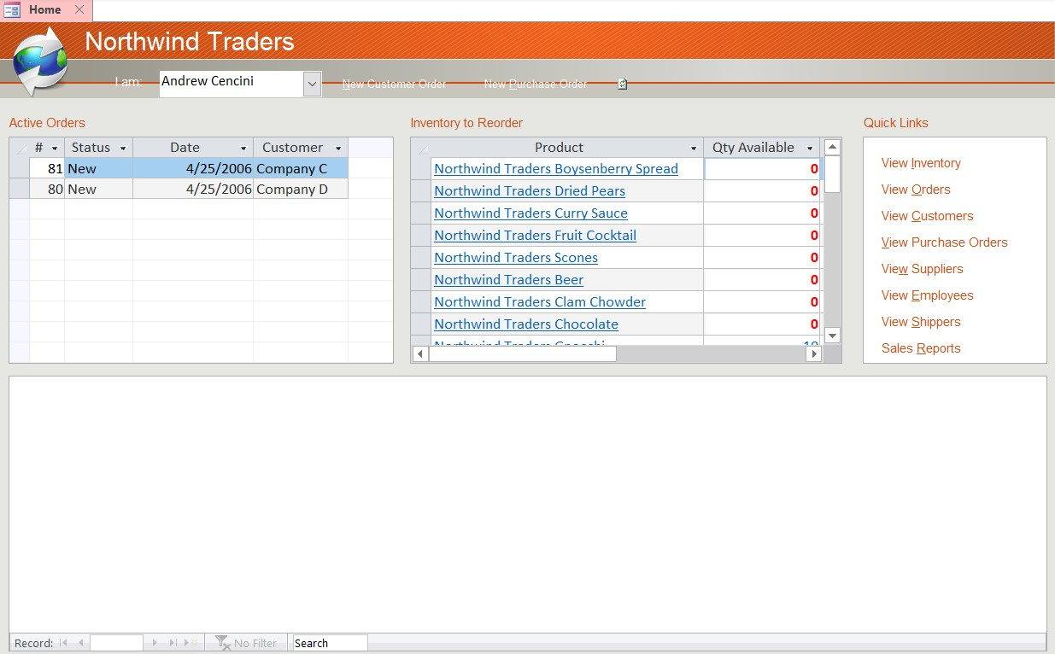
How should a replica look like?

Slide 34
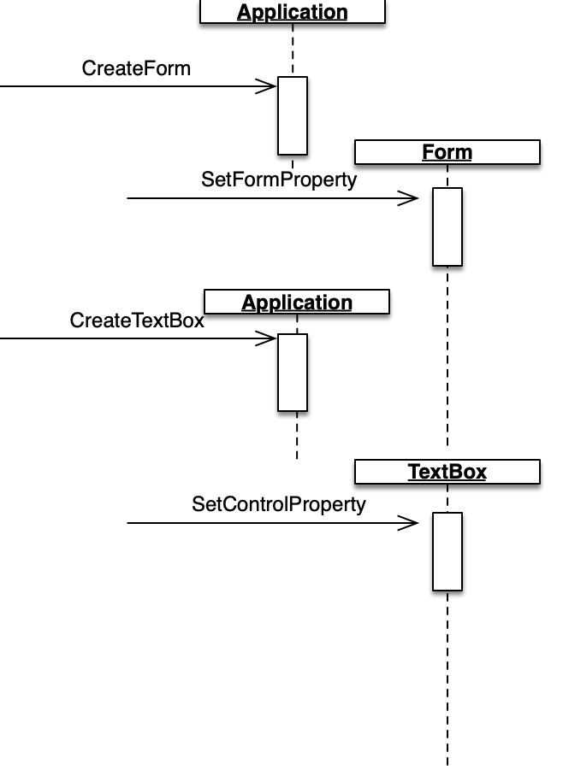
How do we replicate a project?
Access allows programmatic creation
Projects
First Class Citizen
Controls / Columns
Properties

Slide 35
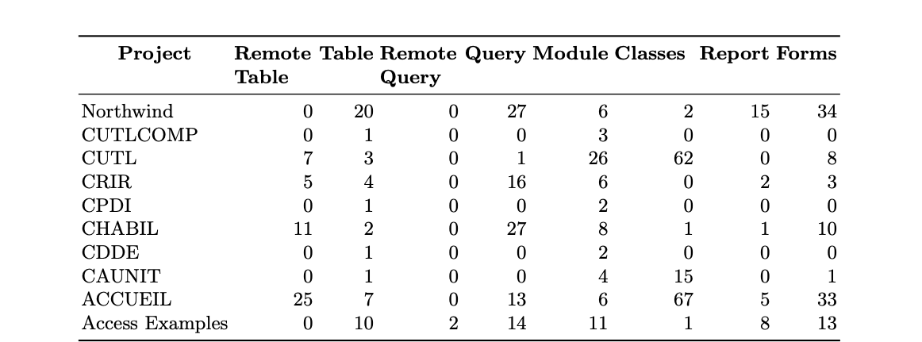
General demographics

Slide 36
Results Overview

Slide 37
Validation Methodology

Slide 38
Completeness and Failures Overview

Slide 39
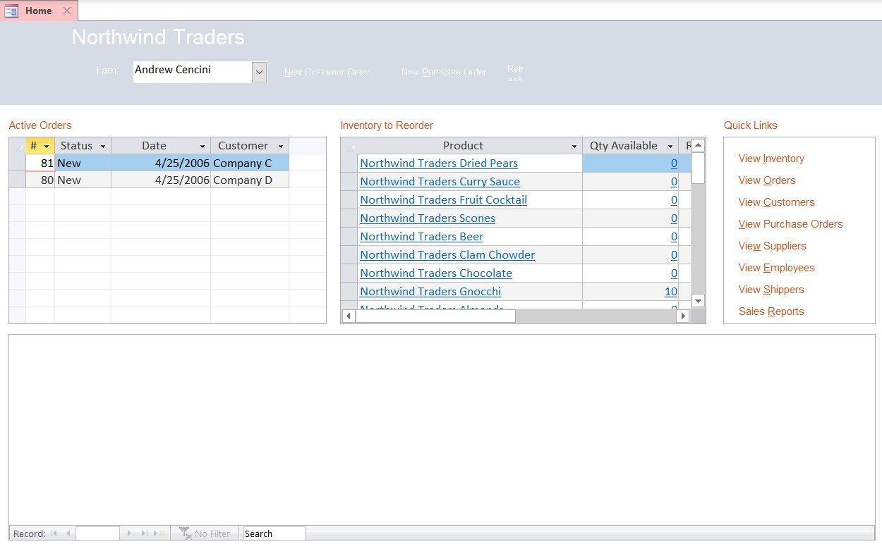
Human Insight & Opinion

Slide 40
Threats to Validity
Multiple Version
Different versions between origin and destination may suppose a problem
Empirical Study
10 Projects
623 Components
Many kinds of projects may not be represented
Undocumented Features Used
Approach based on SaveAsText

Slide 41
Discussion
Source version control-based solution
Undocumented features
Context and performance
Selectiveness
What our validation does not validates
Text representation is incomplete

Slide 42
Contributions
4 Challenges – 3 Real industry requirements
1 Implementation
1 Validation approach
1 Novel approach on modeling
Do you have some Microsoft Access or Visual Basic 6 Based Migration?
Let’s work together! ☺
S. Bragagnolo @sbragagnolo santiago.bragagnolo@berger-levrault.com
santiago.bragagnolo@inria.fr

Slide 43
Contributions
4 Challenges – 3 Real industry requirements
1 Implementation
1 Validation approach
1 Novel approach on modeling
Do you have some Microsoft Access or Visual Basic 6 Based Migration?
Let’s work together! ☺
S. Bragagnolo @sbragagnolo santiago.bragagnolo@berger-levrault.com
santiago.bragagnolo@inria.fr

Slide 44
Results: Forms

Slide 45
Results: Reports

Slide 46
Results: Tables

Slide 47
Results: Queries

Slide 48
Weighting Errors

Slide 49
Weighting Differences

